Slide 1
BMS 524 - “Introduction to Confocal Microscopy and Image Analysis”
The Principles of Microscopy: II
Department of Basic Medical Sciences,
School of Veterinary Medicine
Weldon School of Biomedical Engineering
Purdue University
J. Paul Robinson, Ph.D.
SVM Professor of Cytomics & Professor of Biomedical Engineering
Director, Purdue University Cytometry Laboratories, Purdue University
These slides are intended for use in a lecture series. Copies of the slides are distributed and students encouraged to take their notes on these graphics. All material copyright J. Paul Robinson unless otherwise stated. No reproduction of this material is permitted without the written permission of J. Paul Robinson. Except that our materials may be used in not-for-profit educational institutions with appropriate acknowledgement. It is illegal to post these lectures on Course Hero or any other site.
This PowerPoint lecture is available at http://tinyurl.com/2dr5p
Note: AUDIO is available
In this lecture by clicking
On the speaker icon on
each slide
This lecture was last updated in January, 2021
Find other PUCL Educational Materials at http://www.cyto.purdue.edu/class

Slide 2
Introduction to Lecture 2
Principles of Microscopy II
Magnification
Nature of Light
Basic Microscopes -Optical Designs
Numerical Aperture
Refractive Index

Slide 3
Learning Objectives – Lecture 2
Understand the different type of microscopes and what their different applications are
Learn the basics of the most important things that define restrictions on optical detection systems
The electromagnetic spectrum and its relevance to optical microscopy

Slide 4
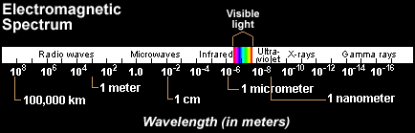
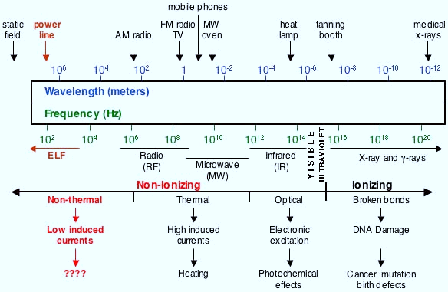
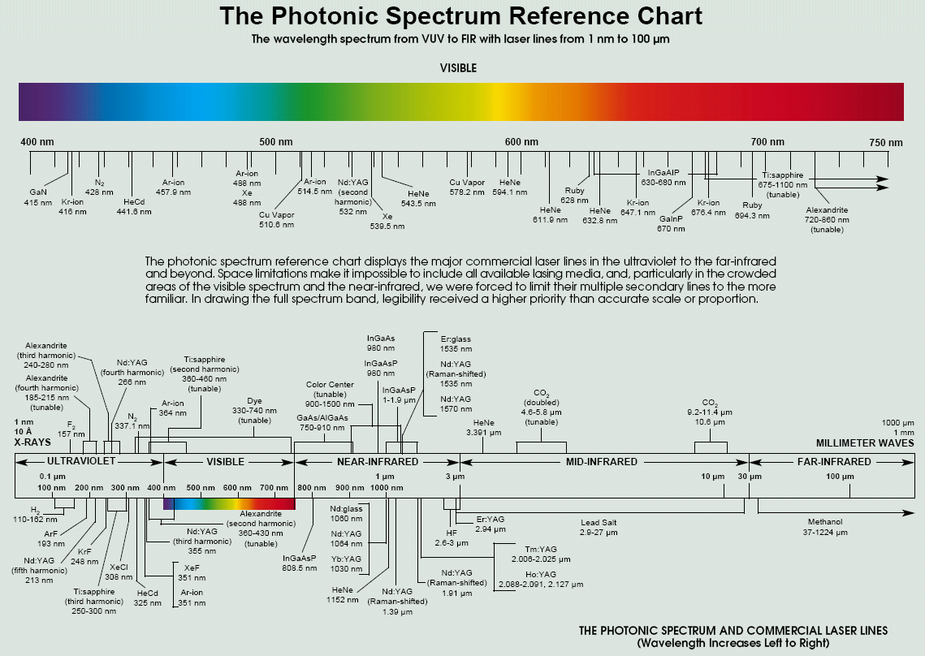
The Light Spectrum
The Electromagnetic Spectrum.
  The “Optical” spectrum regime covers the range of wavelengths from 10⁻³ m
  (far-infrared) to 10⁻⁸ m
  (ultra-violet).
Image Source:
http://www.cwa-union.org/issues/osh/articles/microwave-radio-frequency-radiation.html
Image Source: http://www.imt.liu.se/edu/courses/TBMT36/artiklar/intro/6.Spectrum.pdf

Slide 5
Some Definitions
Absorption
  When light passes through an object the intensity is reduced depending upon the color absorbed. Thus the selective absorption of white light produces colored light.
Refraction
  Direction change of a ray of light passing from one transparent medium to another with different optical density. A ray from less to more dense medium is bent perpendicular to the surface, with greater deviation for shorter wavelengths
Diffraction
  Light rays bend around edges - new wavefronts are generated at sharp edges - the smaller the aperture the lower the definition
Dispersion
  Separation of light into its constituent wavelengths when entering a transparent medium - the change of refractive index with wavelength, such as the spectrum produced by a prism or a rainbow

Slide 6
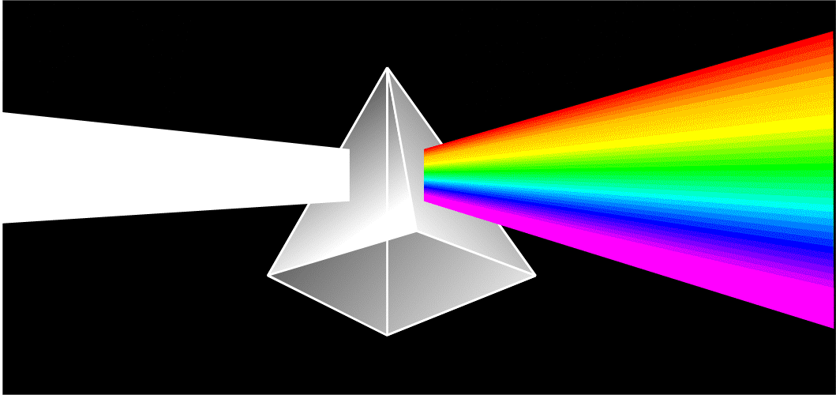
Refraction & Dispersion
Short wavelengths are “bent” more than long wavelengths
dispersion
Light is “bent” and the resultant colors separate (dispersion).
Red is least refracted, violet most refracted.

Slide 7
Refraction
He sees the fish here….
.
But it is really here!!

Slide 8
Control
Absorption
B & G absorbed
No blue/green light
red filter

Slide 9
Light absorption
NOTE: Microsoft powerpoint changes colors according to whatever style you have loaded, so be aware of this “feature” when looking at colors on slides!!
white light
blue light
red light
green light
R & G absorbed
B & G absorbed
B & R absorbed

Slide 10
Absorption Chart
Color in white light
Color of light absorbed
red
blue
green
blue
red
green
green
red
blue
yellow
blue
magenta
green
cyan
red
black
red
green
blue
gray
pink
green
blue
NOTE: Microsoft powerpoint changes colors according to whatever style you have loaded, so be aware of this “feature” when looking at colors on slides!!

Slide 11
The light spectrum
Wavelength ---- Frequency
Blue light
488 nm
short wavelength
high frequency
high energy (2 times the red)
Photon as a wave packet of energy
Red light
650 nm
long wavelength
low frequency
low energy

Slide 12
Magnification
An object can be focussed generally no closer than 250 mm from the eye (depending upon how old you are!)
This is considered to be the normal viewing distance for 1x magnification
Young people may be able to focus as close as 125 mm so they can magnify as much as 2x because the image covers a larger part of the retina - that is it is “magnified” at the place where the image is formed

Slide 13
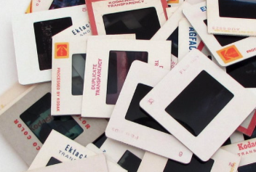

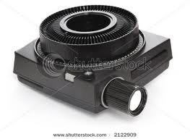
Magnification
There used to be things called “Slide Projectors”!!!
Look it up on Google!!!
1000mm
35 mm slide
24x35 mm
1000 mm
M =
= 28
p
35 mm
        The projected image is 28 times larger than we would see it at 250 mm from our eyes.
If we used a 10x magnifier we would have a magnification of 280x, but we would reduce the field of view by a factor of 10x.

Slide 14
Some Principles of Magnification
Rule of thumb is is not to exceed 1,000 times the NA of the objective
Modern microscopes magnify both in the objective and the ocular and thus are called “compound microscopes” - Simple microscopes have only a single lens

Slide 15
Basic Microscopy
Bright field illumination does not reveal differences in brightness between structural details - i.e. no contrast
Structural details emerge via phase differences and by staining of components
The edge effects (diffraction, refraction, reflection) produce contrast and detail

Slide 16
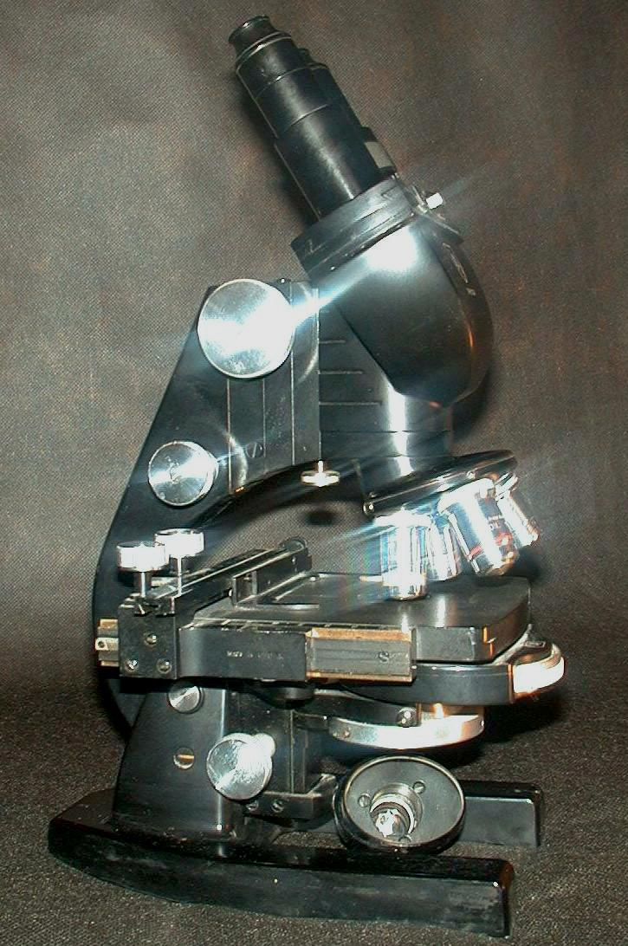
Microscope Basics
Originally conformed to the German DIN standard
  Deutsche Industrie Norm, or DIN standard configuration
Standard required the following
  real image formed at a tube length of 160mm
  the parfocal distance set to 45 mm
  object to image distance set to 195 mm
Currently we use the ISO standards
And of course most microscopes are now infinity not 160mm
DIN standard eyepieces have an international standard 23mm diameter
Some objectives have a color ring to help identify the magnification: black (1x), brown (2x), red (4x), yellow (10x), green (20x), turquoise (25x), light blue (40x), dark blue (60x), white (100x).
Object to
Image
Distance
Mechanical
= 195 mm
tube length
= 160 mm
Focal length
of objective
= 45 mm
© J.Paul Robinson

Slide 17
The Conventional Microscope
Mechanical
tube length
= 160 mm
Object to
Image
Distance
= 195 mm
Focal length
of objective
= 45 mm
Modified from “Pawley “Handbook of Confocal Microscopy”, Plenum Press

Slide 18
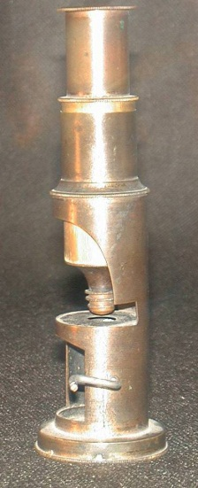
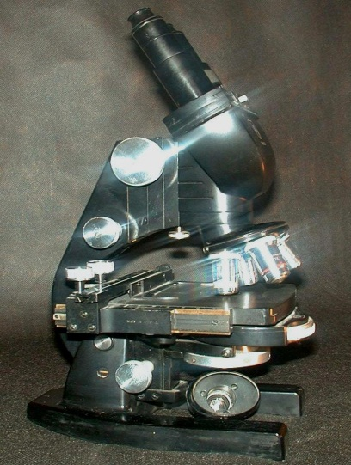
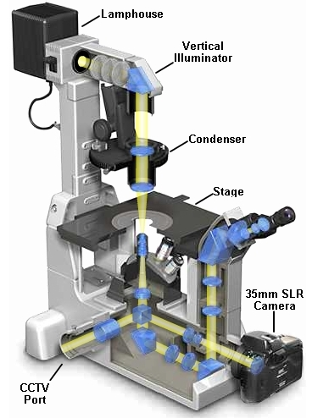
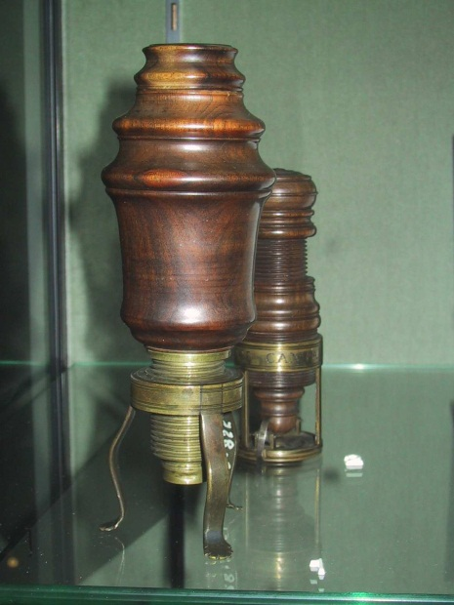
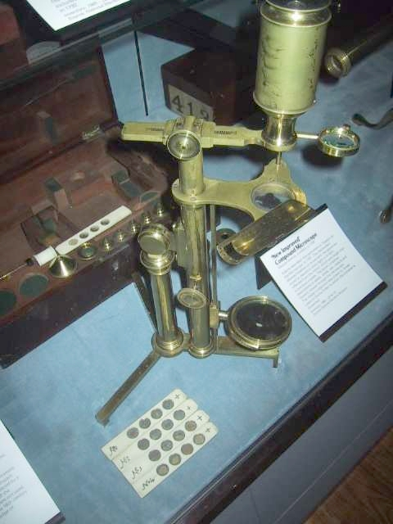
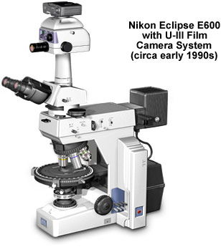
Microscopes - then to now
© J.Paul Robinson
Photos: © J. Paul Robinson
Images from Nikon
promotional materials
© J.Paul Robinson

Slide 19
Upright Scope
Epi-
illumination
Source
Image from Nikon
promotional materials
Brightfield
Source

Slide 20
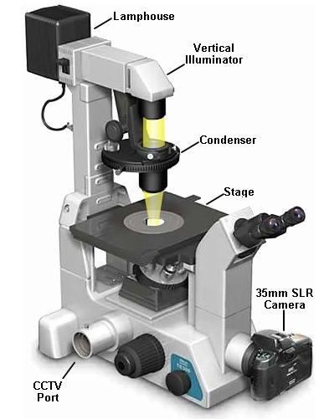

Inverted Microscope
Brightfield
Source
Image from Nikon
promotional materials
Epi-
illumination
Source

Slide 21
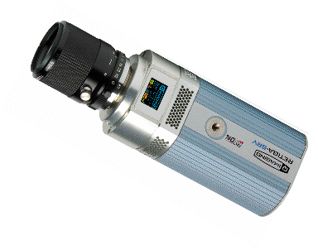
Typical Inverted Microscope
Image from Nikon
promotional materials
These days we use modern
Digital cameras not 35 mm !!

Slide 22
Conventional Finite Optics with Telan system
Modified from “Pawley “Handbook of Confocal Microscopy”, Plenum Press
Ocular
Intermediate Image
195 mm
160 mm
Telan Optics
Other optics
Objective
45 mm
Sample being imaged

Slide 23
Infinity Optics
Ocular
Primary Image Plane
The main advantage of infinity corrected lens systems is the relative insensitivity to additional optics within the tube length. Secondly one can focus by moving the objective and not the specimen (stage)
Tube Lens
Infinite
Image
Distance
Other optics
Other optics
Objective
Modified from “Pawley “Handbook of Confocal Microscopy”, Plenum Press
Sample being imaged

Slide 24
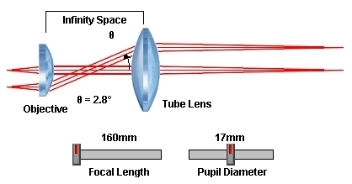
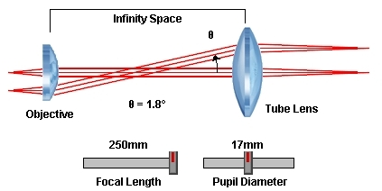
Images reproduced from:
http://micro.magnet.fsu.edu/

Slide 25
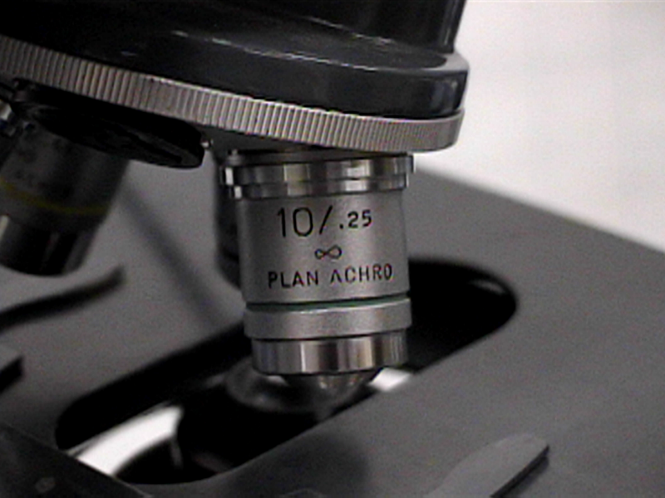
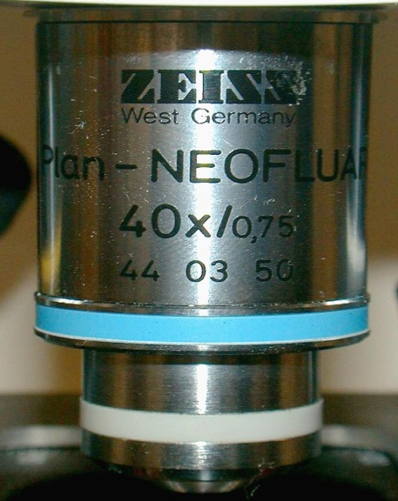
Objectives
∝ - Infinity
corrected
PLAN-APO-40X 1.30 N.A. 160/0.22
Flat field Apochromat Magnification Numerical Tube Coverglass
Factor
Aperture Length Thickness

Slide 26
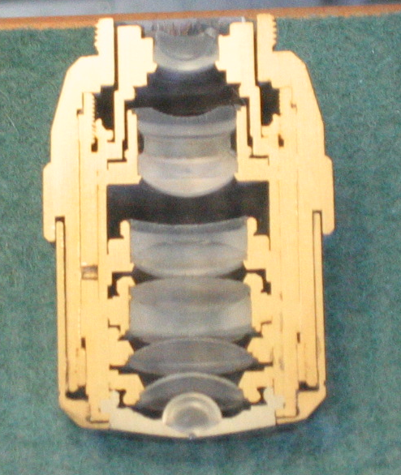
“Half” of a Zeiss Microscope objective
Photo taken by the author in Zeiss Museum, Jena

Slide 27
Objectives
Limit for smallest resolvable distance d between 2 points is (Rayleigh criterion):
d =
1.22λ
2 ΝΑ
This defines a “resel” or “resolution element”
Thus, high NUMERICAL APERTURE is critical for high magnification
In a medium of refractive index n the wavelength gets shorter: λ = λ/n

Slide 28
Numerical Aperture
Resolving power is directly related to numerical aperture.
The higher the NA the greater the resolution
Resolving power:
  The ability of an objective to resolve two distinct lines very close together
  NA = n sin μ
  (n=the lowest refractive index between the object and first objective element) (hopefully 1)
  μ is 1/2 the angular aperture of the objective

Slide 29
μ
Light cone
NA=n(sin μ)
(n=refractive index)

Slide 30
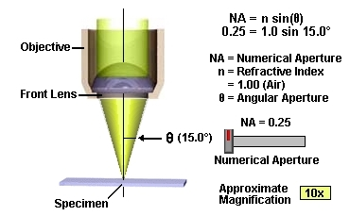
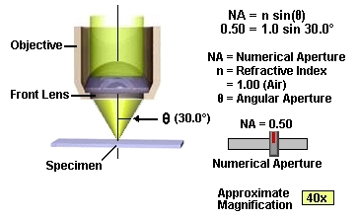
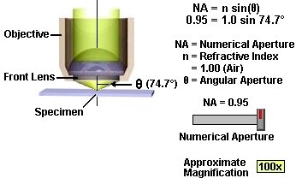
Numerical Aperture
The wider the angle the lens is capable of receiving light at, the greater its resolving power
The higher the NA, the shorter the working distance
Images reproduced from:
http://micro.magnet.fsu.edu/
Please go to this site and do the tutorials

Slide 31
Numerical Aperture
For a narrow light beam (i.e. closed illumination aperture diaphragm) the finest resolution is (at the brightest point of the visible spectrum i.e. 530 nm)…(closed condenser).
λ
.00053
=
= 0.53 μm
1.00
NA
With a cone of light filling the entire aperture the theoretical resolution is…(fully open condenser)..
λ
.00053
=
= 0.265 μm
2 x NA
2 x 1.00

Slide 32
Raleigh Criterion
Rayleigh criterion is the generally accepted criterion for the minimum resolvable detail - the imaging process is said to be diffraction-limited when the first diffraction minimum of the image of one source point coincides with the maximum of another.
http://hyperphysics.phy-astr.gsu.edu/hbase/phyopt/Raylei.html
λ
where θ is the angular resolution (radians), λ is the wavelength of light, and D is the diameter of the lens' aperture.
θ
= 1.220
___
D
The factor 1.220 is derived from a calculation of the position of the first dark circular ring surrounding the central Airy disc of the diffraction pattern. This number is more precisely 1.21966989... (OEIS: A245461), the first zero of the order-one Bessel function.
By Spencer Bliven - Own work, Public Domain, https://commons.wikimedia.org/w/index.php?curid=31456019
https://en.wikipedia.org/wiki/Angular_resolution

Slide 33
Object Resolution
Example:
40 x 1.3 N.A. objective at 530 nm light
λ
.00053
=
= 0.20 μm
2 x NA
2 x 1.3
40 x 0.65 N.A. objective at 530 nm light
λ
.00053
=
= 0.405 μm
2 x NA
2 x .65
R=λ/(2NA) 1
R=0.61 λ/NA 2
R=1.22 λ/(NA(obj) + NA(cond)) 3

Slide 34
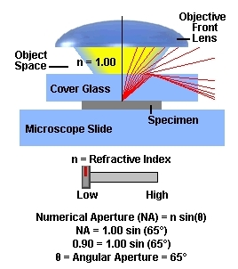
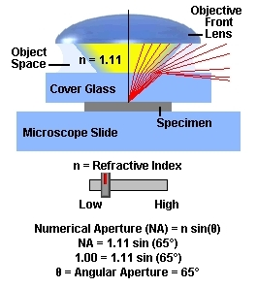
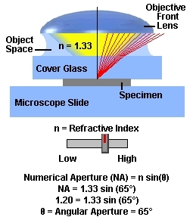
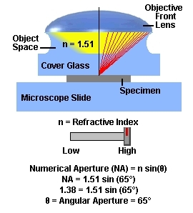
Images reproduced from:
http://micro.magnet.fsu.edu/
Please go to this site and do the tutorials

Slide 35
Microscope Objectives
Cover slips are not all equal!!!
Standard Coverglass Thickness
#00 = 0.060 - 0.08
#0 = 0.080 - 0.120
#1 = 0.130 - 0.170
#1.5 = 0.160 - 0.190
#2 = 0.170 - 0.250
#3 = 0.280 - 0.320
#4 = 0.380 - 0.420
#5 = 0.500 - 0.60 mm
Microscope
Objective
60x 1.4 NA
PlanApo
Oil
Stage
Coverslip
Specimen

Slide 36
Refractive Index
n = 1.52
Objective
n = 1.5
n = 1.52
Oil
Air
n = 1.0
n=1.52
Coverslip
n = 1.52
n=1.52
Specimen
Water
n=1.33
Matched RI
Mis-Matched RI

Slide 37
Summary Lecture 2
Simple versus compound microscopes
Achromatic aberration
Spherical aberration
Refraction, absorption, dispersion, diffraction
Magnification
Upright and inverted microscopes
Optical Designs - 160 mm and infinity optics
Microscope Objectives
Refractive Index

