Slide 1




Spectral Flow Cytometry
J. Paul Robinson
The SVM Professor of Cytomics
Professor of Biomedical Engineering
Director, Purdue University Cytometry Laboratories
BMS 631 Class Notes
@Cytometryman
Home of the Purdue Cytometry Mail-list est 1989
cytometry@lists.purdue.edu

Slide 2
Purdue University Cytometry Laboratories Acknowledgements
Some slides from Prof Silas Leavesley,
Dept. of Chemical Engineering, University of South Alabama
Contributors
  Staff Engineer: Valery Patsekin
Faculty: Bartek Rajwa, Euiwon Bae, J. Paul Robinson
Data and collaborations with: Gary Nolan Lab (Stanford), David Hedley (Toronto), Bernd Bodenmiller (Zurich), Paul Wallace (Buffalo), Jonathon Irish Lab (Vanderbilt)
Staff
  Kathy Ragheb (flow)
  Anisa Dunham (assay dev)
  Doris Kemler (Bioassays)
Funding:
NIH, NSF, USDA, Purdue University
Corporate: Beckman-Coulter, Point-Source, Parker-Hannifin, Polysciences, Bangs labs, Roche, MediaCybernetics, Q-Imaging, Kodak Medical Systems, Crystalplex, Becton-Dickinson , Icyt,
eBioscience, ITG Indiana, Roche, Edmund Optic, Perkin Elmer, Digilab Inc., Spherotech, Inc., IntelliCyt, Inc, ThermoFisher
Research reported in this presentation was supported by the National Institute of General Medical Sciences & the National Cancer Institute of the National Institutes of Health under Award Numbers 1R56AI089511-01, R21RR033593-01 & 1R33CA140084 and U.S. Department of Agriculture, project 1935-42000-072-02G, Center for Food Safety Engineering at Purdue University. . The content is solely the responsibility of the authors and does not necessarily represent the official views of the National Institutes of Health.

Slide 3
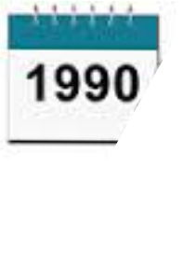
1t’s 1990
You too can do 3 colors
  …..it’s pretty hard, but the best labs are doing it!
Software – Oh, you don’t want to use the software on your flow cytometer for analysis?
Disc drive capacity – Noone could possibly need more than 80 megs….
New Sorters – at least 10,000 cells per second – you will never need to go faster
New Computers – the IBM PC introduced to run a sorter

Slide 4
There really was a time when a 3 color assay was a key publication
Steinkamp, J. A., Stewart, C. C., Crissman, H. A.; Three-color fluorescence measurements on single cells excited at three laser wavelengths, CYTOMETRY, 2, 226-231, 1982
Lanier, L. L., Loken, M. R.; Human lymphocyte subpopulations identified by using three-color immunofluorescence and flow cytometry analysis: correlation of Leu-2, Leu-3, Leu-7, Leu-8, and Leu-11 cell surface antigen expression, J. Immunol, 132: 151-156, 1984
Lansdorp, P. M., Smith, C., Safford, M., Terstappen, L. W. M. M., Thomas, T. E.; Single laser three color immunofluorescence staining procedures based on energy transfer between phycoerythrin and cyanine 5; Cytometry, 12:723-730, 1991
Robinson, J. P., Maguire, D. J., Kelley, S., Ragheb, K., King, G. B.; Statistical determination of minimum cell numbers for 2 and 3 color immunophenotyping, Cytometry Supl 6: 75, 1993

Slide 5
So spectral technology allows you to measure virtually any color without changing any filters
Spectral
Cytometry
◉

Slide 6
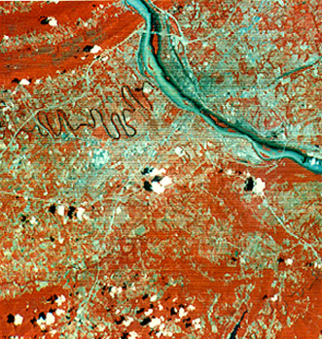
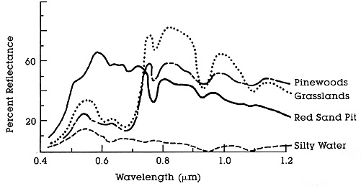
Spectral Imaging from the 1960’s
Spectral = multiple bands
Hyperspectral ≥ 20 bands
Used by NASA in the LandSAT program.
Many applications in biology and medicine.
Key Wavelengths
http://rst.gsfc.nasa.gov/Intro/Part2_6.html
http://rst.gsfc.nasa.gov/Intro/Part2_5.html
Notes:
Multispectral imaging is a process in which a series of monochrome images are taken at multiple wavelengths.
Multispectral imaging was pioneered by engineers such as David Landgrebe, at Purdue, as part of the LandSat project.
Although originally developed for use in the space program, it has many applications in biology and medicine.
This is because multispectral imaging can detect wavelength-dependent reflection or emission with a much higher spectral resolution than the human eye or RGB color imaging.
Here is an example of multispectral images taken by NASA. The image at left is a false color image of red and IR wavelengths. The coloring enhances the contrast between vegetation and buildings.
At right are sample spectra from a multispectral image set. Clearly, certain wavelengths are better for differentiating vegetation than others.
3-color RGB imaging often groups these wavelengths into the same color channel, resulting in a loss of data and an illusion of colors that may not be present in the original sample.

Slide 7
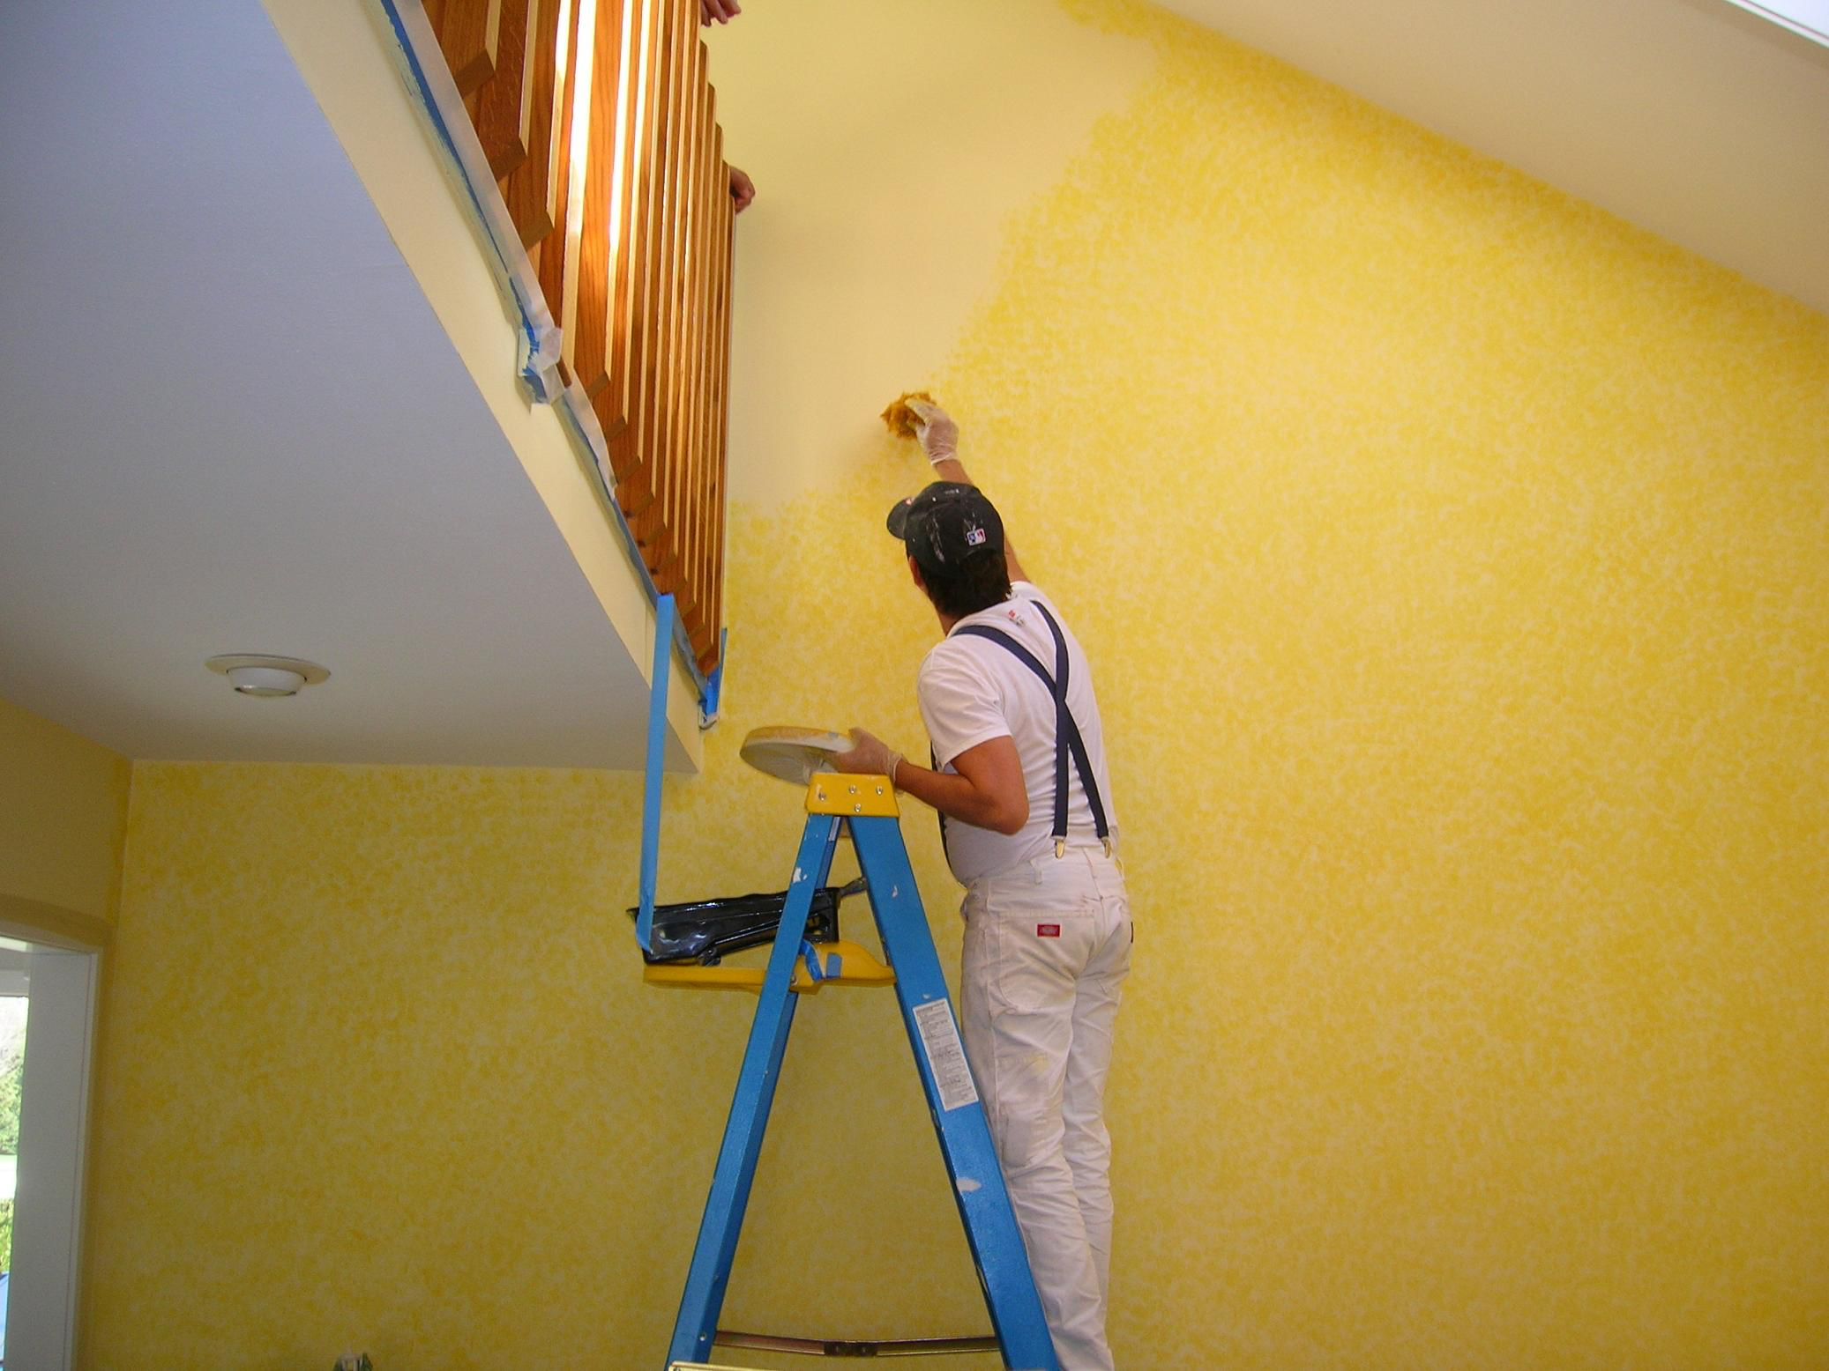
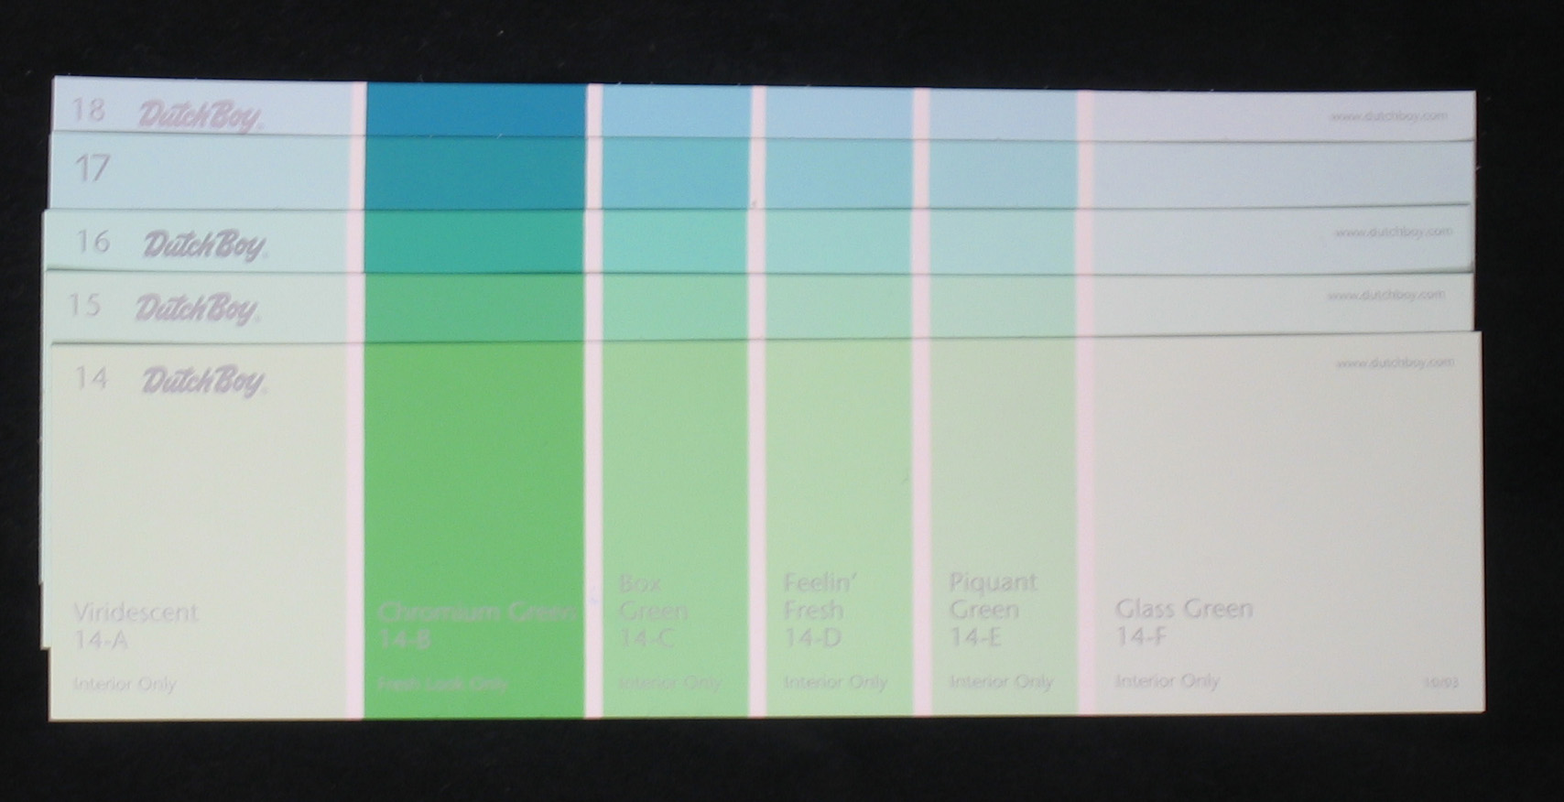
Reflection Example
Dutch Boy paint cards
Colors difficult to distinguish by visual inspection

Slide 8
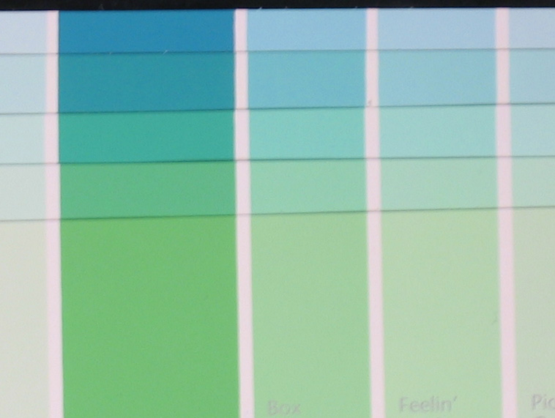
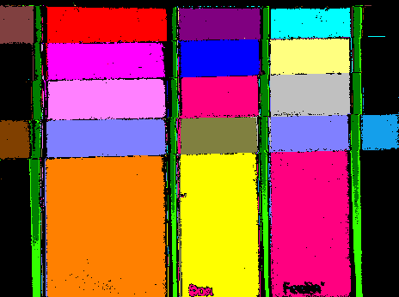
Reflection Example – Clustering
Distinctly separable spectra?
YES!

Slide 9
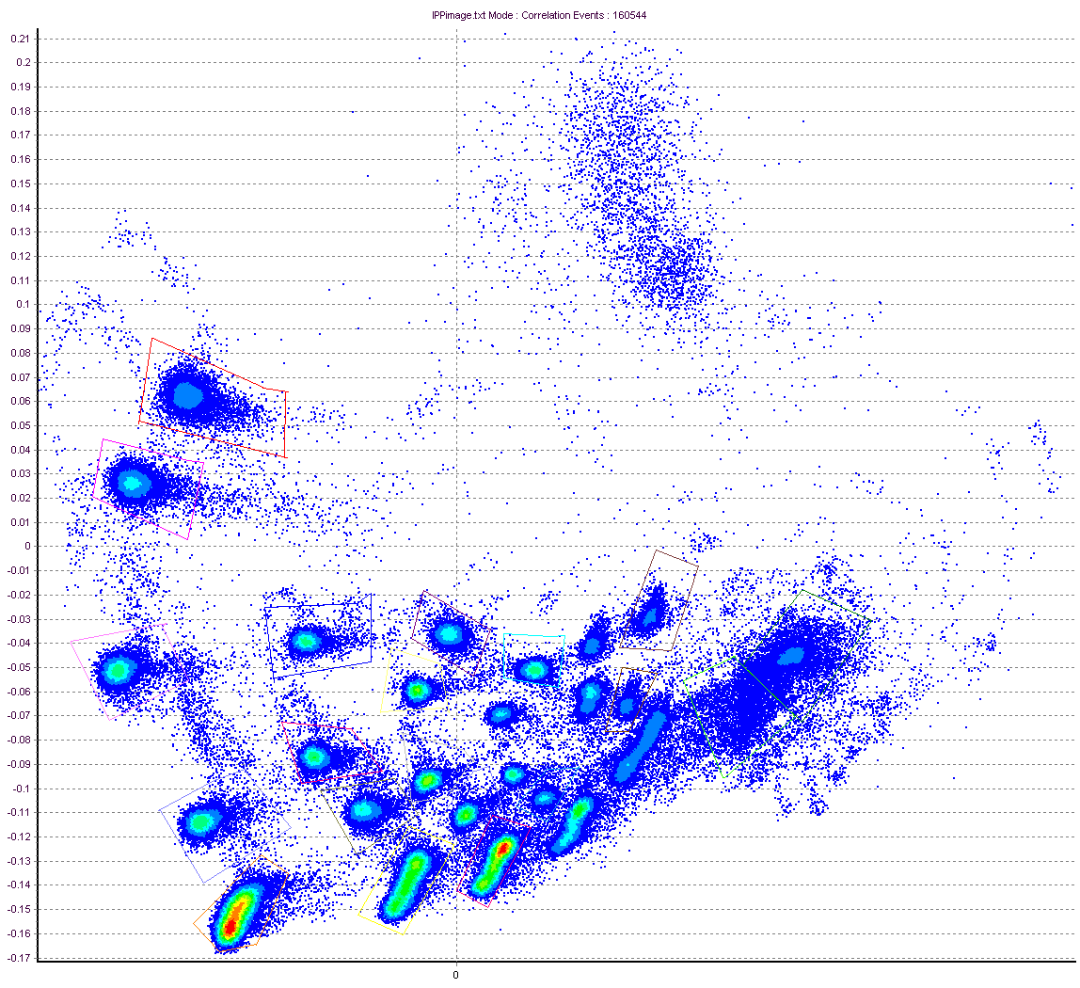
Reflection Example – Clustering
PCA Density Plot From Cytospec Software (Purdue)
Cytospec Software free download
http://www.cyto.purdue.edu/Purdue_software

Slide 10
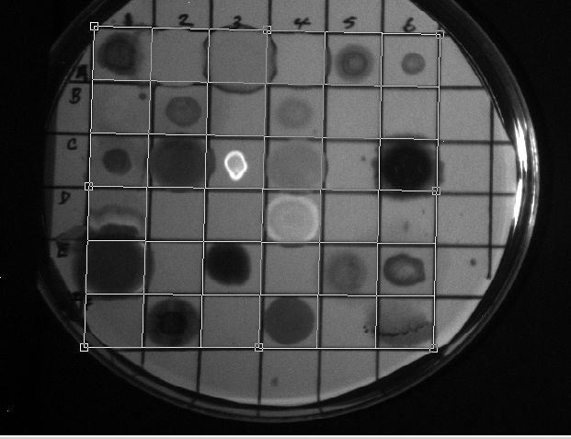
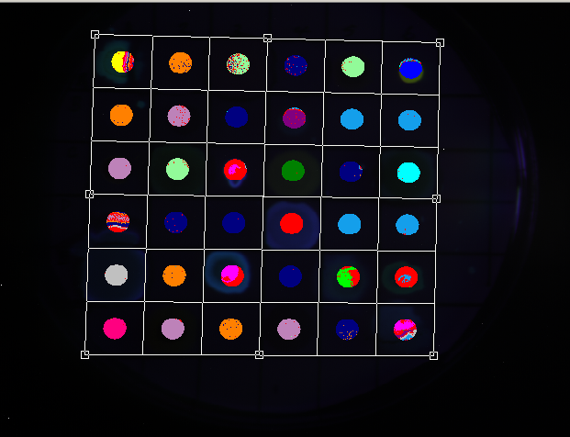
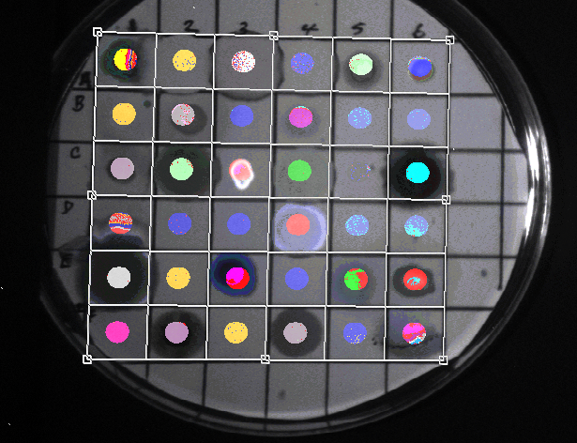
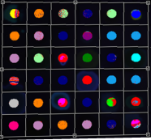
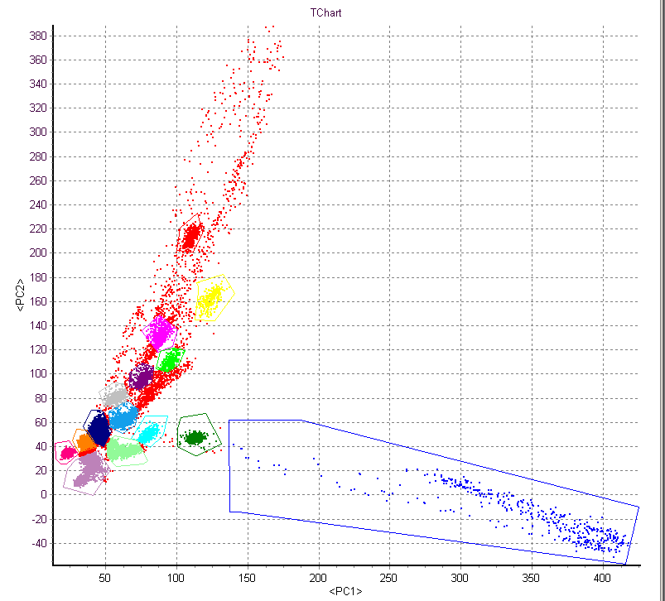
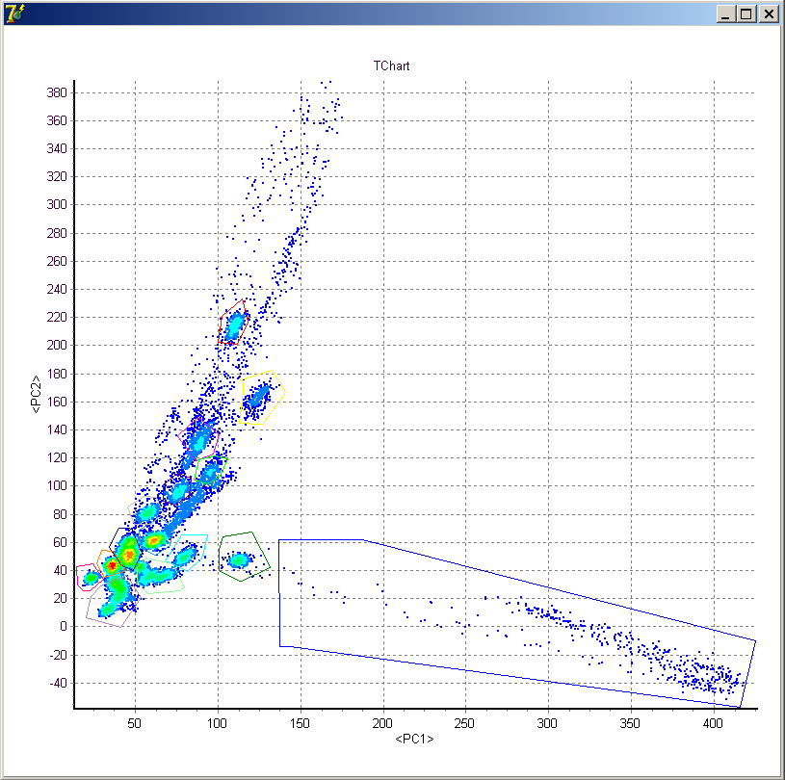
Fluorescence Example
Excitation = 488 nm
Emission = 510-750 nm
Δλ ≈ 4 nm
+
=
Reflected Image
Gated Analysis
Spatial + Chemical Information
Density plot
Nile Red
PCA
Nile Red
Post-acquisition analysis performed by Valery Patsekin, PUCL

Slide 11
Spectral Image Processing
Clustering
  Little or no a priori information
  Examples: Isodata, statistical (PCA), …
Classification
  Usually requires a training set
  Examples: Spectral angle mapper, maximum likelihood, minimum Euclidean distance, …
Unmixing
  Sub-pixel method
  Examples: Linear unmixing is the most common

Slide 12
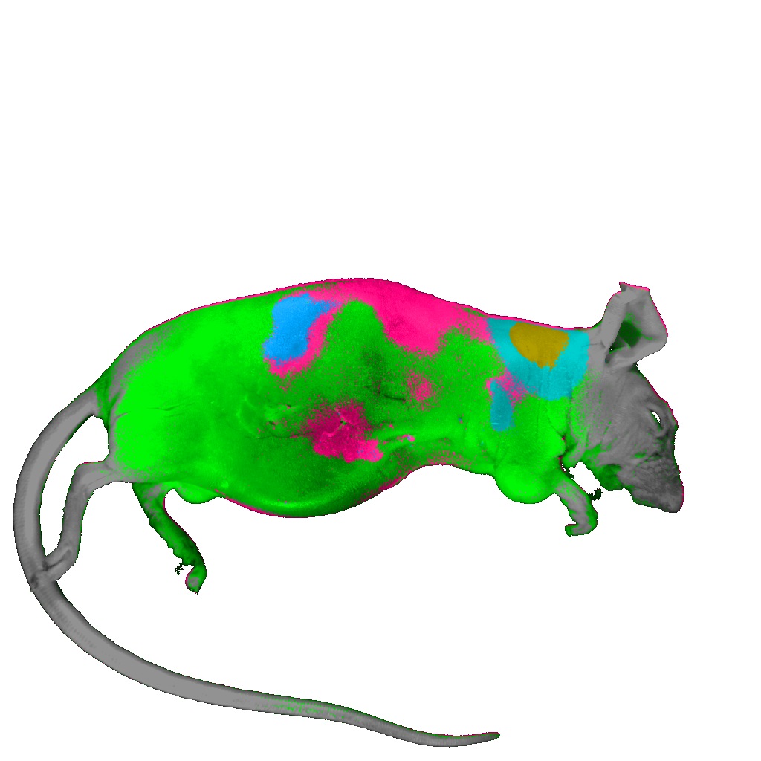
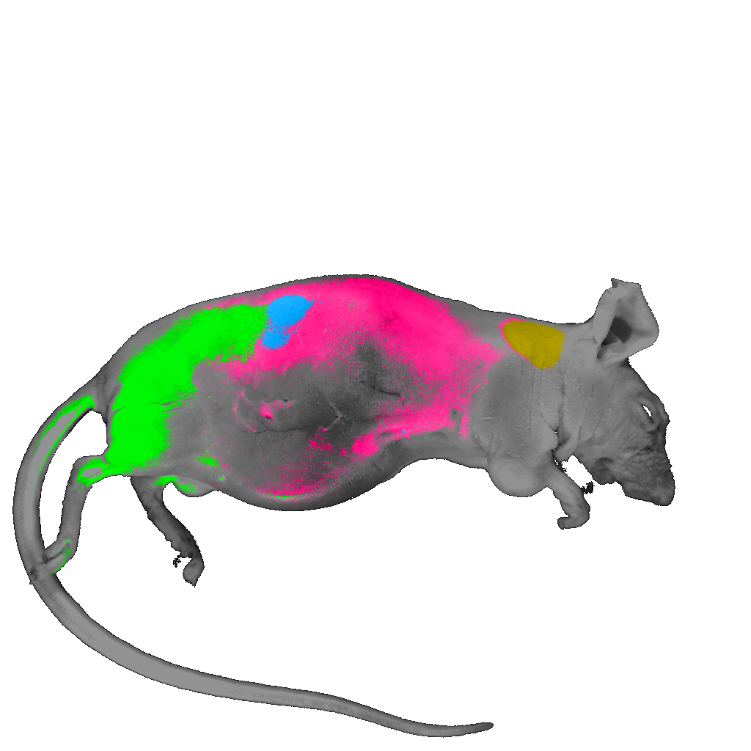
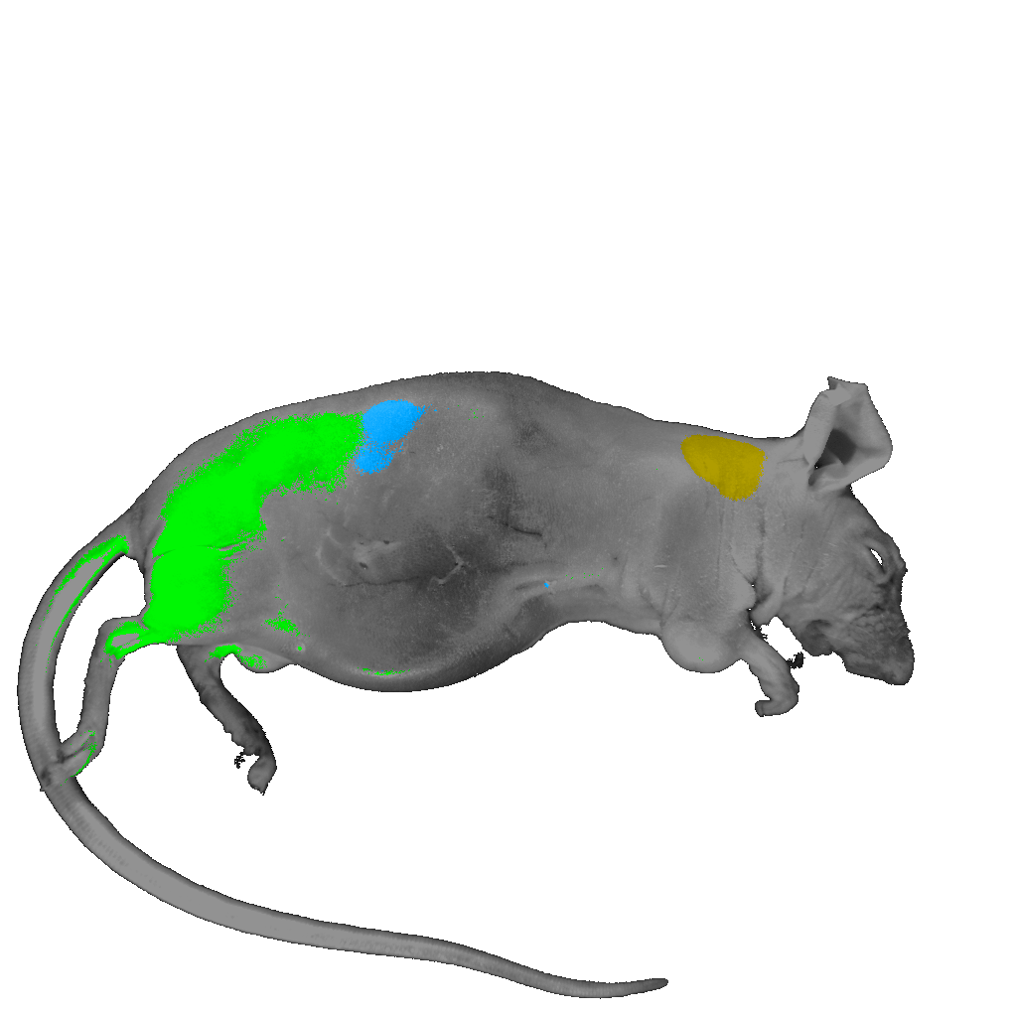
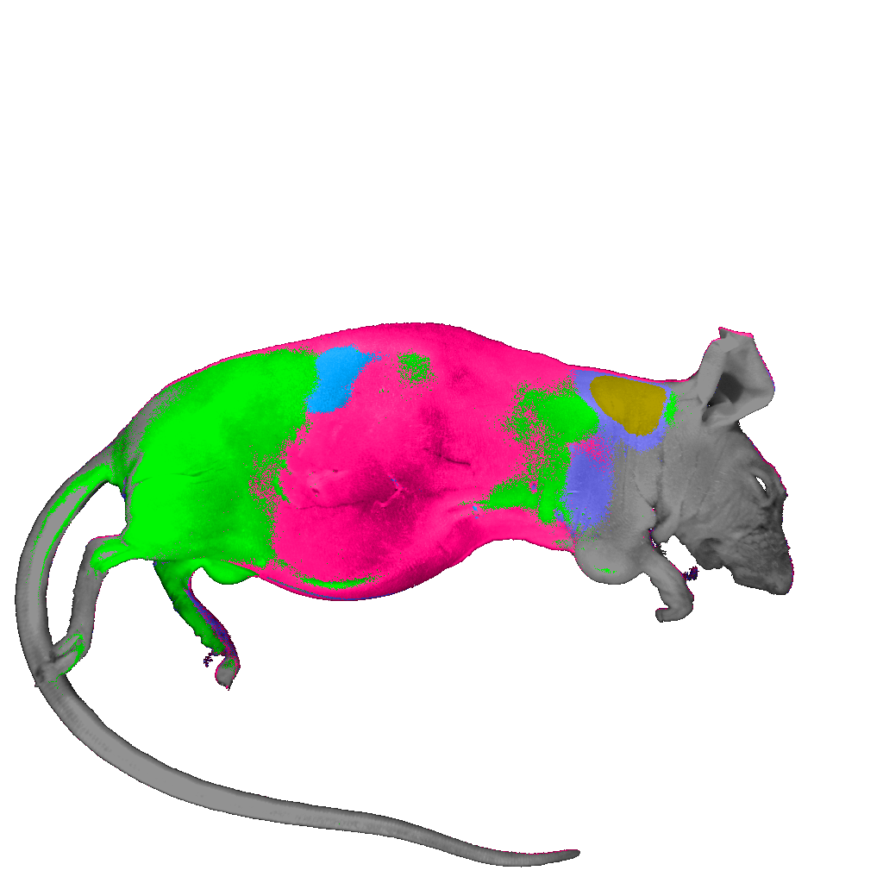
Clustering Algorithms
Spectral Angle Mapper
Maximum Likelihood
ECHO (2x2): Spectral-Spatial
Fisher Linear Likelihood

Slide 13
Spectral Imaging Advantages & Disadvantages
Advantages
  Spectral discrimination
  Autofluorescence removal
  Quantitation
  Can use many (any) fluorochromes
  Can use very similar dyes (ie same color!!)
Disadvantages
  System has to be specifically designed for spectral
  Narrow bands → Poor S/N (per band)
  Wavelength dependence of system must be considered:
    Optical components
    Noise
    Sample
    Speed??
    Issues with multiple lasers
    Unknown if very low expressing epitopes will work well

Slide 14
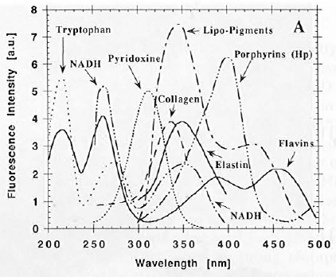
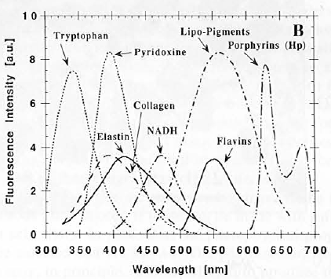
Spectral Imaging in Biology
Endogenous molecules have unique fluorescence spectra
  Complicates studies with fluorescence labels
  Could be a source of untapped cellular information
Absorption
Emission
Wagnières,Star, Wilson, “In vivo fluorescence spectroscopy and imaging for oncological applications” Photochem. and Photobio., 68(5), 603-632, 1998.
Notes:
It is useful to begin within the context of the biomolecules that attenuate photonic flux.
Many biomolecules are endogenous fluorophores with unique absorption and fluorescence emission spectra.
The combination of these individual spectra yield the spectrum seen by the imaging detector.
If the individual spectra contributing to this overall spectrum are known, it is possible to calculate the relative contribution of each of these individual spectra (given that an adequate number of wavelengths are sampled).
The relative contribution of these individual spectrum may correlate to the biomolecule concentration.
Thus, multispectral imaging suggests the possibility of mapping relative endogenous fluorophore concentration in a tissue sample.
Furthermore, occurrence of some biomolecules can be correlated to cellular events.
Here you see plots of the absorption and emission spectra for some relevant biomolecules.

Slide 15
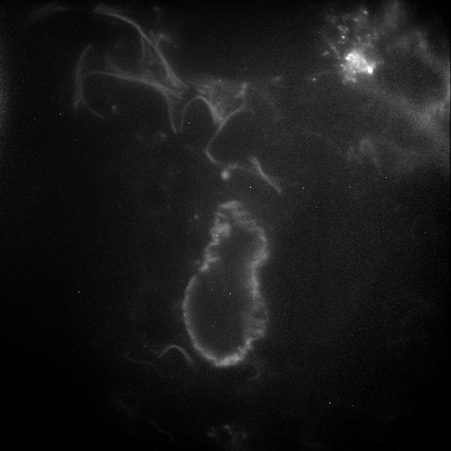
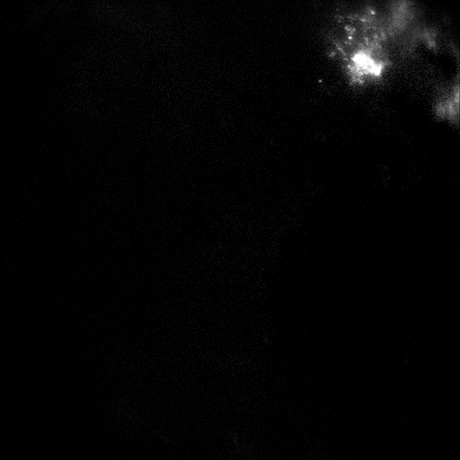
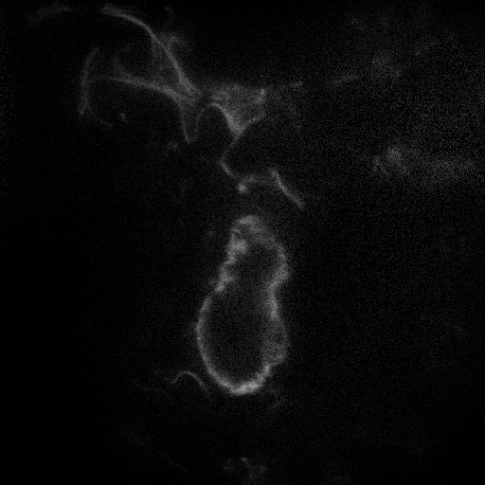
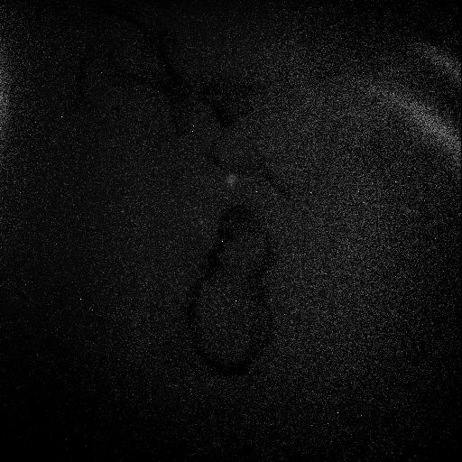
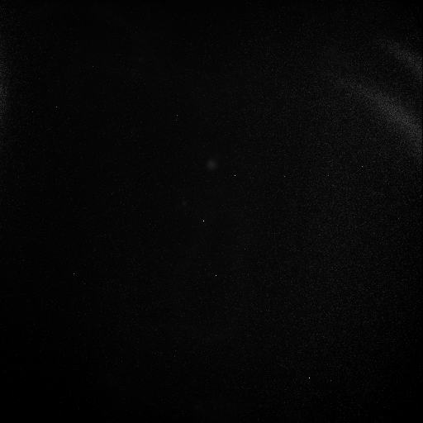
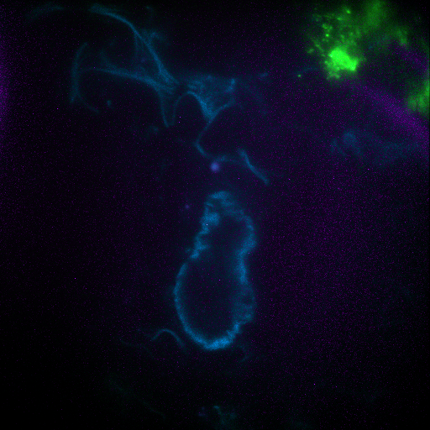
Separating GFP from Lung Autofluorescence
Raw Image
Unmixed Image
GFP
Autofluorescence
Background
RMS Error
Slide from Silas Leavesley

Slide 16

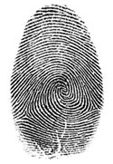

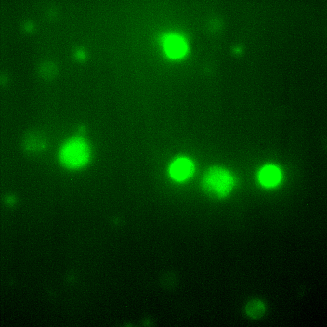
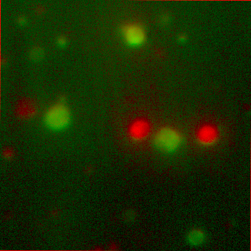
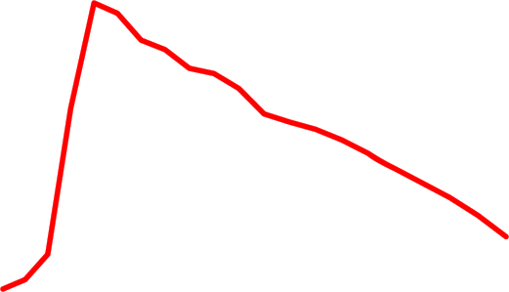


Spectral “unmixing”
Cell
Fingerprint
Before
After
Green
Dye 1: bis-(1,3-dibutylbarbituric acid)trimethine oxonol, DiBAC₄(3)
Dye 2: 3,3'-dihexyloxacarbocyanine iodide, DiOC₆(3)
Green
Human lymphocytes
FITC filter block
Unmixed
DiOC₆(3)
And bis-oxonol

Slide 17
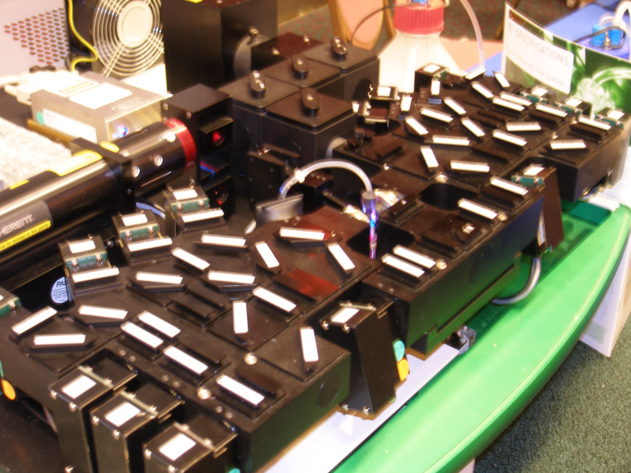
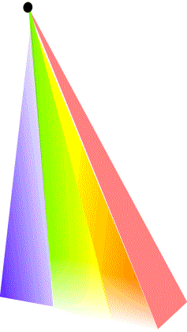
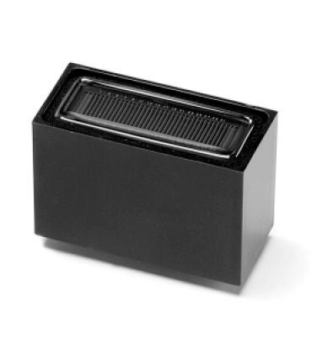
Advanced polychromatic cytometry
How do you do spectral cytometry?
spectrometer
Hyperspectral cytometry
14 PMTs
41 filters
Photo: Andrea Cossarizza Lab instrument

Slide 18
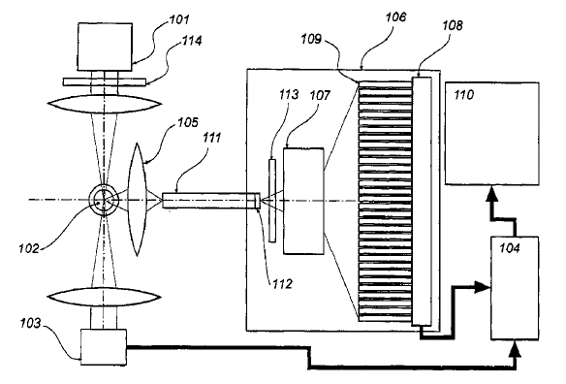
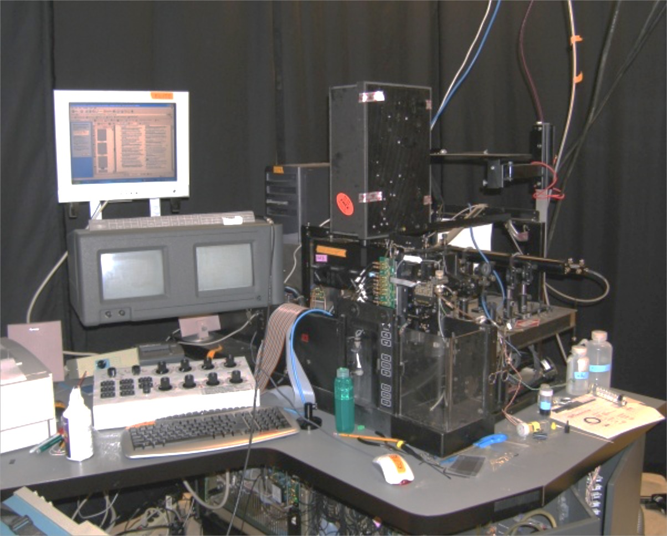
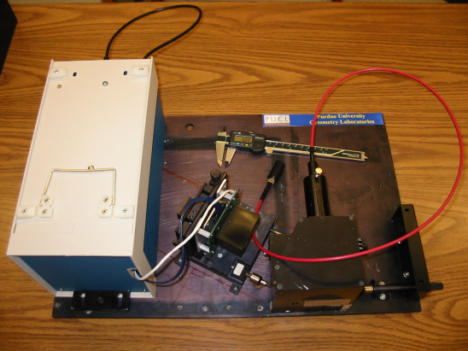
Detectors
Purdue Designed Spectral Flow Cytometry (Circa 2002)
ADC Electronics
32 spectral channels Hamamatsu
6 regular fluorescence channels
1 side scatter channel
6 forward scatter detectors
1 time gate
64 ch 16 Bit ADC
Purdue Issued Patent #7,280,204

Slide 19
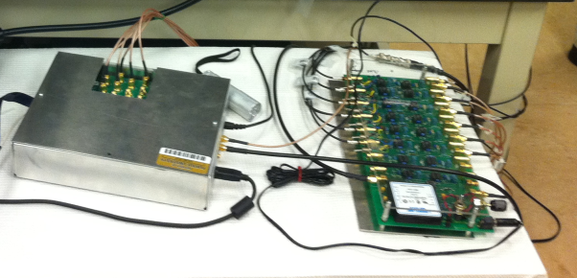
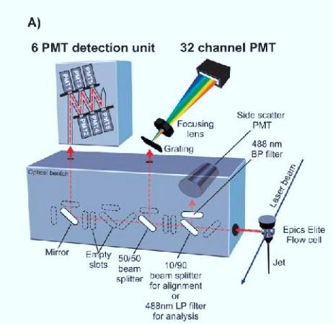
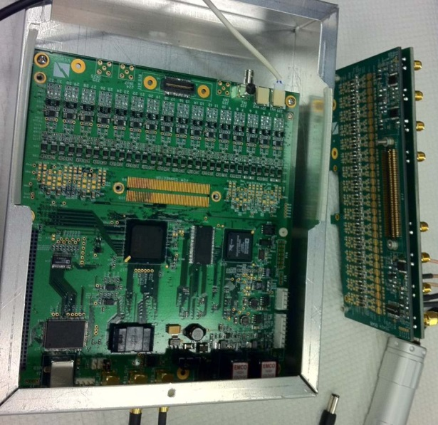
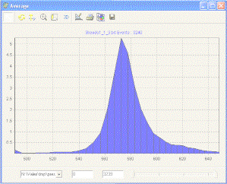
Hyperspectral Single Cell Cytometry
64 ch ADC`
10 μs available
10,000-100,000 cells
Built in 2002-2003

Slide 20
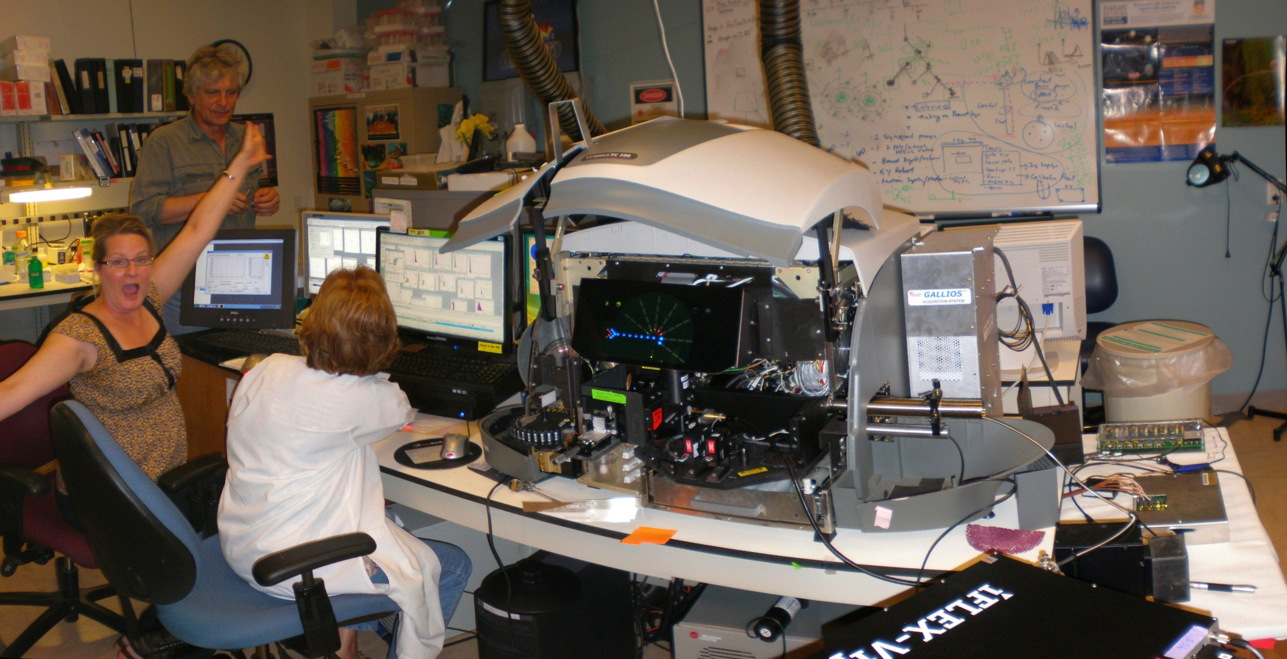
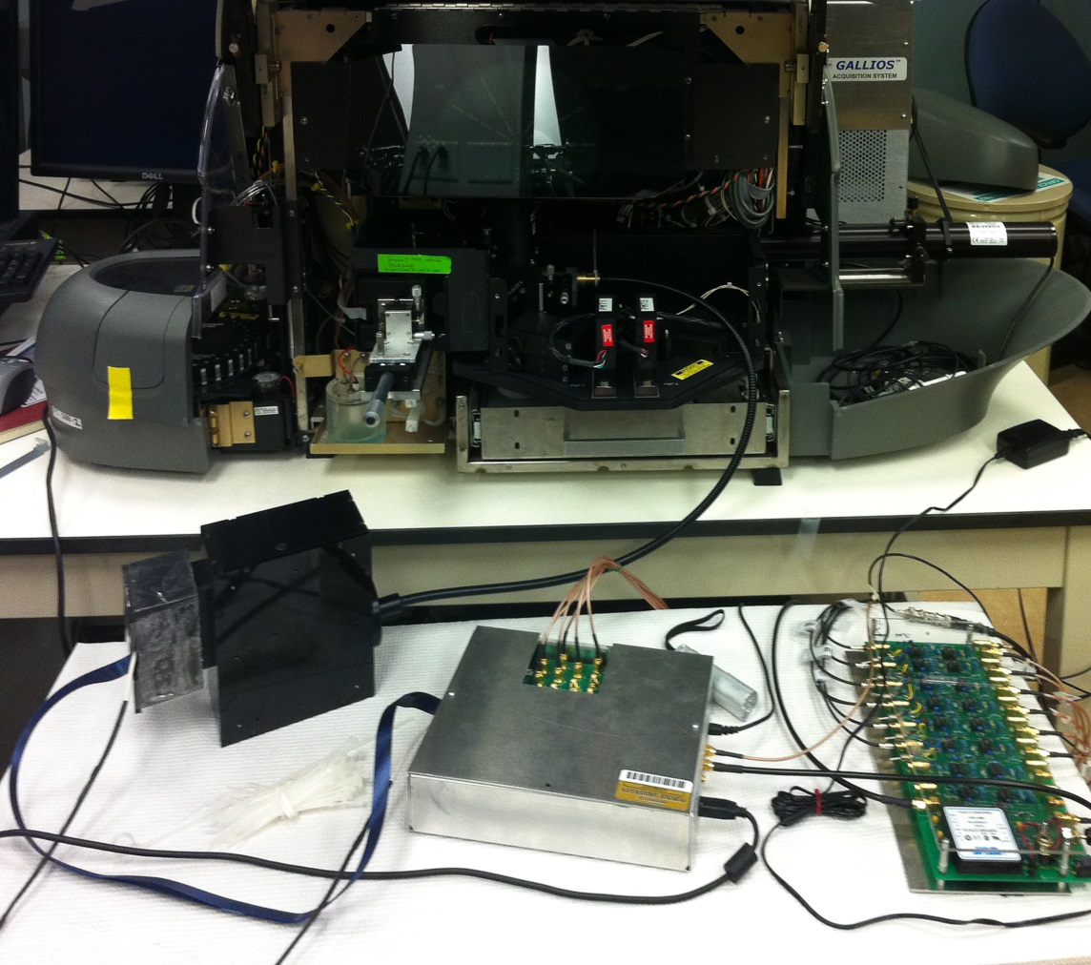
A new generation of hyperspectral detector
installed on a conventional flow cytometer
FC500
Gallios
Spectral
optics
FC500/GALLIOS Hybrid + 32 channel electronics + iFlex Viper (Qioptiq)

Slide 21
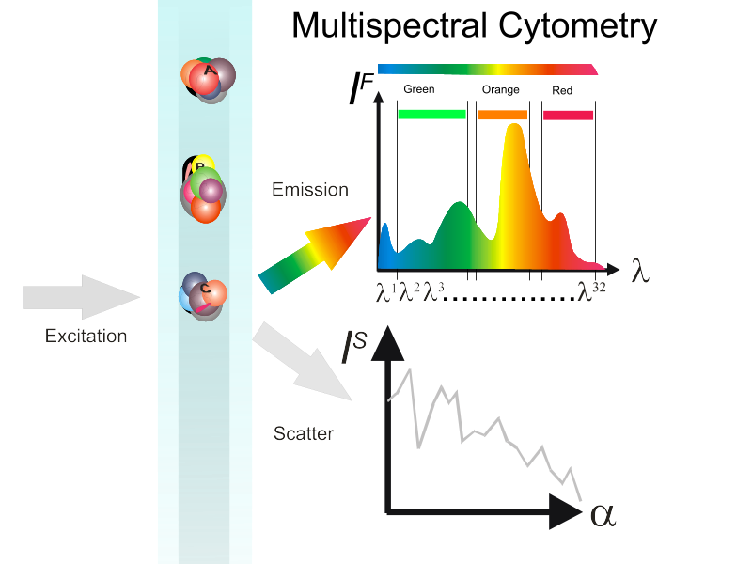
Cell
Fingerprint

Slide 22
Multicolor (polychromatic) vs. multispectral cytometry (I)
P¹ P² P³…..
Single intensity as a parameter (usually)
Spectrum as a parameter

Slide 23
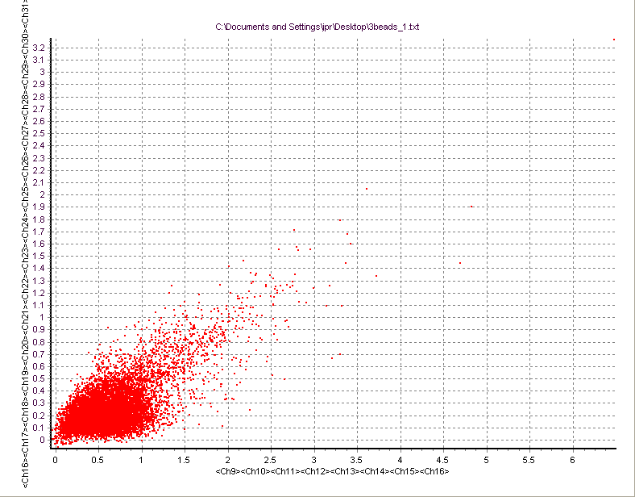
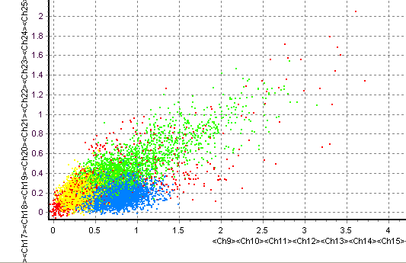
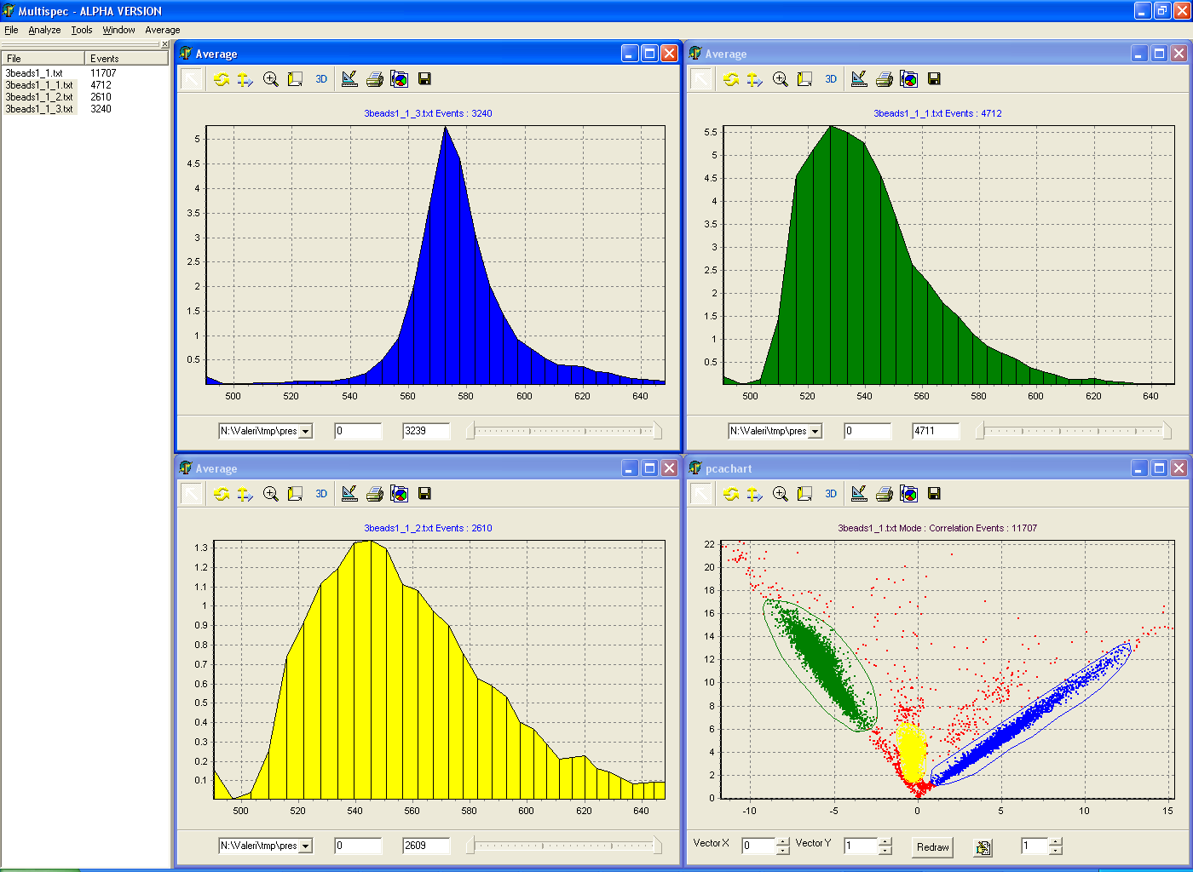
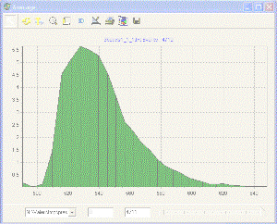
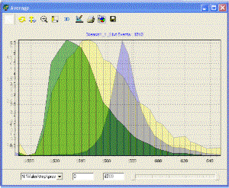
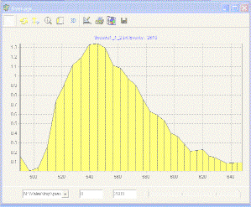
PE
Chlorophyll
Rh-123
“2” color analysis
Bang’s
Labs
Dyed
Beads*
These CAN now be resolved
These CANNOT be resolved
Advanced classification tools
like PCA are required

Slide 24
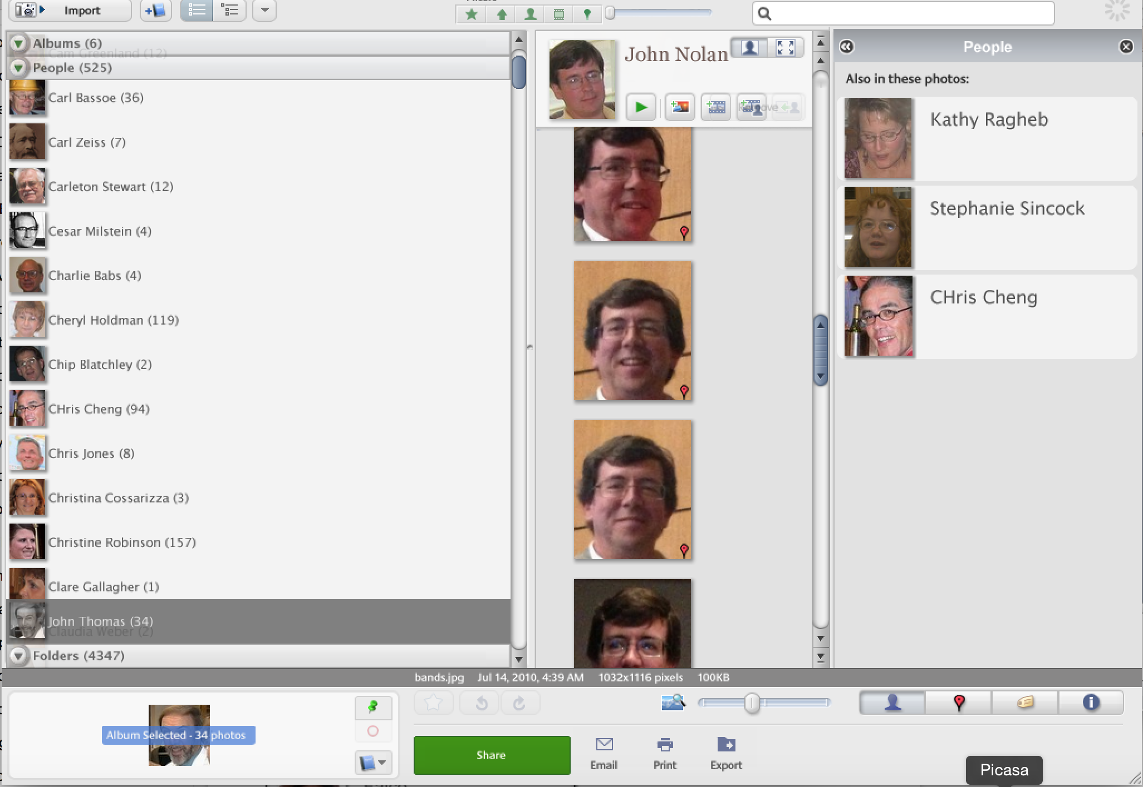
Face Recognition Technology (Picasa)

Slide 25

Spectral “fingerprints” identify samples

Slide 26

Spectral “fingerprints” identify samples
This technology is now a commercial technology (Sony) (…to HT)

Slide 27
Supervised vs. Unsupervised
Learning
Unsupervised learning (clustering)
  The class labels of training data is unknown
  Given a set of measurements, observations, etc. with the aim of establishing the existence of classes or clusters in the data
Supervised learning (classification)
  Supervision: The training data (observations, measurements, etc.) are accompanied by labels indicating the class of the observations
  New data is classified based on the training set

Slide 28


Slide 29

5-(and-6)-carboxy-2´,7´-dichlorofluorescein diacetate (CDCFA)
5(6)-carboxy-4',5'-dimethylfluorescein (CDMFA)
5-sulfofluorescein diacetate (SFDA)
Cell Tracker Green – 5-chloromethylfluorescein diacetate (CTG)
5-(and-6)-carboxy-2´,7´-dichlorofluorescein diacetate, succinimidyl ester (DCF)
bis-(1,3-dibutylbarbituric acid)trimethine oxonol (DiBAC₄(3))
3,3'-dipentyloxacarbocyanine iodide (DiOC₅(3))
3,3'-dihexyloxacarbocyanine iodide (DiOC₆(3))
Rhodamine 110

Slide 30
Spectral plots
5-(and-6)-carboxy-2´,7´-dichlorofluorescein diacetate (CDCFA)
5(6)-carboxy-4',5'-dimethylfluorescein (CDMFA)
5-sulfofluorescein diacetate (SFDA)
Cell Tracker Green – 5-chloromethylfluorescein diacetate (CTG)
5-(and-6)-carboxy-2´,7´-dichlorofluorescein diacetate, succinimidyl ester (DCF)
bis-(1,3-dibutylbarbituric acid)trimethine oxonol (DiBAC₄(3))
3,3'-dipentyloxacarbocyanine iodide (DiOC₅(3))
3,3'-dihexyloxacarbocyanine iodide (DiOC₆(3))
Rhodamine 110
1
2
3
4
5
6
7
8
9

Slide 31
Scatter matrix
Matrix of 2-D scatterplot allow us to visualize all the possible combination of channels.
Result: we are overwhelmed by information, so the matrix is not very useful

Slide 32
Principal components
The principal components with the highest variance, however, do not necessarily carry the greatest information to enable a discrimination between classes.

Slide 33
Method: Automated classification using support vector machines
The SVM algorithm creates a hyperplane that separates the data into two classes with the maximum-margin. The SVM idea was proposed by Vladimir Vapnik in 1963
For categorical variables a dummy variable is created with case values as either 0 or 1. Thus, a categorical dependent variable consisting of three levels, say (A, B, C), is represented by a set of three dummy variables: A: {1 0 0}, B: {0 1 0}, C: {0 0 1}

Slide 34









7 of 9 “green” dyes could be resolved
All dyes
Oxonol Events: 3373
Human Lymphocytes

Slide 35


Confusion matrix
5-(and-6)-carboxy-2´,7´-dichlorofluorescein diacetate (CDCFA)
5(6)-carboxy-4',5'-dimethylfluorescein (CDMFA)
5-sulfofluorescein diacetate (SFDA)
5-(and-6)-carboxy-2´,7´-dichlorofluorescein diacetate, succinimidyl ester (DCF)
Cell Tracker Green – 5-chloromethylfluorescein diacetate (CTG)
bis-(1,3-dibutylbarbituric acid)trimethine oxonol (DiBAC₄(3))
3,3'-dipentyloxacarbocyanine iodide (DiOC₅(3))
3,3'-dihexyloxacarbocyanine iodide (DiOC₆(3))
Rhodamine 110
CDCFA
CDMFA
SFDA
CTG
DCF
DiBAC43
DiOC₅(3)
DiOC₆(3)
RH110
CDCFA
87.92%
0.00%
0.76%
2.72%
0.00%
6.04%
1.92%
0.64%
0.00%
CDMFA
0.24%
97.76%
0.52%
0.04%
0.00%
0.00%
0.16%
0.88%
0.40%
SFDA
0.04%
0.00%
94.36%
4.88%
0.00%
0.00%
0.00%
0.72%
0.00%
CTG
5.44%
0.00%
5.04%
86.44%
0.00%
0.20%
0.80%
2.04%
0.04%
DCF
0.00%
0.00%
0.00%
0.00%
100.00%
0.00%
0.00%
0.00%
0.00%
DiBAC43
3.72%
0.20%
0.04%
0.40%
0.00%
92.76%
0.96%
1.92%
0.00%
DiOC₅(3)
4.12%
0.28%
0.56%
1.92%
0.00%
1.32%
77.60%
14.20%
0.00%
DiOC₆(3)
1.92%
0.12%
0.76%
1.72%
0.00%
1.24%
17.72%
76.52%
0.00%
RH110
0.00%
0.00%
0.08%
0.36%
0.00%
0.00%
0.00%
0.20%
99.36%

Slide 36
Misclassified events
Dichlorofluorescein diacetate
Dimethylfluorescein diacetate
Sulfofluorescein diacetate
Cell Tracker Green
Dichlorofluorescein, succinimidyl ester
DiBAC4(3) - oxonol
DiOC₅(3)
DiOC₆(3)
Rhodamine 110

Slide 37
SVM classification – summary
Collect training dataset
Select features
Model-based
selection
Clean controls required (training samples)!
One training and validation process in completed, classification can be performed “on fly”
Statistics-based
selection
Build the classifier
Collect your data
Train and validate
the classifier
Classify in real-time
The Language is different to our traditional cytometric thinking…..

Slide 38
Nanocrystals/Micro-Dots multiplexed systems
New probes
Potentially 1000’s of combinations
Sensitive, long lived, less bleaching
Difficult to make
Will require some advanced classification software

Slide 39



Sony SP6800 spectral cell analyzer 2013
Spatially separated lasers (488 nm and 638 nm)
The sample’s fluorescence spectra ranging from 500 nm to 800 nm are collected by a 32-channel linear array PMT detector equipped with a multi-prism monochromator
Notice of conflict of interest:
Purdue inventors receive income from non-exclusive License of US patent# 7280204 to Sony

Slide 40


Purdue Patent on spectral flow cytometry licensed to Sony Corporation

Slide 41

Separation of GFP and FITC signals using
spectral cytometry
Data courtesy of W.C. Hyun (UCSF)
Hyperspectral cytometry is capable of combining the channels in the PMT to form “virtual filters”
  Function as a regular polychromatic FC
  Capability of fine-tuning the detection to adjust for particular staining strategies as well as problems with label intensities or markers abundances.
Slide taken from Sony publicity materials

Slide 42

Sony Spectral Cytometer
Slide taken from Sony publicity materials
Data from M. Tomura, Kyoto University

Slide 43

Sony Spectral Cytometer - 12 color separation
Slide taken from Sony publicity materials
Data from E.Watanabe, Y. Nakamuci, N. Watanabe and H. Nakamuchi, Univ. Tokyo

Slide 44


Slide 45


Sony announced 40+ color spectral flow cytometer in June 2019
ID7000 Spectral Cell Analyzer

Slide 46
Polychromatic Cytometry not so perfect!
Fundamental problems with compensation
“Spreading” – low intensity populations change shape
Some events fall below zero representing negative abundance
We are told that this is “because compensation is a subtractive process”
We are told “this is because of noise”.

Slide 47
What have we learned?
Spectral cytometry recovers all the signal
If we model the noise distribution properly, we may be able to avoid spreading after unmixing.
Inaccuracies in the estimation can be addressed by Bayesian approaches

Slide 48
Summary
Spectral Cytometry is a very attractive alternative for many flow cytometry experiments
It opens up many alternatives that are NOT available with traditional flow cytometers
High throughput flow cytometry is not only possible, there are significant advantages for many screening assay systems
Flow cytometry can collect very high content data in a systems biology mode
New classification tools allow us to enhance the analytical process and assist in identifying signaling pathways
For analysis of these complex data sets – the complexity can be “under the hood”, but must be easy, interactive and accurate

Slide 49
Thank you
Purdue University Cytometry Laboratories
Home of the Purdue Cytometry Discussion List
cytometry@lists.purdue.edu
@Cytometryman

