Slide 1
BMS 524 - “Introduction to Confocal Microscopy and Image Analysis”
This lecture was last updated in March, 2017
Lecture 9: Components of the microscope
Department of Basic Medical Sciences,
School of Veterinary Medicine
Weldon School of Biomedical Engineering
Purdue University
J. Paul Robinson, Ph.D. & Bartek Rajwa, Ph.D.
SVM Professor of Cytomics & Professor of Biomedical Engineering
Director, Purdue University Cytometry Laboratories, Purdue University
See also Microscopy Encyclopedia chapter
http://www.cyto.purdue.edu/flowcyt/research/pdfs/micro.pdf
See more lectures and slides at:
http://www.cyto.purdue.edu/flowcyt/educate/pptslide.htm
These slides are intended for use in a lecture series. Copies of the slides are distributed and students encouraged to take their notes on these graphics. All material copyright J.Paul Robinson unless otherwise stated. No reproduction of this material is permitted without the written permission of J. Paul Robinson. Except that our materials may be used in not-for-profit educational institutions ith appropriate acknowledgement. It is illegal to upload this lecture to CourseHero or any other site.
You may download this PowerPoint lecture at http://tinyurl.com/2dr5p
Find other PUCL Educational Materials at http://www.cyto.purdue.edu/class

Slide 2
Learning Objectives
Understand:
Components of a confocal microscope system
Optical pathways used in systems
Optical resolution - Airy disks
Reflected light/backscatter imaging

Slide 3
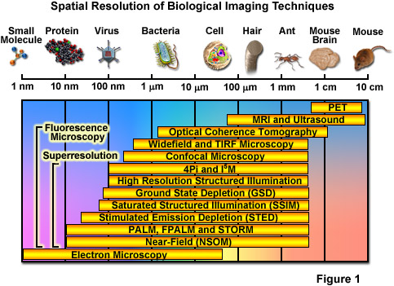
http://zeiss-campus.magnet.fsu.edu/articles/superresolution/introduction.html

Slide 4
Benefits of Confocal Microscopy
Reduced blurring of the image from light scattering
Increased effective resolution
Improved signal to noise ratio
Clear examination of thick specimens
Z-axis scanning
Depth perception in Z-sectioned images
Magnification can be adjusted electronically

Slide 5
Fluorescent Microscope
Arc Lamp
Excitation Diaphragm
Excitation Filter
Ocular
Objective
Emission Filter

Slide 6
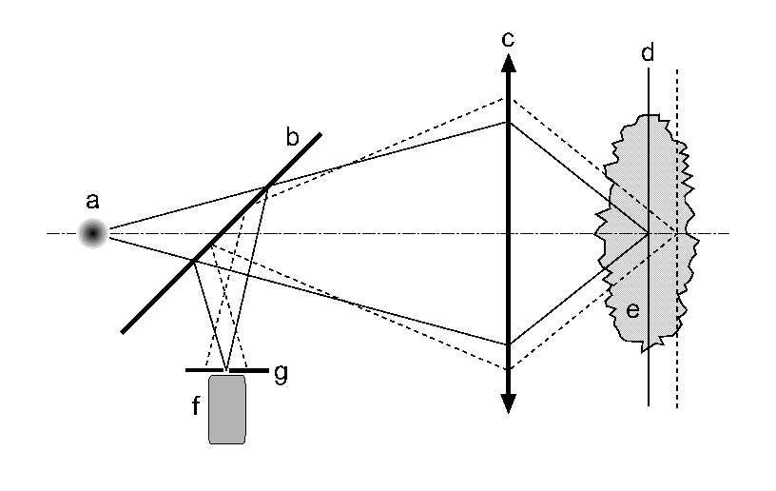
Confocal microscopy
Figure from D. Andrews, I. S. Harper and J. R. Swedlow

Slide 7
Confocal Principle
Laser
Excitation Pinhole
Excitation Filter
PMT
Objective
Emission
Filter
Emission Pinhole

Slide 8
Fluorescent Microscope
Confocal Microscope
Arc Lamp
Laser
Excitation Diaphragm
Excitation Pinhole
Excitation Filter
Excitation Filter
Ocular
PMT
Objective
Objective
Emission
Filter
Emission Filter
Emission Pinhole

Slide 9
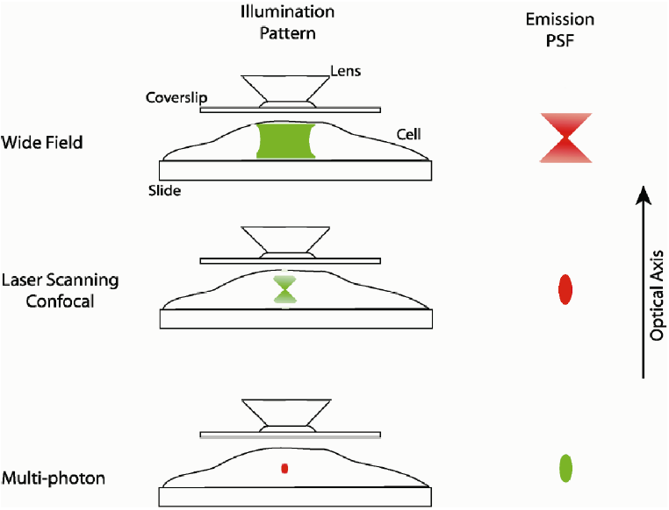
Wide-field vs confocal vs 2-p
Drawing by P. D. Andrews, I. S. Harper and J. R. Swedlow

Slide 10
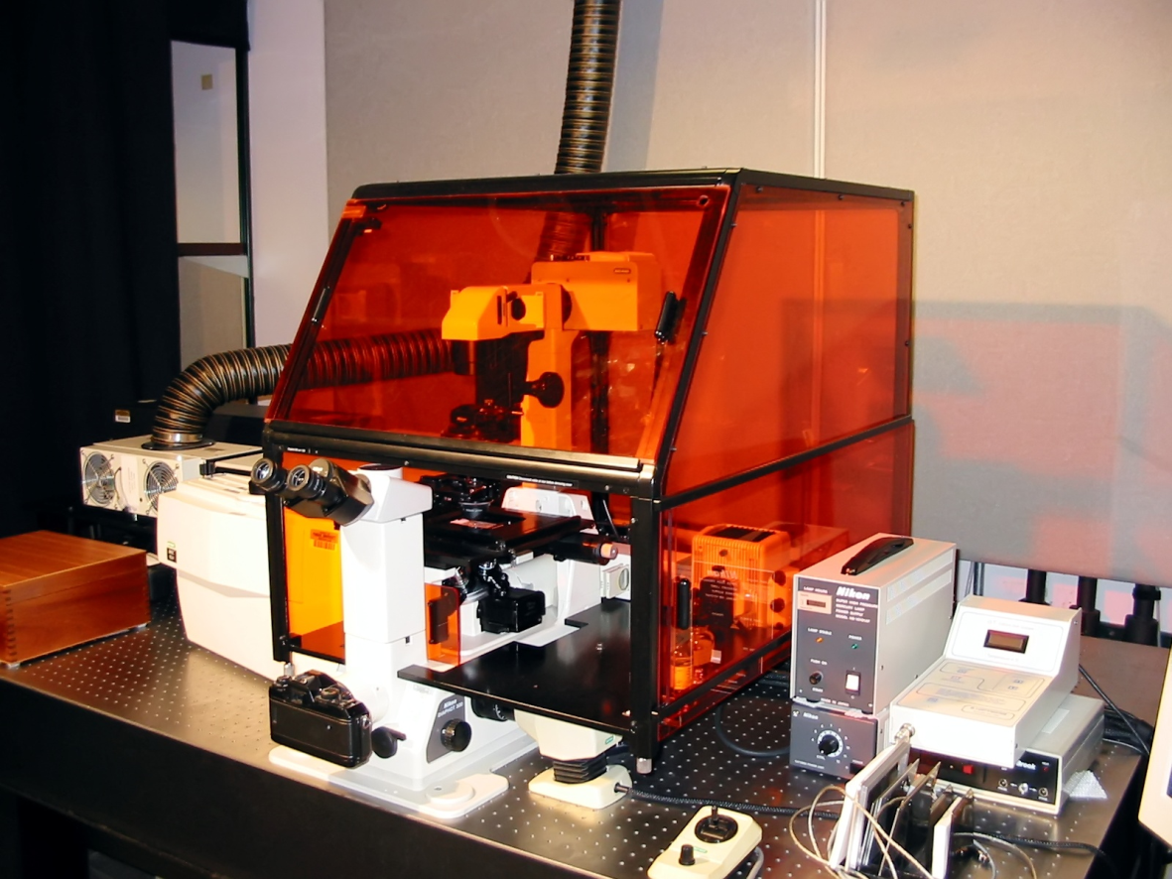
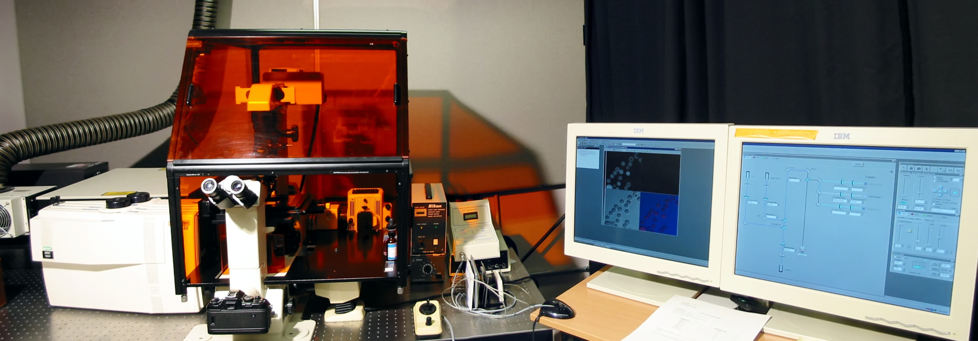
Bio-Rad MRC 1024
(Circa 1993-2000)
(UV 350 nm microscopy)
The first fully UV confocal microscope – thus the protection canopy around the microscope
Historical Slide

Slide 11
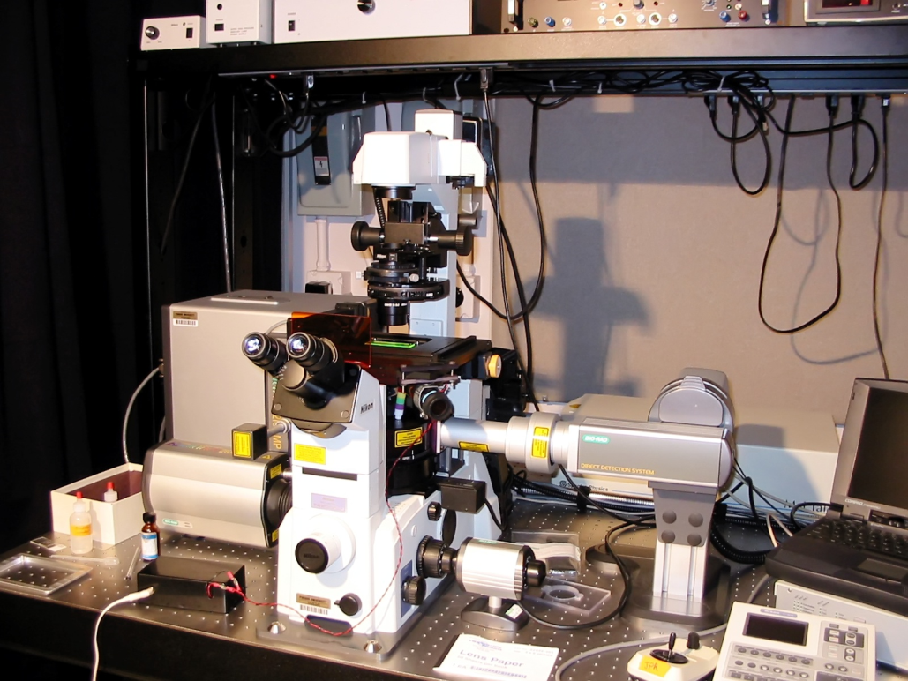
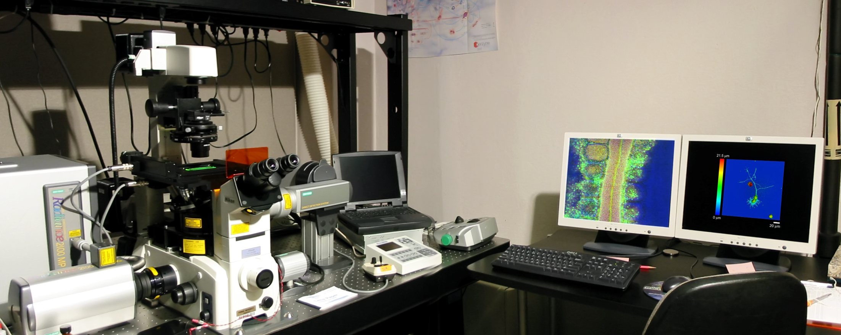
Radiance 2100MP in
Purdue University Cytometry Laboratories
Nikon
Leica
Zeiss Confocal Scopes

Slide 12

Original Confocal layout using large lasers
Lasers
Optical
Components
Microscope
Computer
UV Laser
Optical Mixer
Computer
analysis
Kr-Ar Laser
Scanhead
Microscope

Slide 13
e.g.MRC 1024 System
Light Path Concept for Confocal
PMT

Slide 14
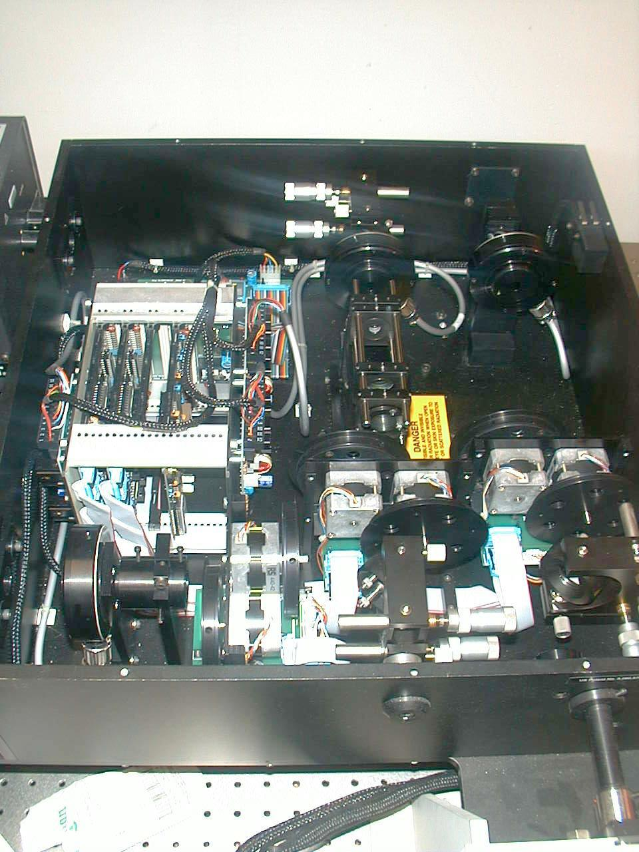
Optical Mixer - MRC 1024 UV
Excitation optics
Argon Laser
353,361 nm
UV
Visible
Filter
Wheels
Fast Shutter
UV Correction
Optics
Argon-
Krypton
Laser
488, 514 nm
488,568,647 nm
Beam Expander
To Scanhead

Slide 15
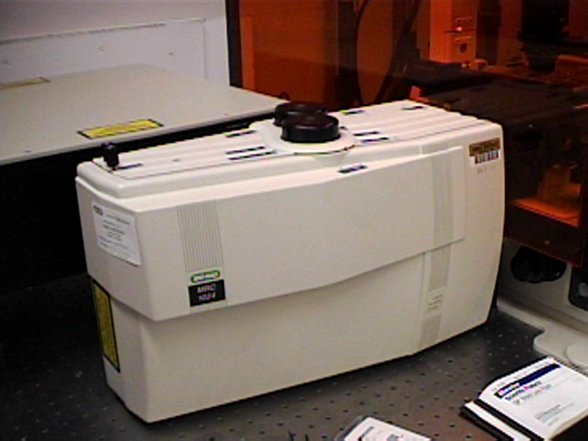
MRC 1024 Scanhead
2
3
Emission
Filter
Wheel
From Laser
PMT
1
Galvanometers
To and from Scope

Slide 16
Scanning Galvanometers
Point Scanning
x
y
Laser out
To
Microscope
Laser in

Slide 17
MRC 1024 Scanhead
This dichroic separates the excitation from the emission signals
PMT
PMT
2
3
Emission
Filter
Wheels
From Laser
1
PMT
Galvanometers
To and from Scope

Slide 18
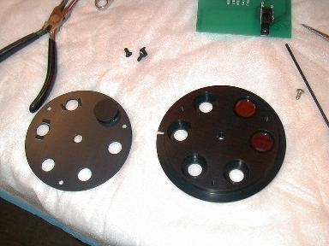
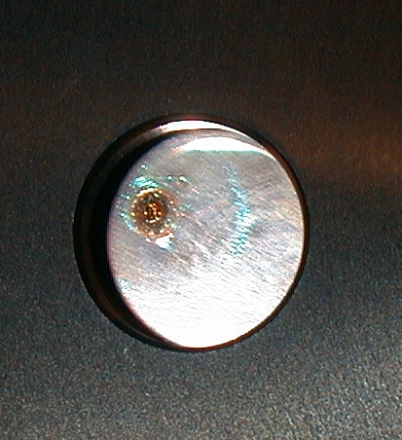
Confocal problems
Destroyed optical excitation filters
Hole burned in filter

Slide 19
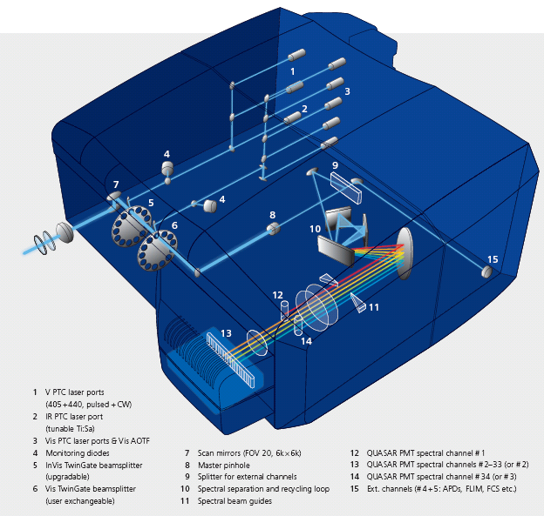
Zeiss 710 system
Materials from Zeiss publication

Slide 20
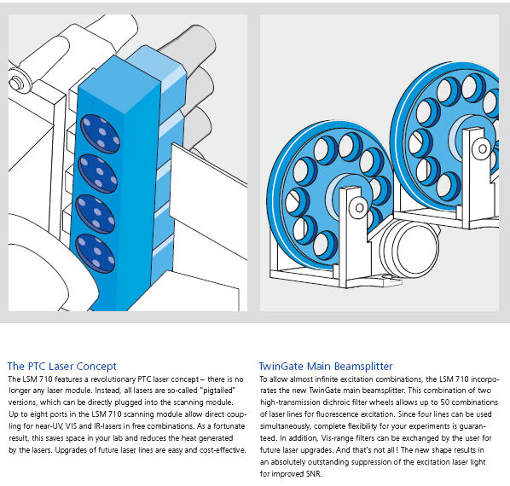
Zeiss 710
Materials from Zeiss publication

Slide 21
Complex optical pathways
BioRads “Twingate” beam splitters from early 1990s

Slide 22
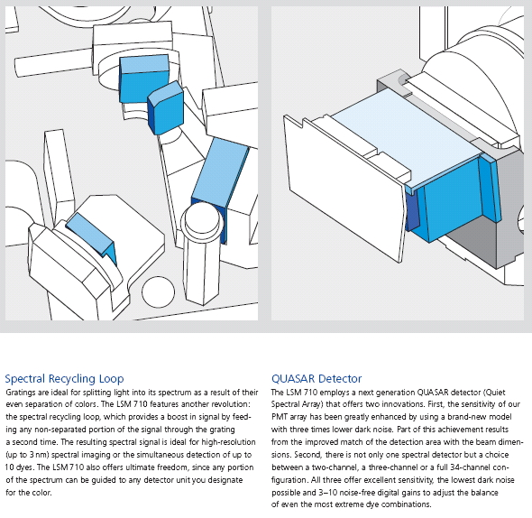
Zeiss 710
Materials from Zeiss publication

Slide 23
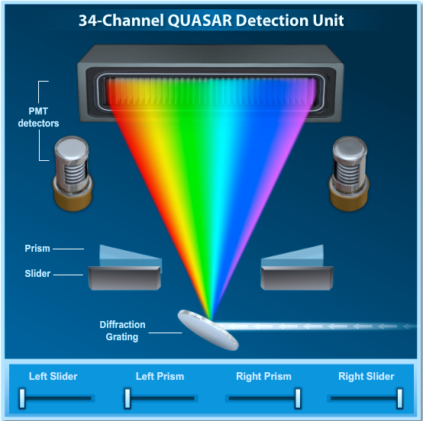
Zeiss 710 spectral system
http://zeiss-campus.magnet.fsu.edu/tutorials/spectralimaging/quasar34ch/index.html

Slide 24
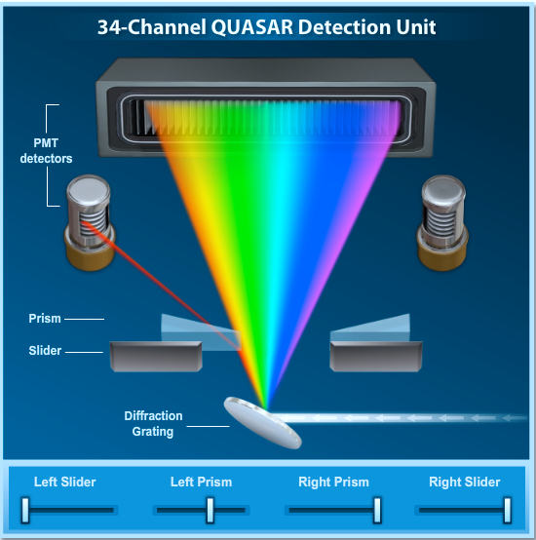
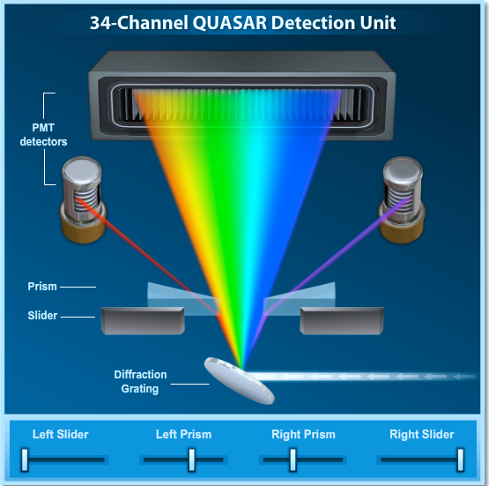
Zeiss 710 spectral system
Images from: http://zeiss-campus.magnet.fsu.edu/tutorials/spectralimaging/quasar34ch/index.html

Slide 25
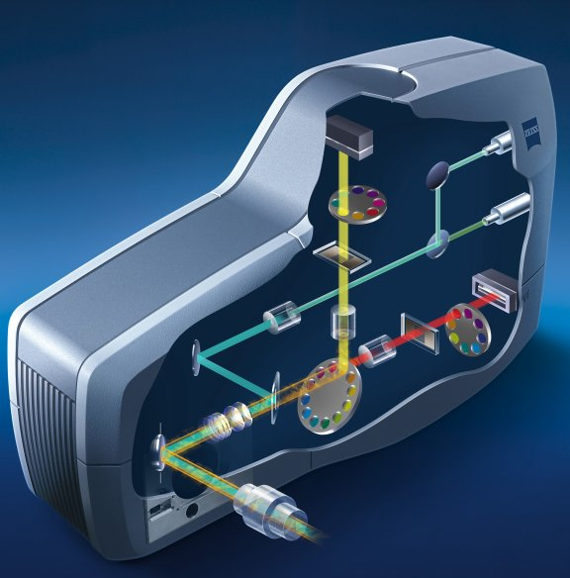
Spectral CLSM (Zeiss)
Multianode PMT
Dispersion grating
Zeiss LSM 5 LIVE
A new system concept of optics and electronics
Materials from leica publication

Slide 26
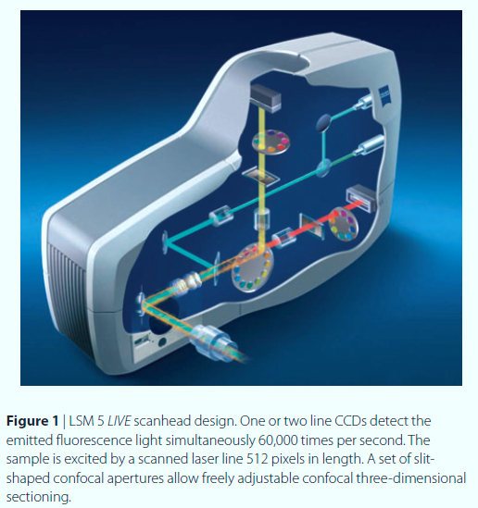
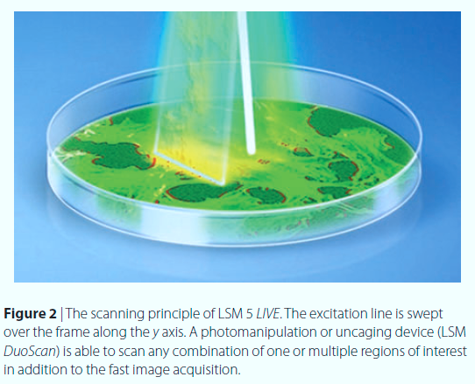
512 x 50 pixels – 1010 frames/sec
512x512 pixels – 100 FPS
http://www.zeiss.com/C12567BE00472A5C/EmbedTitelIntern/Article_Nature_Methods/$File/Faster_than_real-time.pdf

Slide 27
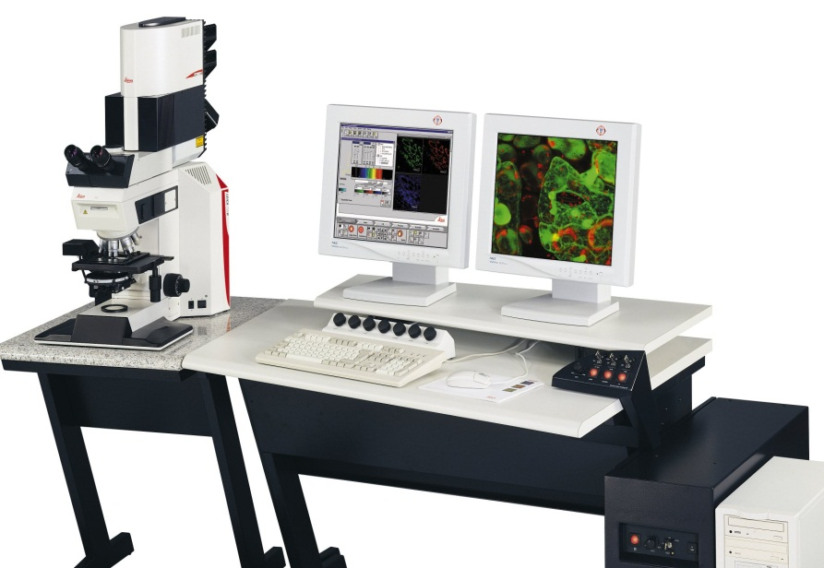
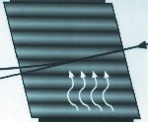
Spectral CLSM (Leica)
Original Leica System
Fluorescence signal was dispersed on a prism, to provide spectral analysis capability
Excitation via acousto-optical
tunable filter:
Free selection of excitation lines
Individual line attenuation
Less crosstalk
Less fading
Materials from leica publication

Slide 28
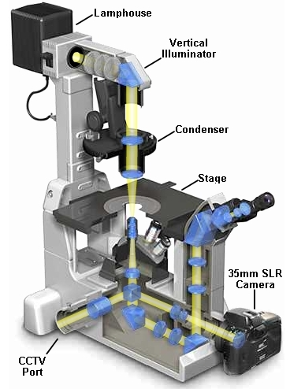
Review of the fundamental principles
From
Scanhead
To Scanhead

Slide 29
The Scan Path of the Laser Beam
Early confocal systems
0
Leica SP2
400 Hz
512 line image takes 1.28 seconds
4096 line image takes 10.24 seconds
Start
767, 1023, 1279, etc
0
Specimen
511, 1023
Frames/Sec # Lines
1 512
2 256
4 128
8 64
16 32
Nikon A1 has up to 4096 lines
Zeiss 710 has up to 6000 lines

Slide 30
How a Confocal Image is Formed
Pinhole 1
Pinhole 2
Specimen
Detector
Condenser
Lens
Objective
Lens
Modified from: Handbook of Biological Confocal Microscopy. J.B.Pawley, Plennum Press, 1989

Slide 31
Fundamental Limitations of Confocal Microscopy
From
Source
PIXEL
2D space
Resolution_{x,y} = λ / 2[η • sin(α)]
Resolution_{z} = 2λ / [η • sin(α)]²
n₁ photons
.
λ₁
(NA)
α₁
Is around 150 nanometers in the lateral dimension and approaching 400 nanometers in the axial dimension
δ_{y}
δ_{x}
δ_{z}
VOXEL
3D space
x,y,z
α₂
n₂ photons
λ₂
To Detector
From: Handbook of Biological Confocal Microscopy. J.B.Pawley, Plennum Press, 1989

Slide 32
Super Resolution Microscopy
(to be discussed in a later lecture in detail)
In super-resolution microscopy both lateral and axial resolution can be measured in the tens of nanometers. Thus they are able to resolve features beneath the diffraction limit by switching fluorophores on and off sequentially in time so that the signals can be recorded consecutively.
STED (Stimulated Emission Depletion; from the Stefan Hell laboratory)
SSIM (Saturated Structured Illumination Microscopy; pioneered by Mats Gustafsson).
PALM (PhotoActivated localization Microscopy; introduced by Eric Betzig and Harald Hess)
STORM (Stochastic Optical Reconstruction Microscopy; first reported by Xiaowei Zhang).

Slide 33
Microscopy Definitions
Near-field, (NSOM) the specimen is imaged within a region having a radius much shorter than the illumination wavelength.
Far-field, the specimen many thousands of wavelengths away from the objective (often a millimeter or more) and is limited in resolution by diffraction of the optical wave-fronts as they pass through the objective rear aperture (this would include brightfield, DIC, and phase contrast, widefield fluorescence, confocal, and multiphoton are considered far-field, diffraction-limited instruments.

Slide 34
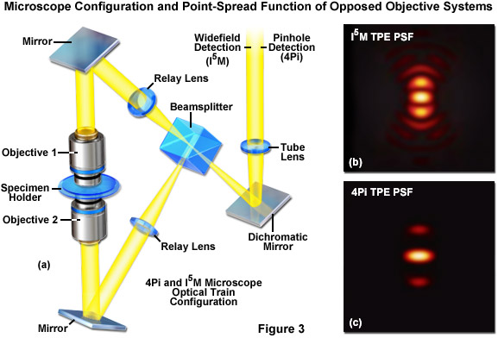
I⁵M and 4Pi Microscopy
http://zeiss-campus.magnet.fsu.edu/articles/superresolution/introduction.html

Slide 35
Light Sheet Microscopy
Light sheet flow cytometry
Gualda et al, Cytometry Part A 91A: 144151, 2017
https://www.researchgate.net/publication/306283216_New_Methods_to_Improve_Large-Scale_Microscopy_Image_Analysis_with_Prior_Knowledge_and_Uncertainty/figures?lo=1

Slide 36
Gray Level & Pixelation (reminder)
Analogous to intensity range
For computer images each pixel is assigned a value. If the image is 8 bit, there are 2⁸ or 256 levels of intensity If the image is 10 bit there are 1024 levels, 12 bit 4096 levels etc.
The intensity analogue of a pixel is its grey level which shows up as brightness.
The display will determine the possible resolution since on a TV screen, the image can only be displayed based upon the number of elements in the display. Of course, it is not possible to increase the resolution of an image by attributing more “pixels” to it than were collected in the original collection!

Slide 37
Sampling Theory (Reminder)
The Nyquist Theorem
  Nyquest theory describes the sampling frequency (f) required to represent the true identity of the sample.
  i.e., how many times must you sample an image to know that your sample truly represents the image?
  In other words to capture the periodic components of frequency f in a signal we need to sample at least 2f times
Nyquist claimed that the rate was 2f. It has been determined that in reality the rate is 2.3f - in essence you must sample at least 2 times the highest frequency.
For example in audio, to capture the 22 kHz in the digitized signal, we need to sample at least 44.1 kHz (unless of course you can’t hear 22k Hz and then you don’t need 44.1 kHz!!!!)
(See previous lecture on Nyquist Theorem)

Slide 38
Digital Zoom
1 x
1024 points
2 x
1024 points
4 x
1024 points
Note that we have reduced the field of view of the sample
Note #2: There will only be a single zoom value where
optimal resolution can be collected.

Slide 39
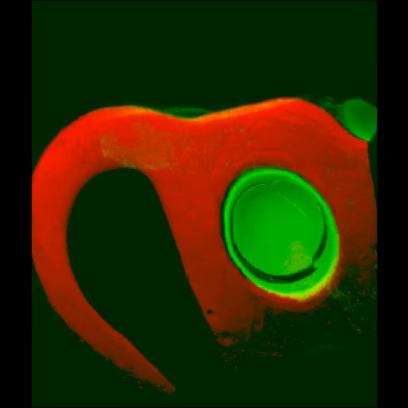
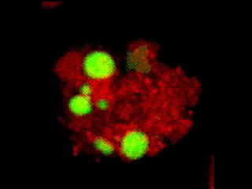
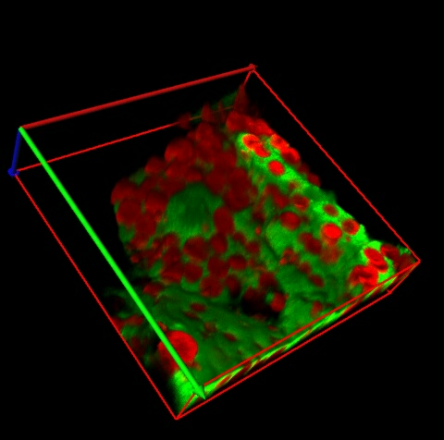
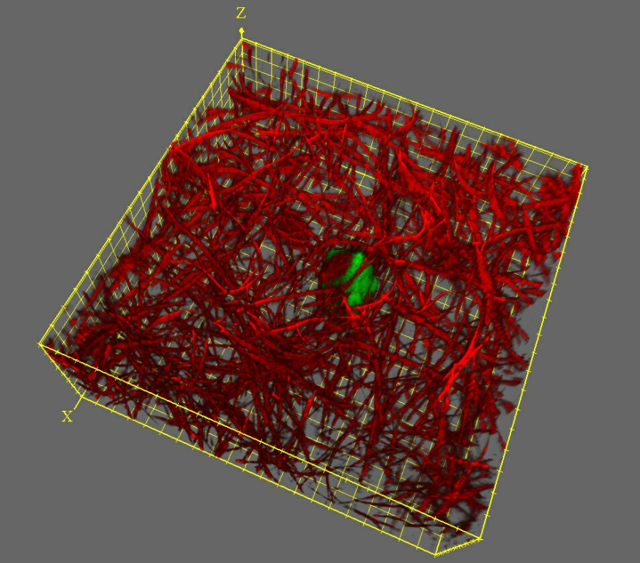
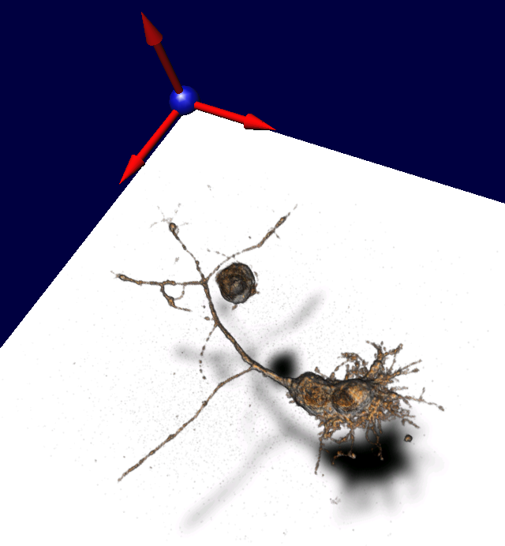
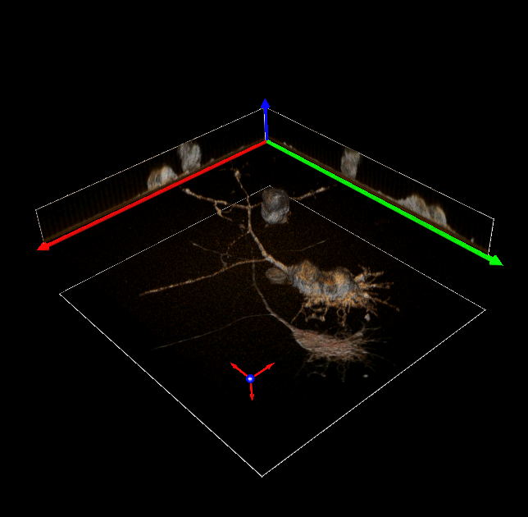
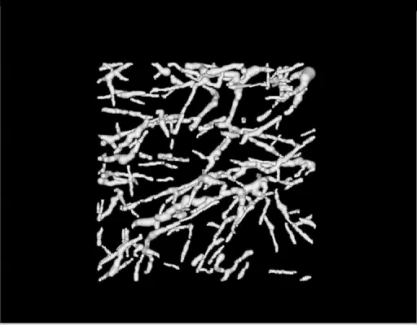
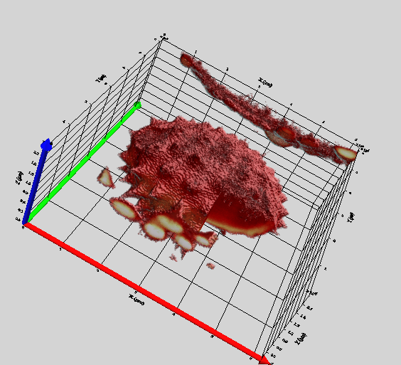
3D imaging using CLSM

Slide 40
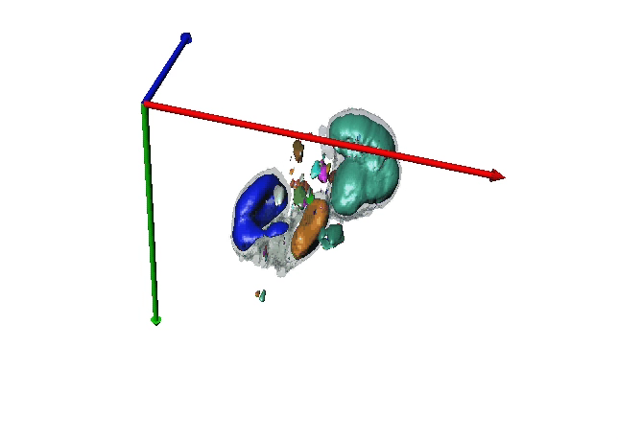
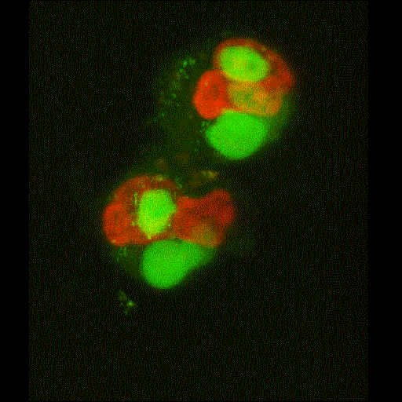
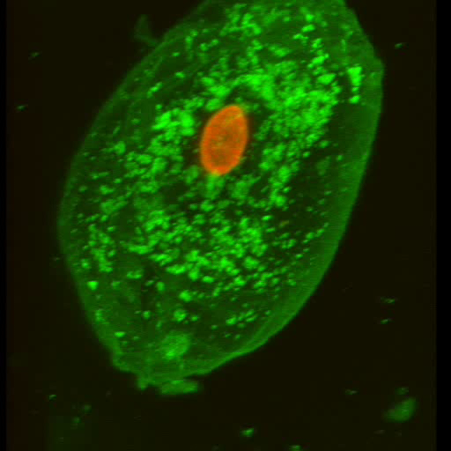
Live Human Neutrophils
Phagocytosing yeast
Reference: Bassoe-C-F, Nianyu Li, Kathy Ragheb, Gretchen Lawler, Jennie Sturgis, J. Paul Robinson, Cytometric Investigations of Phagosomes, Mitochondria and Acidic Granules in Human neutrophils. Cytometry 2003:51B:21-29.

Slide 41

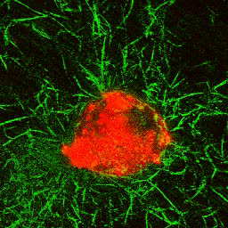
Cells in ECM

Slide 42
Reflection Imaging
Backscattered light imaging
Same wavelength as excitation
Advantages: no photobleaching since not using a photo-probe (note: does not mean no possible damage to specimen)
Problems: optical reflections from components of microscope

Slide 43
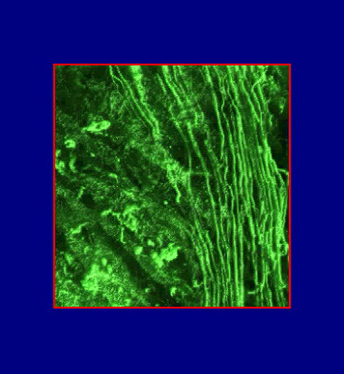
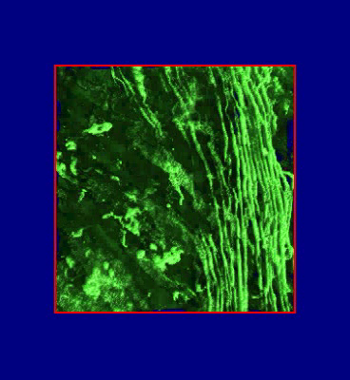
CLSM can utilize autofluorescence:
Example - topography of SIS
Raw image
Deconvolved image
/Users/wombat/Syncplicity/PI4D image symposium materials/sis_af_02.mp4

Slide 44
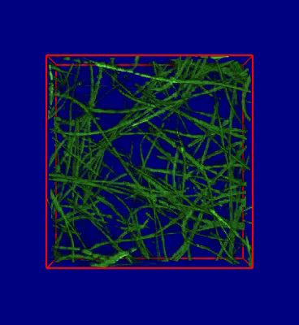
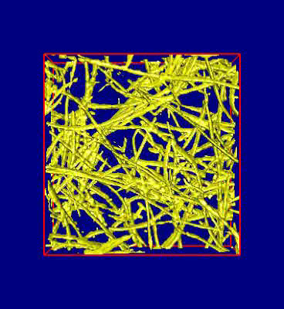
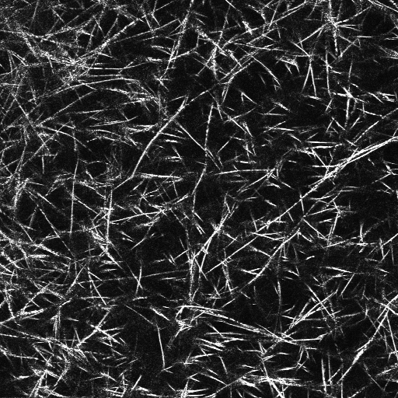
Backscattered light imaging – another CLSM modality
Movies/Gel_bs2.mpg
Movies/gel_bsl_02.avi
Collagen gel (ECM model) visualized by BSL-confocal microscopy. Volume- (left) and surface-rendering (right) of a confocal dataset.
Collagen gel – an optical section

Slide 45
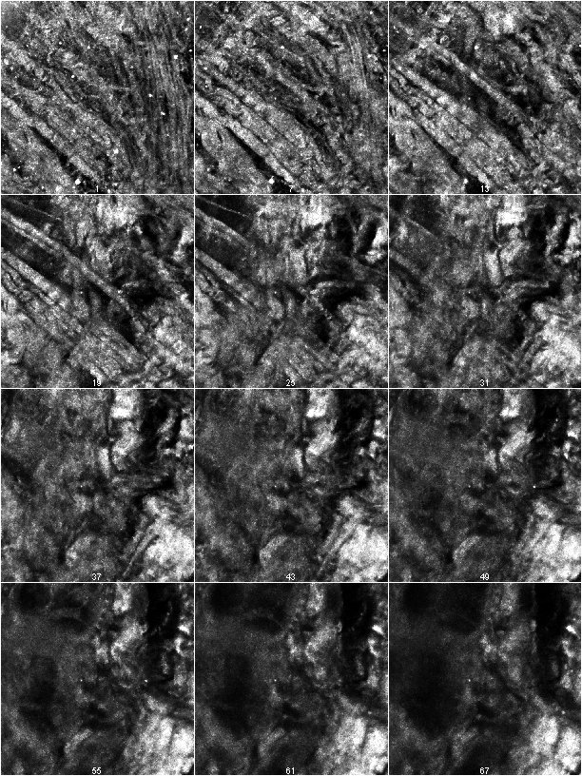
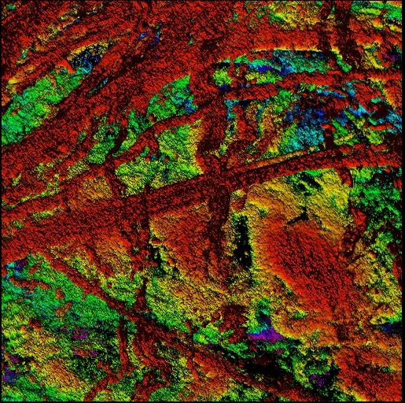
Backscattered light: tissue imaging
Left: Optical sections of SIS visualized with BSL-confocal technique. Bottom: color-coded height map revealing the topography of height map of SIS

Slide 46
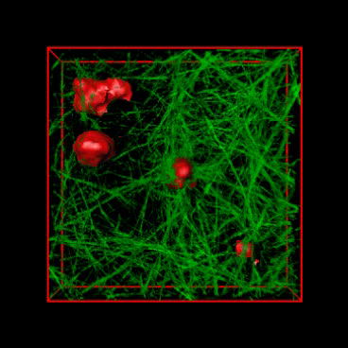
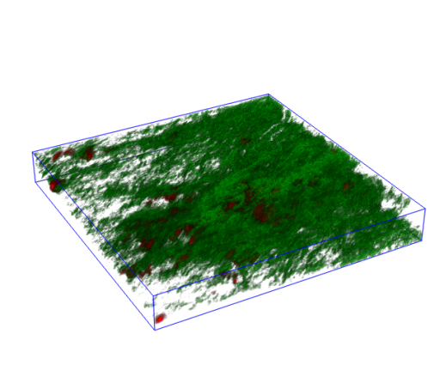
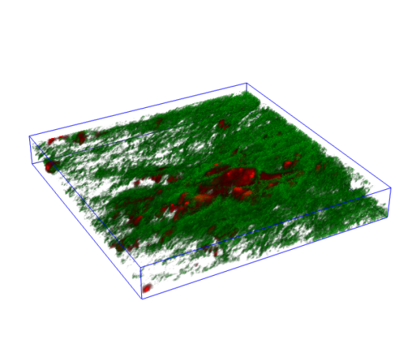
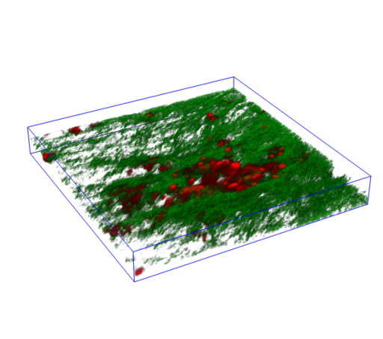
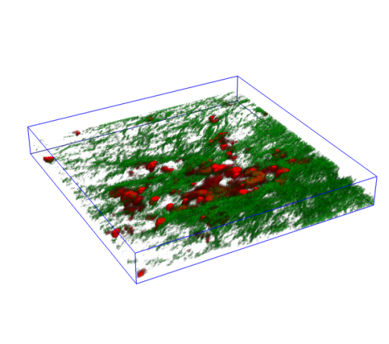
Example: BSL and AF signals combined
HepG2 cells grow embedded within a collagen matrix (animation)

Slide 47
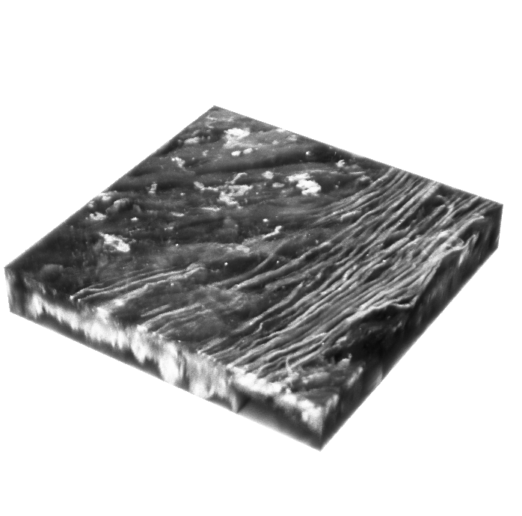
Reflected light images
Collagen imaged by
a 1024 Confocal
CD-ROM pits imaged on a 1024 Bio-Rad confocal

Slide 48
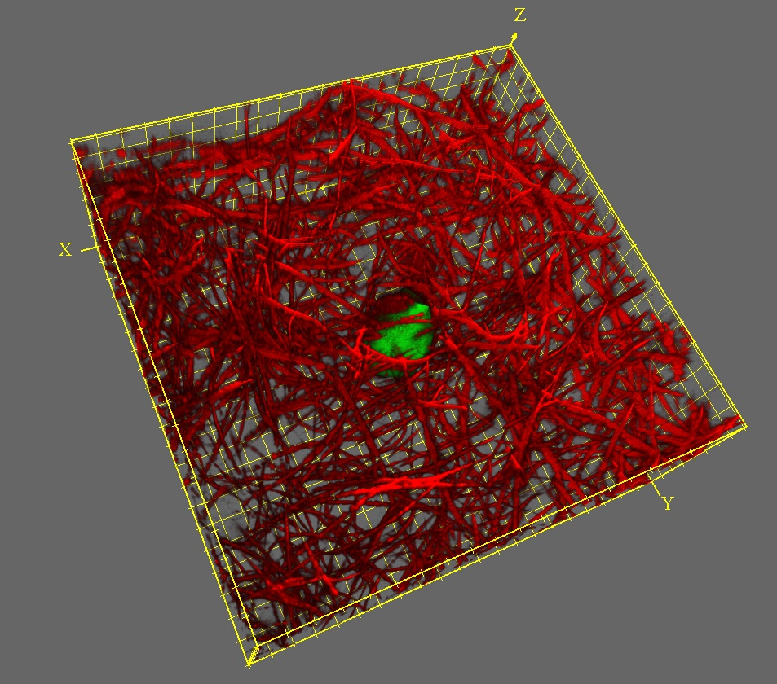

Backscattered light and autofluorescence signals combined collagen gel & HepG2 cells

Slide 49

Imaging spectroscopy

Slide 50
Issues for good confocal imaging
Axial Resolution
  Must determine the FWHM (full width half maximum) intensity values of a vertical section of beads
Field Flatness
  Must be able to collect a flat field image over a specimen - or z-axis information will be inaccurate
Chromatic Aberration
  must test across an entire field that emission is constant and not collecting radial or tangential artifacts due to chromatic aberration in objectives
Z-drive precision and accuracy
  must be able to reproducibility measure distance through a specimen - tenths of microns will make a big difference over 50 microns

Slide 51

SUMMARY SLIDE
Components of a confocal system
Optical pathways
Optical resolution
Sampling rate (Nyquist Theorem)
Reflection imaging
Current imaging systems

