Slide 1
Live Cell Imaging Applications in Confocal Microscopy
BMS 524 - “Introduction to Confocal Microscopy and Image Analysis”
Purdue University Department of Basic Medical Sciences, School of Veterinary Medicine
J. Paul Robinson, Ph.D.
SVM Professor of Cytomics
Professor of Biomedical Engineering
Director, Purdue University Cytometry Laboratories
These slides are intended for use in a lecture series. Copies of the graphics are distributed and students encouraged to take their notes on these graphics. All material copyright J. Paul Robinson unless otherwise stated, however, the material may be freely used for lectures, tutorials and workshops. It may not be used for any commercial purpose including uploading to CourseHero.
The text for this course is Pawley “Introduction to Confocal Microscopy”, Plenum Press, 2nd Ed. A number of the ideas and figures in these lecture notes are taken from this text.
UPDATED March 2019

Slide 2
Goals of this lecture
Identify applications of imaging related to live cell work
Identify tools useful for doing live cell work
Identify reagents compatible with live cell imaging
Identify problems associated with live cell imaging
Show some examples of live cell imaging

Slide 3
Applications
Organelle Structure
Probe ratioing
Conjugated antibodies
DNA/RNA
Cytochemical Identification
Oxidative Metabolism
Exotic Applications

Slide 4
Applications
Organelle Structure & Function
  Mitochondria (Rhodamine 123)
  Golgi (C6-NBD-Ceramide)
  Actin (NBD-Phaloidin)
  Lipid (DPH)

Slide 5
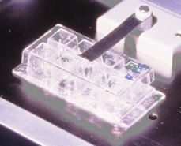
Step 1: Cell Culture
top view
1
2
Step 2: Cell Wash
3
4
Below: the culture dishes for live cell imaging using a confocal microscope and high NA objectives.
6
5
Step 3: Transfer to Lab-Tek plates
7
8
side view
170 μM coverslip
Lab-Tek
Step 4: Addition of DCFH-DA, Indo-1, or HE
stimulant/inhibitor added
37º heated stage
oil immersion
objective
confocal microscope

Slide 6
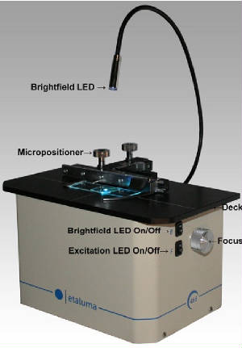
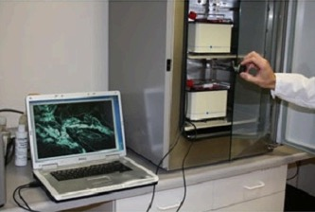
Lumascope
The LumaScope is a low price, compact, USB-based, inverted fluorescence microscope. The system fits on a shelf inside an incubator or inside a hood. It has a built-in camera and light source. This runs on a laptop/desktop using just one USB cable, captures fluorescence or brightfield images and has options of 2.5x, 4x, 10x, 20x, 40x and 100x (oil) lenses. The software allows to do time-laps study. The machine does not have a mechanical shutter to block the light (to avoid photo-toxicity or photo-bleaching), but the software can control the light to turn on/off to less expose the cells to the light.

Slide 7
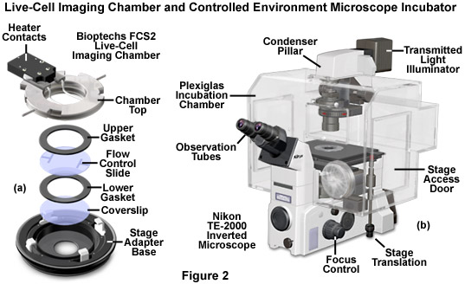
Nikon live cell imaging
Image source: http://www.microscopyu.com/articles/livecellimaging/livecellmaintenance.html

Slide 8
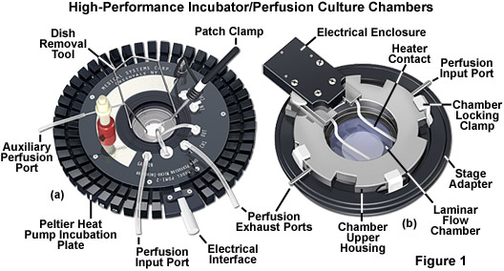
Live Cell Chambers
http://www.microscopyu.com/articles/livecellimaging/culturechambers.html

Slide 9
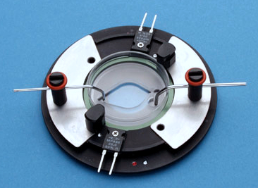
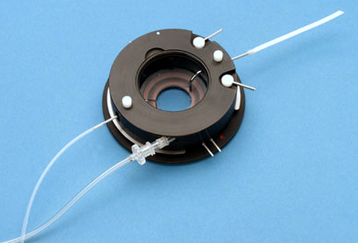
Examples of micro-incubation systems
Images from: http://www.harvardapparatus.com/webapp/wcs/stores/servlet/haisku3_10001_11051_68114_-1_HAI_ProductDetail_N_37474_37500_44260

Slide 10
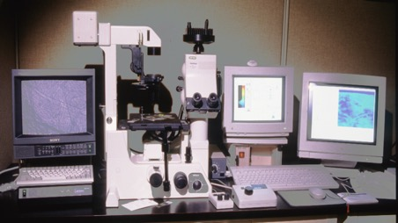
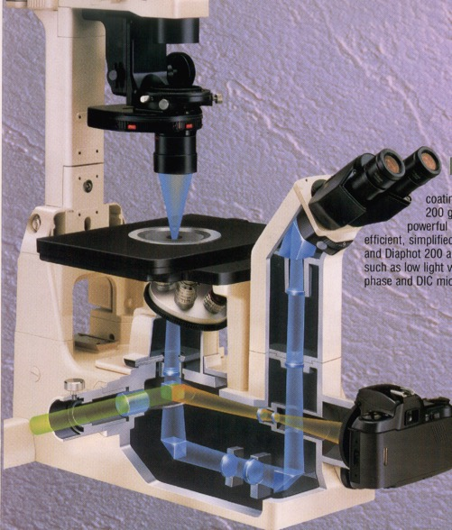
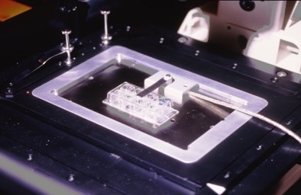
Confocal System
Culture System
Photos taken in Purdue University Cytometry Labs
Photo taken from Nikon promotion material

Slide 11
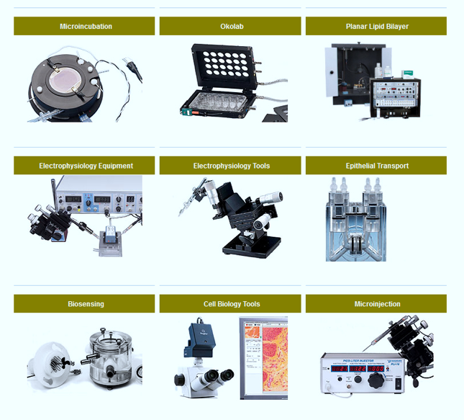
Live cell manipulation devices
Image source: http://www.warneronline.com/products.cfm?CFID=6704527&CFTOKEN=47754450

Slide 12
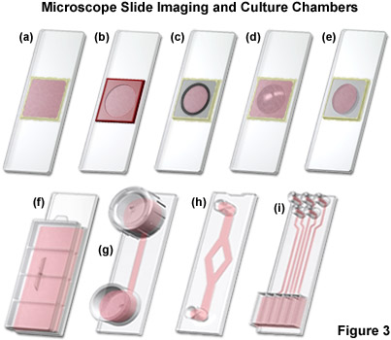
LabtekTM culture chambers
http://www.microscopyu.com/articles/livecellimaging/culturechambers.html

Slide 13
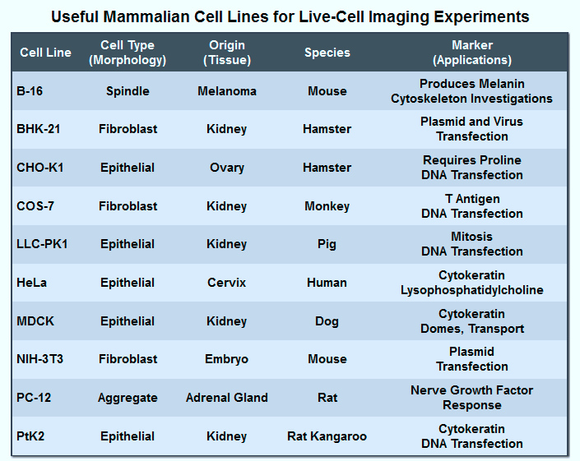
Useful cell lines
Table from: http://www.microscopyu.com/articles/livecellimaging/livecellmaintenance.html

Slide 14
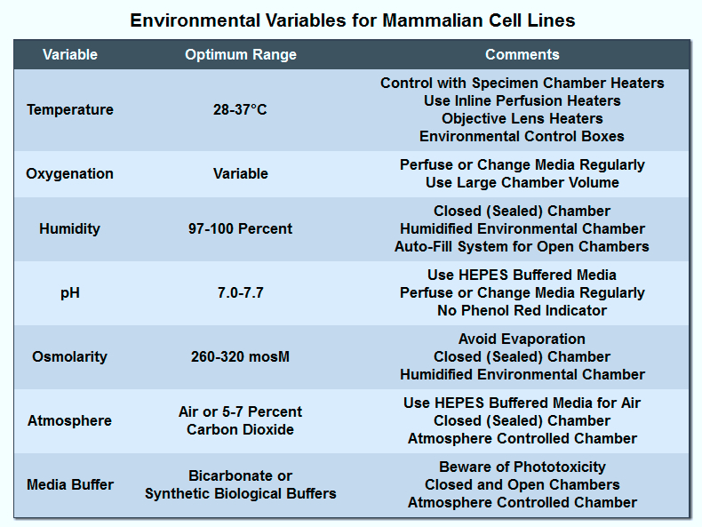
Growth conditions
Table from: http://www.microscopyu.com/articles/livecellimaging/livecellmaintenance.html

Slide 15
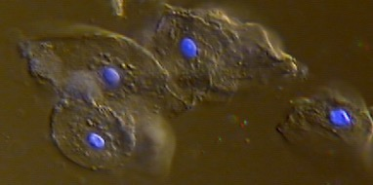
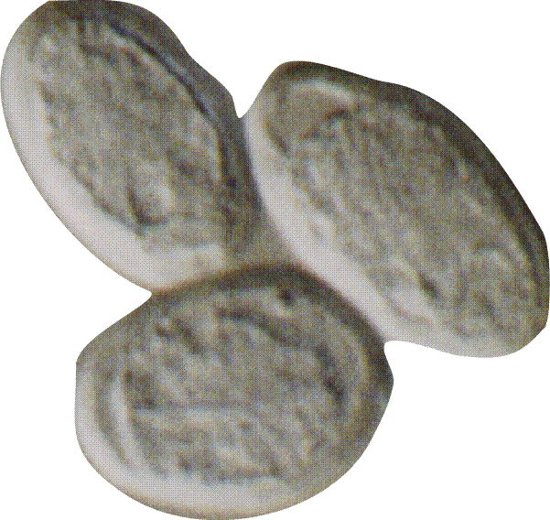
Example of DIC and Fluorescence
Giardia (DIC image)
(no fluorescence)
(photo taken from a 35 mm slide and scanned - cells were live when photographed)
(JPR lab)
Human cheek epithelial cells (from JPR!) stained with Hoechst 33342 - wet prep, 20 x objective, 3 x zoom (Bio-Rad 1024 MRC) (Image from JPR lab)

Slide 16
Fluorescence Microscope image of Hoechst stained cells (plus DIC)
Image collected with a 470T Optronics cooled camera (Image from JPR lab)

Slide 17
Measurement of DNA
G₀-G₁
G₂-M
S
# of Events
Fluorescence Intensity
Use for DNA content and cell viability
  33342 for viability
Less needed to stain for DNA content than for viability
  decrease nonspecific fluorescence
Low laser power decreases CVs
Notes:
Ratio of 33342 fluorescence
510-560 (green) vs. 390-440 (violet)
different for different subclasses of chicken thymocytes
shift of 33258 emission toward green as [dye] increased
fixed rat thymocytes
low dye/Protein ratio, Hi affinity binding with hi QE yield blue fluorescence
as increased [dye], lower affinity binding to secondary sites, emission shifts toward green, and DNA precipitates

Slide 18
PI - Cell Viability
How the assay works:
PI cannot normally cross the cell membrane
If the PI penetrates the cell membrane, it is assumed to be damaged
Cells that are brightly fluorescent with the PI are damaged or dead
Viable Cell Damaged Cell
PI
PI
PI
PI
PI
PI
PI
PI
PI
PI
PI
PI
PI
PI

Slide 19
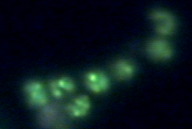
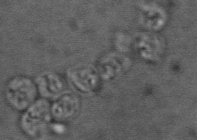
Crypto
4
Fluorescence Transmission
10
3
10
2
10
Flow cytometric scatter plot of gamma irradiated C. parvum oocysts. The oocysts region is clearly distinguished from ghosts and debris. Images on the right show Sytox green fluorescence and transmission images of these regions. Note ghosts do not take up Sytox green dye.
1
10
0
10
10
0
10
1
10
2
10
3
10
4
Green Fluorescence
Notes:
Crypto isolated from cow (purchased)
gamma irradiated 900 Krads (kills alm ost all)
Stained with Sytox Green (membrane impermeant) i.e. gamma irradiation damages oocyst wall to all dye to penetrate and stain DNA
Ghosts - don’t stain because trophozoites have left and there is no DNA to stain
Dead cells stain because of the damaged membrane from the gamma irradiation
Live cells will not stain either

Slide 20
Specific Organelle Probes
Probe Site Excitation Emission
BODIPY Golgi 505 511
NBD Golgi 488 525
DPH Lipid 350 420
TMA-DPH Lipid 350 420
Rhodamine 123 Mitochondria 488 525
DiO Lipid 488 500
diI-Cn-(5) Lipid 550 565
diO-Cn-(3) Lipid 488 500
BODIPY - borate-dipyrromethene complexes
NBD - nitrobenzoxadiazole
DPH - diphenylhexatriene
TMA - trimethylammonium

Slide 21
Organelle Function
Mitochondria Rhodamine 123
Endosomes Ceramides
Golgi BODIPY-Ceramide
Endoplasmic Reticulum DiOC₆(3) Carbocyanine

Slide 22
Calcium Related Applications
Probe Ratioing
  Calcium Flux (Indo-1)
  pH indicators (BCECF, SNARF)
Molecule-probe Excitation Emission
Calcium - Indo-1 351 nm 405, >460 nm
Calcium- Fluo-3 488 nm 525 nm
Calcium - Fura-2 363 nm >500 nm
Calcium - Calcium Green 488 nm 515 nm
Magnesium - Mag-Indo-1 351 nm 405, >460 nm
Phospholipase A- Acyl Pyrene 351 nm 405, >460 nm

Slide 23
Probes for Ions
INDO-1 E_{x}350 E_{m}405/480
QUIN-2 E_{x}350 E_{m}490
Fluo-3 E_{x}488 E_{m}525
Fura -2 E_{x}330/360 E_{m}510

Slide 24
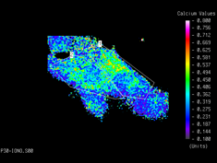
Ionic Flux Determinations
Calcium Indo-1
Intracellular pH BCECF
How the assay works:
Fluorescent probes such as Indo-1 are able to bind to calcium in a ratiometric manner
The emission wavelength decreases as the probe binds available calcium
0.8
0.7
0.6
0.5
0.4
Ratio: intensity of 460nm / 405nm signals
0.3
0.2
Stimulation
0.1
Time (seconds)
0
36
72
108
144
180
0
Time (Seconds)
0
50
100
150
200
Flow Cytometry Image Analysis

Slide 25
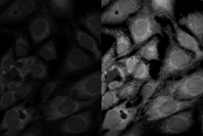

Calcium Flux
Flow Cytometry
Image Cytometry
0.8
0.7
0.6
0.5
Ratio: intensity of 460nm / 405nm signals
0.4
0.3
0.2
Stimulation
0.1
0
36
72
108
144
180
Time (seconds)
Time (Seconds)
0
0
50
100
150
200

Slide 26
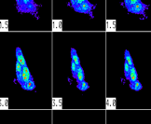


Oxidative-Related Reactions
Superoxide Hydroethidine
Hydrogen Peroxide Dichlorofluorescein
Glutathione levels Monobromobimane
Nitric Oxide Dichlorofluorescein
Nitric Oxide DAF-FM
Nitric Oxide Indicators: DAF-FM and DAF-FM Diacetate
D-23841 DAF-FM (4-amino-5-methylamino- 2',7'-difluorescein)
D-23842 DAF-FM diacetate (4-amino-5-methylamino- 2',7'-difluorofluorescein diacetate)
D-23844 DAF-FM diacetate (4-amino-5-methylamino- 2',7'-difluorofluorescein diacetate) *special packaging*
(Data from Invitrogen website)

Slide 27
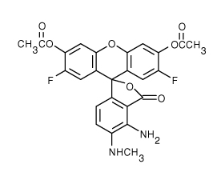
DAF-FM
DAF-FM Diacetate (4-Amino-5-Methylamino-2',7'-Difluorofluorescein Diacetate)
DAF-FM is not a reversible equilibrium sensor, limiting its ability to track rapid fluctuations of the target analyte (NO) in real time.
DAF-FM is a reagent that is used to detect and quantify low concentrations of nitric oxide (NO). It is essentially nonfluorescent until it reacts with NO to form a fluorescent benzotriazole. DAF-FM fluorescence can be detected by any instrument that can detect fluorescein, including flow cytometers, microscopes, fluorescent microplate readers and fluorometers.
Ex/Em of DAF-FM: ~495/515 nm
The fluorescence quantum yield of DAF-FM is ~0.005, but increases about 160-fold, to ~0.81, after reacting with NO
Data and Image from http://products.invitrogen.com/ivgn/product/D23842

Slide 28
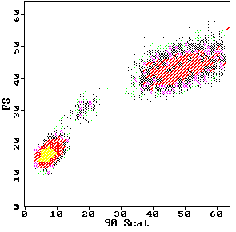
DCFH-DA DCFH DCF
2’,7’-dichlorofluorescin diacetate
O
O
CH3-C-O
O
O-C-CH3
Cl
Cl
2’,7’-dichlorofluorescin
H
COOH
HO
O
OH
Fluorescent
Cellular Esterases
Cl
Cl
H
COOH
2’,7’-dichlorofluorescein
Hydrolysis
HO
O
O
H₂O₂
Cl
Cl
Oxidation
H
COOH
DCFH-DA
Neutrophils
DCFH-DA
80
Monocytes
Control
PMA-stimulated PMN
DCFH
H O
60
2 2
counts
40
DCF
20
Lymphocytes
0
.1
1
10
100
1000
log FITC Fluorescence

Slide 29
Hydroethidine
HE Ethidium
O₂⁻
H₂N
NH₂
H₂N
NH₂
H
N
N
+
Br⁻
CH₂CH₃
CH₂CH₃
Phagocytic Vacuole
NADPH Oxidase
NADPH
O₂
HE
NADP
O₂⁻
SOD
H₂O₂
DCF
O₂⁻
DCF
H₂O₂
OH⁻
Example: Neutrophil Oxidative Burst

Slide 30
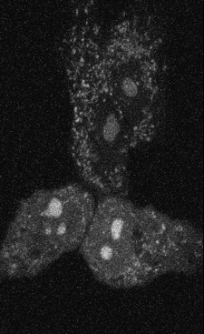
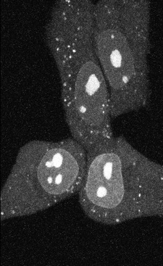
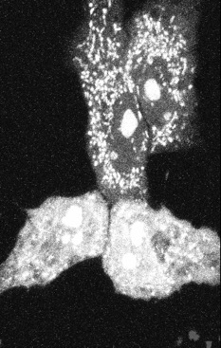
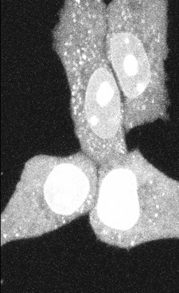
Macrovascular Endothelial Cells in Culture
0
Time (minutes)
60
hydroethidine

Slide 31
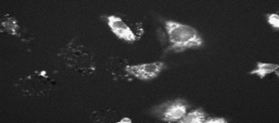
Hydrogen peroxide measurements with DCFH-DA
1
2
3
Change in fluorescence was measured using Bio-Rad software and the data exported to a spread sheet for analysis.
4
5
525 nm
Step 6B: Export data from measured
regions to Microsoft Excel
2000
1800
cell 1
Step 7B: Export data from Excel data
base to Delta Graph
1600
cell 2
% change (DCF fluorescence)
1400
1200
cell 3
1000
cell 4
800
cell 5
600
400
200
0
0
500
1000
1500
2000
2500
3000
Time in seconds

Slide 32
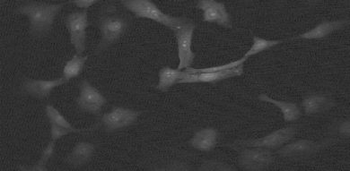
Superoxide measured with hydroethidine
cell 1
cell 3
Change in fluorescence was measured using Bio-Rad software and the data exported to a spread sheet for analysis.
cell 4
cell 2
cell 5
1800
1600
Export data from measured
regions to Microsoft Excel
1400
cell 1
1200
1000
cell 2
%change (DCF fluorescence)
Export data from Excel data
base to Delta Graph
800
cell 3
600
400
cell 4
200
cell 5
0
-200
200 400
600 800
1000 1200 1400 1600 1800
Time in seconds

Slide 33
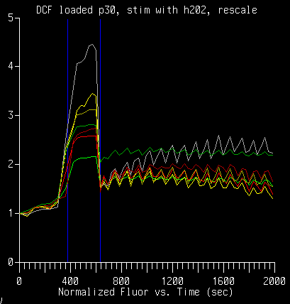
H₂O₂ stimulation and DCF & Ethidium loading in Rat
Pulmonary Artery Endothelial Cells
24 treatments - 5000 cells each
ENDO HBSS
Endo / L-arg + 200uM H2O2
ENDO HBSS TNFa
Endo / L-arg + 200uM H2O2
ENDO L-arg
Endo / L-arg + 200uM H2O2
Confocal System - Fluorescence Measurements
ENDO/ L-arg TNFa
Endo / L-arg TNFa + 200uM H2O2
ENDO/ D-arg
Endo / L-arg TNFa + 200uM H2O2
ENDO/ D-arg TNFa
Endo / L-arg TNFa + 200uM H2O2
Endo + 200uM H2O2
Endo / D-arg + 200uM H2O2
Endo + 200uM H2O2
Endo / D-arg + 200uM H2O2
Endo + 200uM H2O2
Endo / D-arg + 200uM H2O2
Endo / TNFa + 200uM H2O2
Endo / D-arg TNFa + 200uM H2O2
200
Endo / TNFa + 200uM H2O2
Endo / D-arg TNFa + 200uM H2O2
Endo / TNFa + 200uM H2O2
Endo / D-arg TNFa + 200uM H2O2
180
.
160
140
200uM
H₂O₂
added
120
Mean EB Fluorescence
100
DCF Fluorescence
80
60
40
200uM
H₂O₂
added
20
0
Time (seconds)
0
20
40
60
80
100
120
140
Time (minutes)

Slide 34
pH Sensitive Indicators
Probe Excitation Emission
SNARF-1 488 575
BCECF 488 525/620
440/488 525
[2’,7’-bis-(carboxyethyl)-5,6-carboxyfluorescein]

Slide 35
Exotic Applications of Confocal Microscopy
FRAP (Fluorescence Recovery After Photobleaching)
Release of “Caged” compounds
Lipid Peroxidation (Parinaric Acid) Difficult to do with confocal, but possible with 2P (excitation is 325 nm)
Membrane Fluidity (DPH)

Slide 36
“Caged” Photoactivatable Probes
Principle: Nitrophenyl blocking groups e.g. nitrophenyl ethyl ester undergoes photolysis upon exposure to UV light at 340-350 nm
Available Probes
Ca⁺⁺: Nitr-5
Ca⁺⁺ - buffering: Diazo-2
IP₃
cAMP
cGMP
ATP
ATP-γ-S

Slide 37
Release of “Caged” Compounds
UV Beam
Culture dish
Release of “Cage”

Slide 38
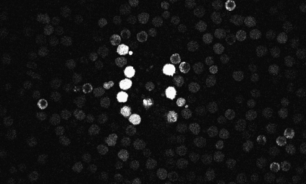
Release of Caged Compounds
UV excited
D
C
CONTROL STUDY
Control Region
250
Release of Caged Nitric Oxide in
250
Attached PMN
200
200
150
Fluorescence Emission at 515 nm
150
100
Fluorescence Emission at 515 nm
100
50
50
0
0
0
100
200
300
400
0
20
40
60
80
100
120
140
160
Time (seconds) CONTROL
Time (seconds) after UV FLASH

Slide 39
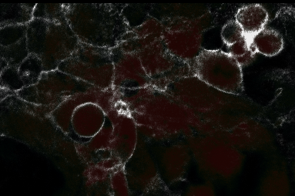
Membrane Polarization
Polarization/fluidity Diphenylhexatriene
How the assay works: The DPH partitions into liphophilic portions of the cell and is excited by a polarized UV light source. Polarized emissions are collected and changes can be observed kinetically as cells are activated.
An image showing DPH fluorescence in cultured endothelial cells.

Slide 40
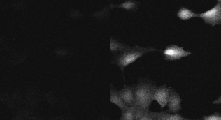
Calcium ratios with Indo-1
Changes in the fluorescence were measured using the Bio-Rad calcium ratioing software. The same region in each wave length was measured and the relative change in each region was recorded and exported to a spread sheet for analysis..
1
1
2
2
3
3
460 nm
405/35 nm
Export data from measured regions to Microsoft Excel
0.8
Ratio: intensity1 (460nm) / intensity2 (405/35nm)
0.7
cell 1
Export data from Excel data
base to Delta Graph
cell 2
0.6
cell 3
0.5
0.4
0.3
0.2
0.1
0
0
50
100
150
200

Slide 41
FRAP
%F
Intense laser Beam
Bleaches Fluorescence
Time
Recovery of fluorescence
Zero time
10 seconds
30 seconds

Slide 42
4D confocal microscopy
Time vs 3D sections
Used when evaluating kinetic changes in tissue or cells
Requires fast 3D sectioning
Difficult to evaluate

Slide 43
4D Imaging
Time
1 2 3 4 5
This could also be achieved using an X-Z scan on a point scanner or
Something like the Zeiss Live instrument which is very fast..

Slide 44
Imaging 3D ECM structures
Mainly collagen based materials
Usually 40-120 microns thick
Require both transmitted and fluorescent signals
Often require significant image processing to extract information

Slide 45

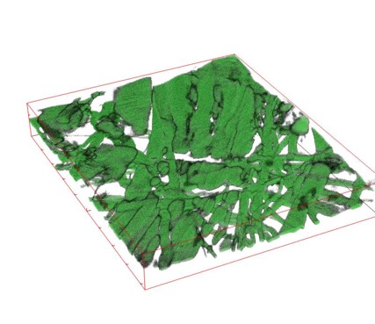
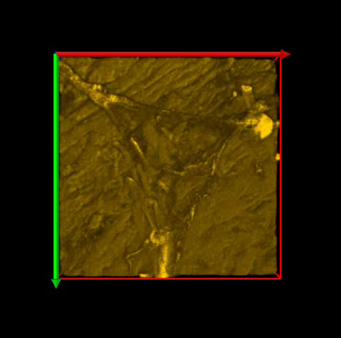

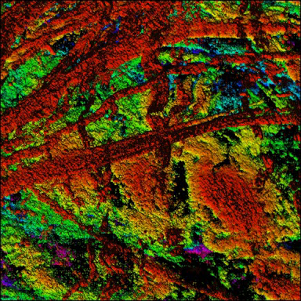
Work done with Prof Sherry Harbin

Slide 46
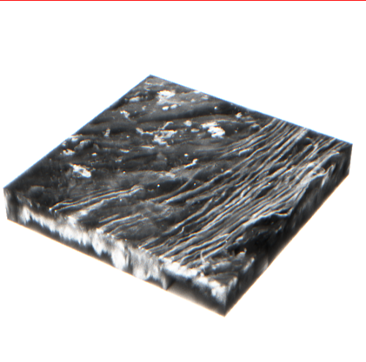
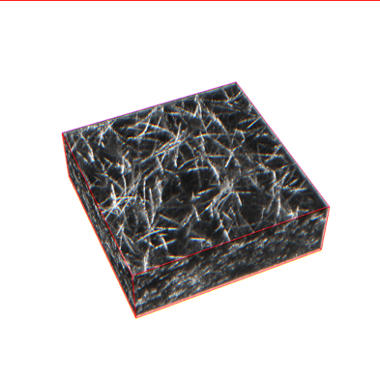
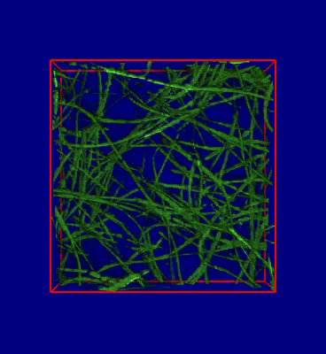
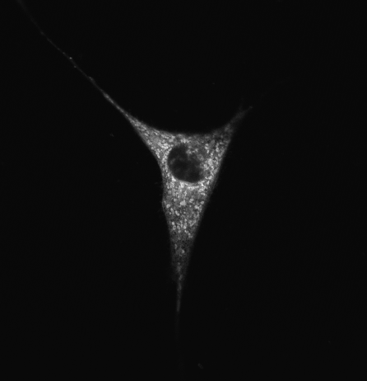
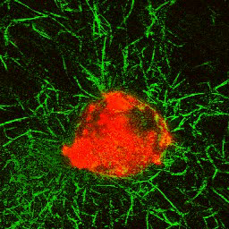
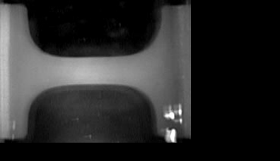
Work done with
Prof Sherry Harbin

Slide 47
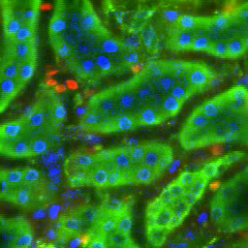
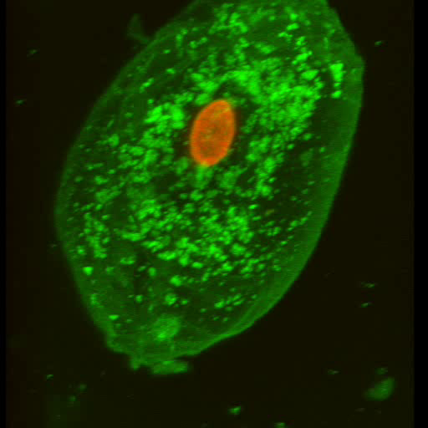
Other functional confocal studies
2P kidney imaging (Bio-rad 2100-PUCL)
Cheek epithelial cell (PUCL)
Confocal – epithelial cells (Biorad 1024)

Slide 48
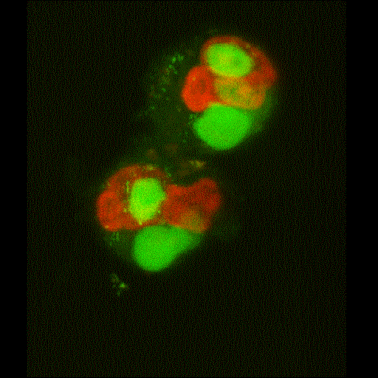
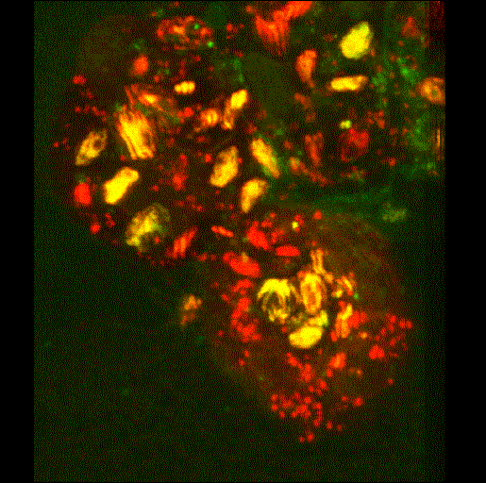
Cytometry 2003 Jan;51B(1):21-9.
Bassoe-C-F, Nianyu Li, Kathy Ragheb, Gretchen Lawler, Jennie Sturgis, J. Paul Robinson, Cytometric Investigations of Phagosomes, Mitochondria and Acidic Granules in Human neutrophils. Cytometry 2003 Jan;51B(1):21-9.
(PUCL)

Slide 49
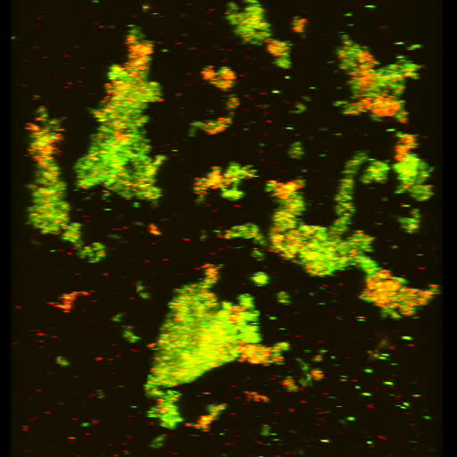
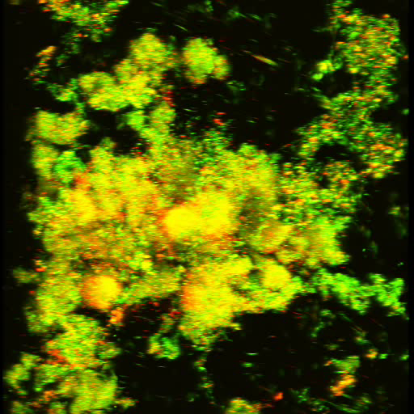
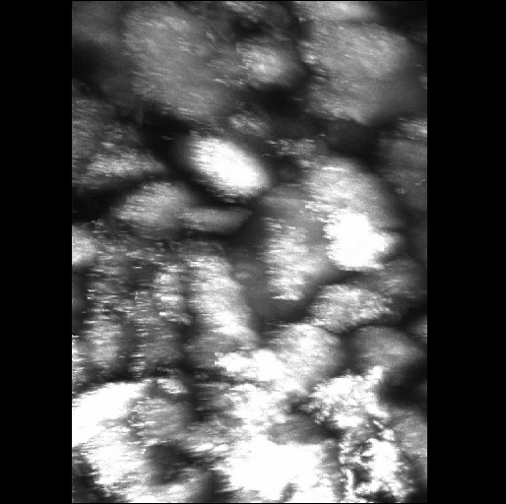
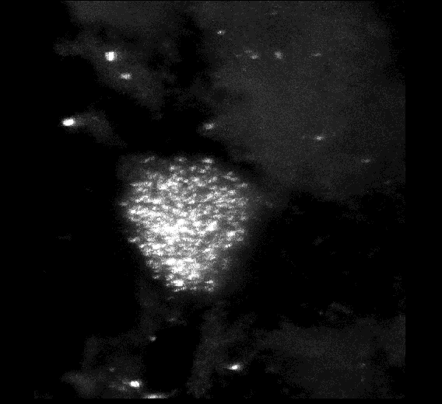

Live bacterial analysis
(Robinson lab)
(PUCL)

Slide 50




Pinecone spores
(PUCL)
Cork
(PUCL)

Slide 51

Thick Tissue - Bone and Cartilage
Very difficult to image thick specimens
Can use live specimens if appropriately stained
Special preparation techniques

Slide 52
Commercial Systems
https://www.keyence.com/landing/lpc/live-cell-imaging.jsp?aw=google-kaenBZ214101bb&k_clickid=de902564-219e-44df-84bb-34e61c4c3f2f&gclid=CjwKCAiA_P3jBRAqEiwAZyWWaHDcrVmGFRe5TpJ03CidMHMGyg6AwzU0G50Sblv5G07kRshzGoVHaBoC9poQAvD_BwE

Slide 53
CellInsight CX7 High-Content Screening (HCS) Platform
https://www.thermofisher.com/us/en/home/life-science/cell-analysis/cellular-imaging/high-content-screening/high-content-screening-instruments.html

Slide 55
Digital microscopy with automated brightfield and fluorescence imaging
https://www.moleculardevices.com

Slide 56
http://zeiss-campus.magnet.fsu.edu/articles/livecellimaging/imagingsystems.html

Slide 57
https://www.leica-microsystems.com

Slide 58
https://www.nexcelom.com

Slide 59
https://www.olympus-lifescience.com/en/solutions/live-cell-imaging/

Slide 60
https://www.bruker.com/products/fluorescence-microscopes/fm-campaigns/live-cell-imaging.html

Slide 61
http://www.mvi-inc.com/products/electronic-imaging/nikon-imaging-systems/

Slide 62
Lecture Summary
Live cell applications are relatively common using confocal microscopy
Correct use of fluorescent probes necessary
Temperature and atmosphere control may be required
Thick specimens often require advanced image processing
Exotic applications are potentially useful
A limited window of time is available to image live cells before cells deteriorate

