Slide 1
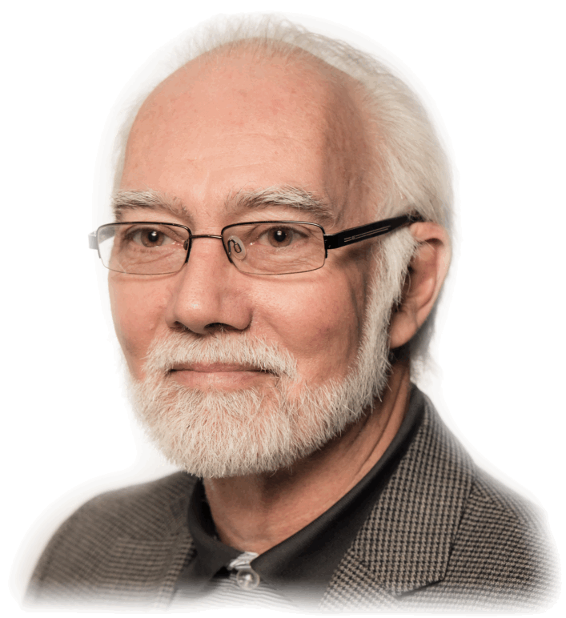
BMS 631 – LECTURE 8 Flow Cytometry: Theory
Flow Systems and Hydrodynamics
J. Paul Robinson
Distinguished Professor of Cytometry
Professor of Biomedical Engineering
Purdue University
Notice: The materials in this presentation are copyrighted materials. If you want to use any of these slides, you may do so if you credit each slide with the author’s name. You may not copy these to Course Hero or any similar repository.
Purdue University
Office: 494 0757
email: robinson@flowcyt.cyto.purdue.edu
WEB http://www.cyto.purdue.edu
Notes:
Material is taken from the course text: Howard M. Shapiro, Practical Flow Cytometry, 3nd edition (1994), Wiley-Liss, New York.
RFM =Slides taken from Dr. Robert Murphy
MLM – Material taken from Melamed, et al, Flow Cytometry & Sorting, Wiley-Liss, 2nd Ed.
    (Shapiro, 133-143 - 3rd; ed 4th Ed 166-177)

Slide 2
Basics of Flow Cytometry
Fluidics:
cells in suspension
flow in single-file through
an illuminated volume where they
scatter light and emit fluorescence
that is collected, filtered and
converted to digital values
that are stored on a computer
Optics
Electronics
Original Slide from Bob Murphy, CMU

Slide 3
Flow Cytometry:
The use of focused light (lasers) to interrogate cells delivered by a hydrodynamically focused fluidics system.
Sheath
fluid
Flow Chamber
Fluorescence
signals
Focused laser
beam

Slide 4
Hydrodynamic Focusing
Sheath
fluid
Note: Not to scale!!
signals
Fluorescence
Most analyzers are operated with the flow chamber facing upwards – this allows bubbles to rise and leave the system instead of creating potential turbulence.
Flow Chamber
beam
Focused laser
Cell input tube

Slide 5
Fluidics - Differential Pressure System
From C. Göttlinger, B. Mechtold, and A. Radbruch

Slide 6
Fluidics Systems
Positive Pressure Systems
  Based upon differential pressure
  between sample and sheath fluid.
  Require balanced positive pressure
  via either air or nitrogen
  Flow rate varies between 2-10 ms⁻¹
Pressure
Flow Chamber
+ + +
+ +
Positive Displacement Syringe Systems
  1-2 ms⁻¹ flow rate
  Fixed volume (50 μl or 100 μl)
  Absolute number calculations possible
  Usually fully enclosed flow chambers
3-way valve
Flow
Chamber
Syringe
100 μl
Sample
Waste
Sample loop
Peristaltic Pump based Systems
  variable flow rate
  “semi” fixed volume (time based)
  Absolute number calculations possible
Flow Chamber
Peristaltic
Pump

Slide 7
Technical Components
Fluidics
+ive Pressure Systems
      EPICS C (Coulter)
      EPICS 5 & 7, Elite series
      Altra, next Gen
      FacStar (B-D), Aria
      FacsVantage (B-D)
      MoFlo
      Brucker
      Profile (Coulter)
      XL (Coulter), FC500, Gallios
      FACScan, Canto (B-D)
      FACS Caliber
      XDP
      Beckman Astrios Sorter
      BD Sorters
      Sony Sorters
      Syringe Drive Systems
      Bryte HS
      Cytotron Absolute
      FACSAria
      FACSJaz
      Influx
      Attune Cytometer
      Harald Steen’s instrument
      Some early Partec systems
Peristaltic Pump Driven
Cytoflex instruments
Cytek spectral Instruments
Accuri Instruments
Bigfoot Sorter
Wolf G2 Cell Sorter
Pizzo Chip based systems
MacsQuant Tito sorter
Other Microchip based sorters
Sony Sorters

Slide 8
Hydrodynamics and Fluid Systems
Cells are always in suspension
The usual fluid for cells is saline
The sheath fluid can be saline or water
The sheath must be saline for sorting
Samples are driven either by syringes or by pressure systems

Slide 9
Fluidics
Need to have cells in suspension flow in single file through an illuminated volume
In most instruments, accomplished by injecting sample into a sheath fluid as it passes through a small (50-300 µm) orifice

Slide 10
Fluidics
When conditions are right, sample fluid flows in a central core that does not mix with the sheath fluid
This is termed Laminar flow

Slide 11
Fluidics - Laminar Flow
Whether flow will be laminar can be determined from the Reynolds number
When R_{e} < 2300, flow is always laminar
When R_{e} > 2300, flow can be turbulent

Slide 12
Fluidics
The introduction of a large volume into a small volume in such a way that it becomes “focused” along an axis is called Hydrodynamic Focusing

Slide 13
Fluidics
The figure shows the mapping between the flow lines outside and inside of a narrow tube as fluid undergoes laminar flow (from left to right). The fluid passing through cross section A outside the tube is focused to cross section a inside.
From V. Kachel, H. Fellner-Feldegg & E. Menke - MLM Chapt. 3

Slide 14
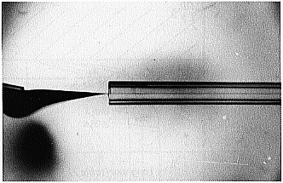
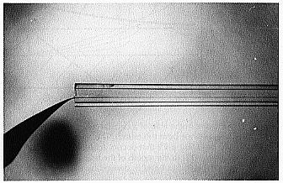
Fluidics – how was this determined?
Notice how the ink is focused into a tight stream as it is drawn into the tube under laminar flow conditions.
Notice also how the position of the inner ink stream is influenced by the position of the ink source.
V. Kachel, H. Fellner-Feldegg & E. Menke - MLM Chapt. 3

Slide 15
Fluidics
How do we accomplish sample injection and regulate sample flow rate?
  Differential pressure
  Volumetric injection
  Peristaltic pumps

Slide 16
Fluidics - Differential Pressure System
Use air (or other gas) to pressurize sample and sheath containers
Use pressure regulators to control pressure on each container separately
(Note: you may see early disclosures in papers about using nitrogen for gas. The reason was that nitrogen is dry – and house air often allowed water to get into the system. However, now days this is not an issue.)

Slide 17
Fluidics - Differential Pressure System
Sheath pressure will set the sheath volume flow rate (assuming sample flow is negligible)
Difference in pressure between sample and sheath will control sample volume flow rate
Control is not absolute - changes in friction cause changes in sample volume flow rate

Slide 18
Fluidics - Volumetric Injection System
Use air (or other gas) pressure to set sheath volume flow rate
Use syringe pump (motor connected to piston of syringe) to inject sample
Sample volume flow rate can be changed by changing speed of motor
Control is absolute (under normal conditions)

Slide 19
Fluidics – Peristaltic Pump Systems
Pump pushes samples through tubing
It is possible to control the system so that a specific volume is delivered, but it is not as accurate as syringe pumps
Sample volume flow rate can be changed by changing speed of motor on the pump
One has to be careful that you do not get pulsation in peristaltic pumps and every company has some secret trick for reducing this

Slide 20
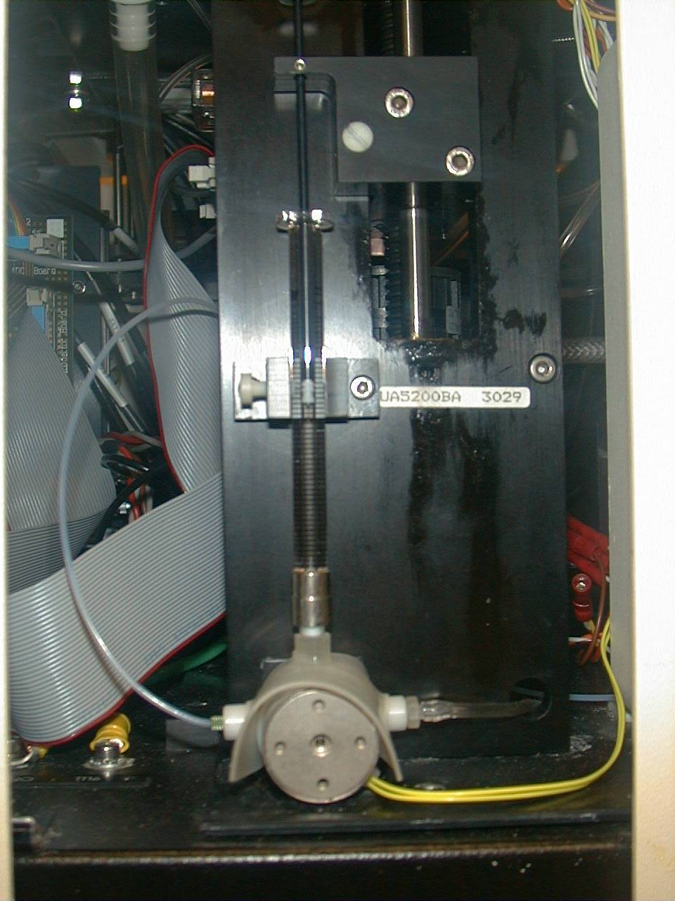
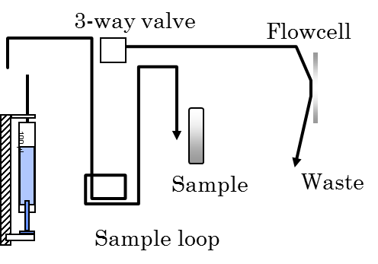
Syringe systems
Bryte HS
Cytometer
Syringe
3 way valve
Photo: J. P Robinson

Slide 21
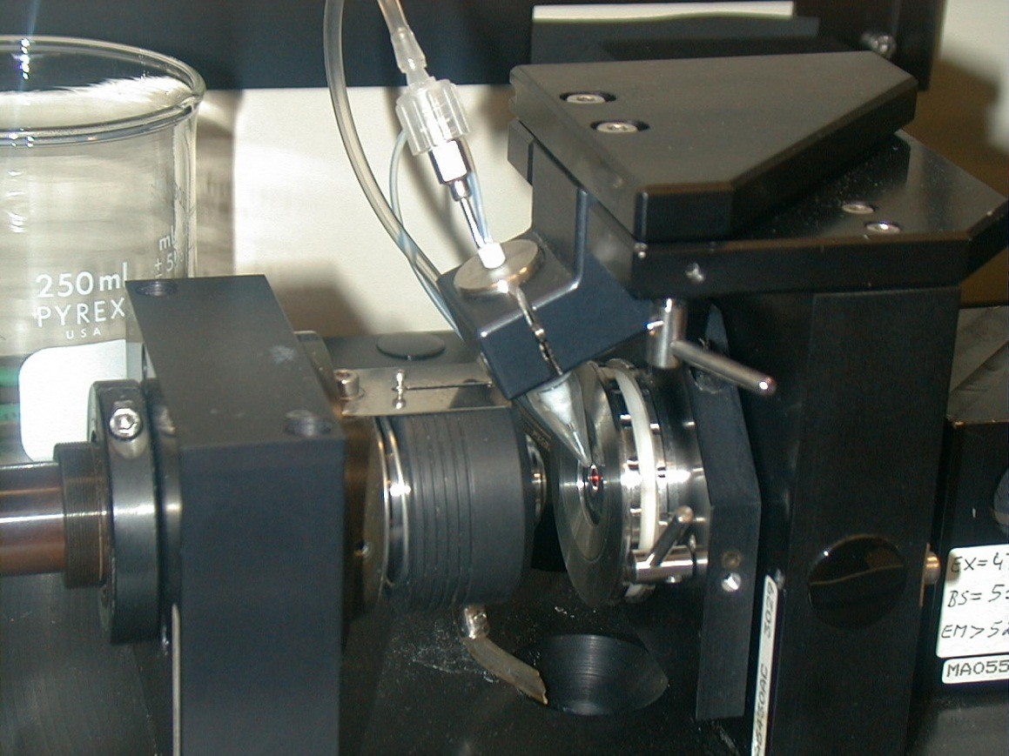
Fluidics - Volumetric Injection System
Photo: J. P Robinson
Source:H.B. Steen - MLM Chapt. 2

Slide 22
Hydrodynamic Systems – Steen system
Signals
Flow
Chamber
Coverslip
Waste
Flow
Chamber
Coverslip
Signals
Microscope
Objective
Microscope
Objective
Waste

Slide 23
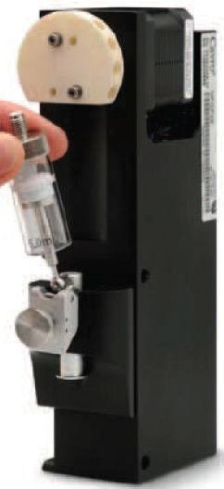
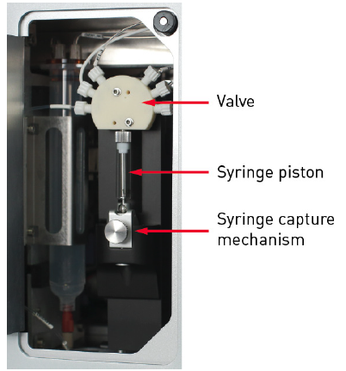
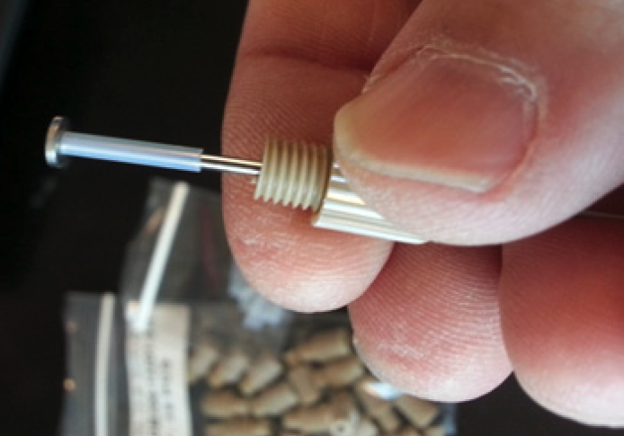
Attune Syringe System
Images from Thermo Website

Slide 24
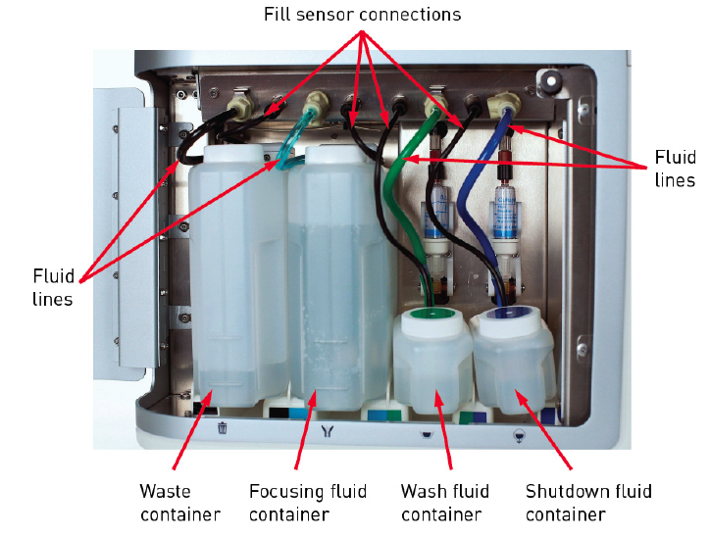
Attune Fluidics System

Slide 25
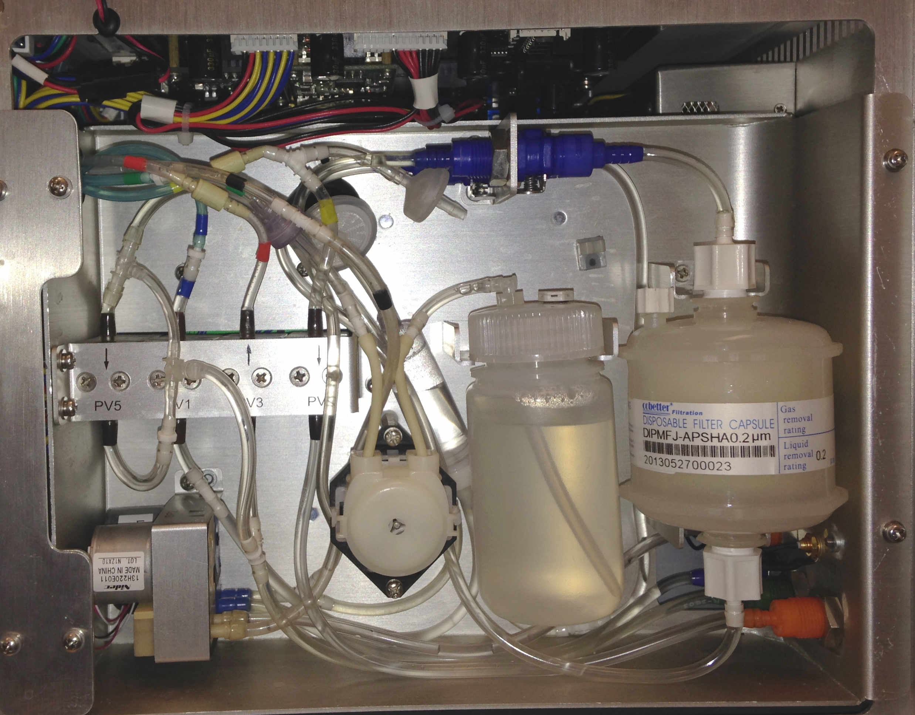
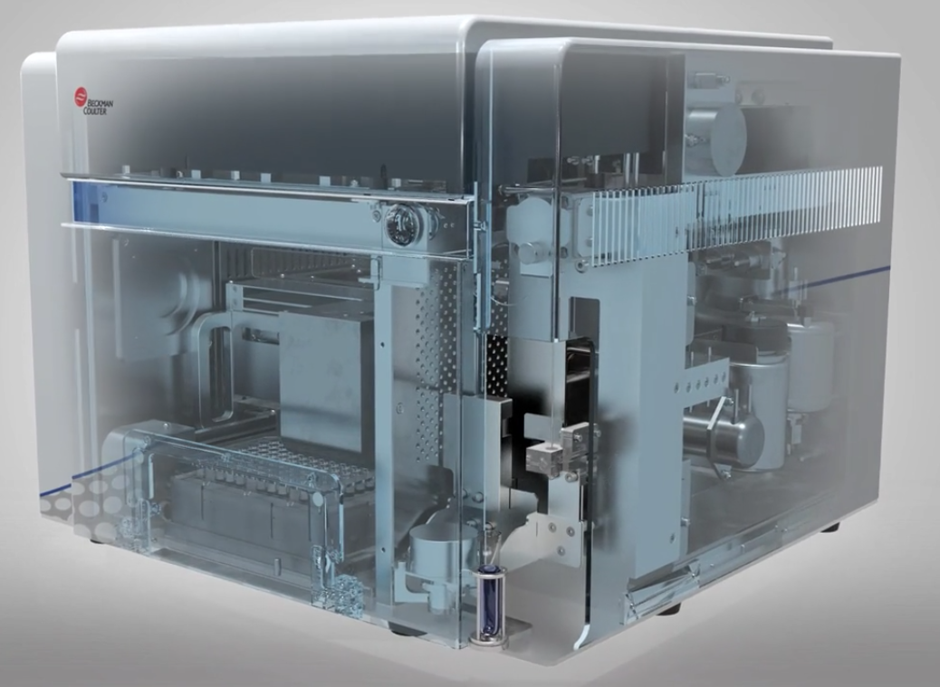
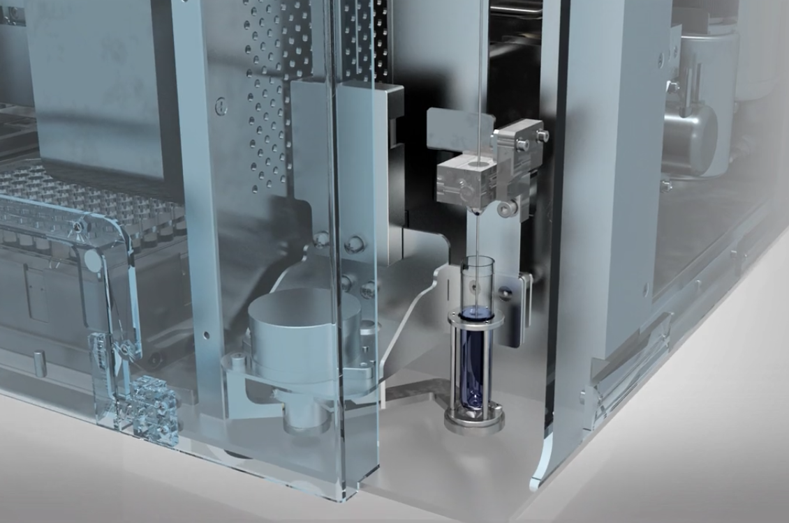
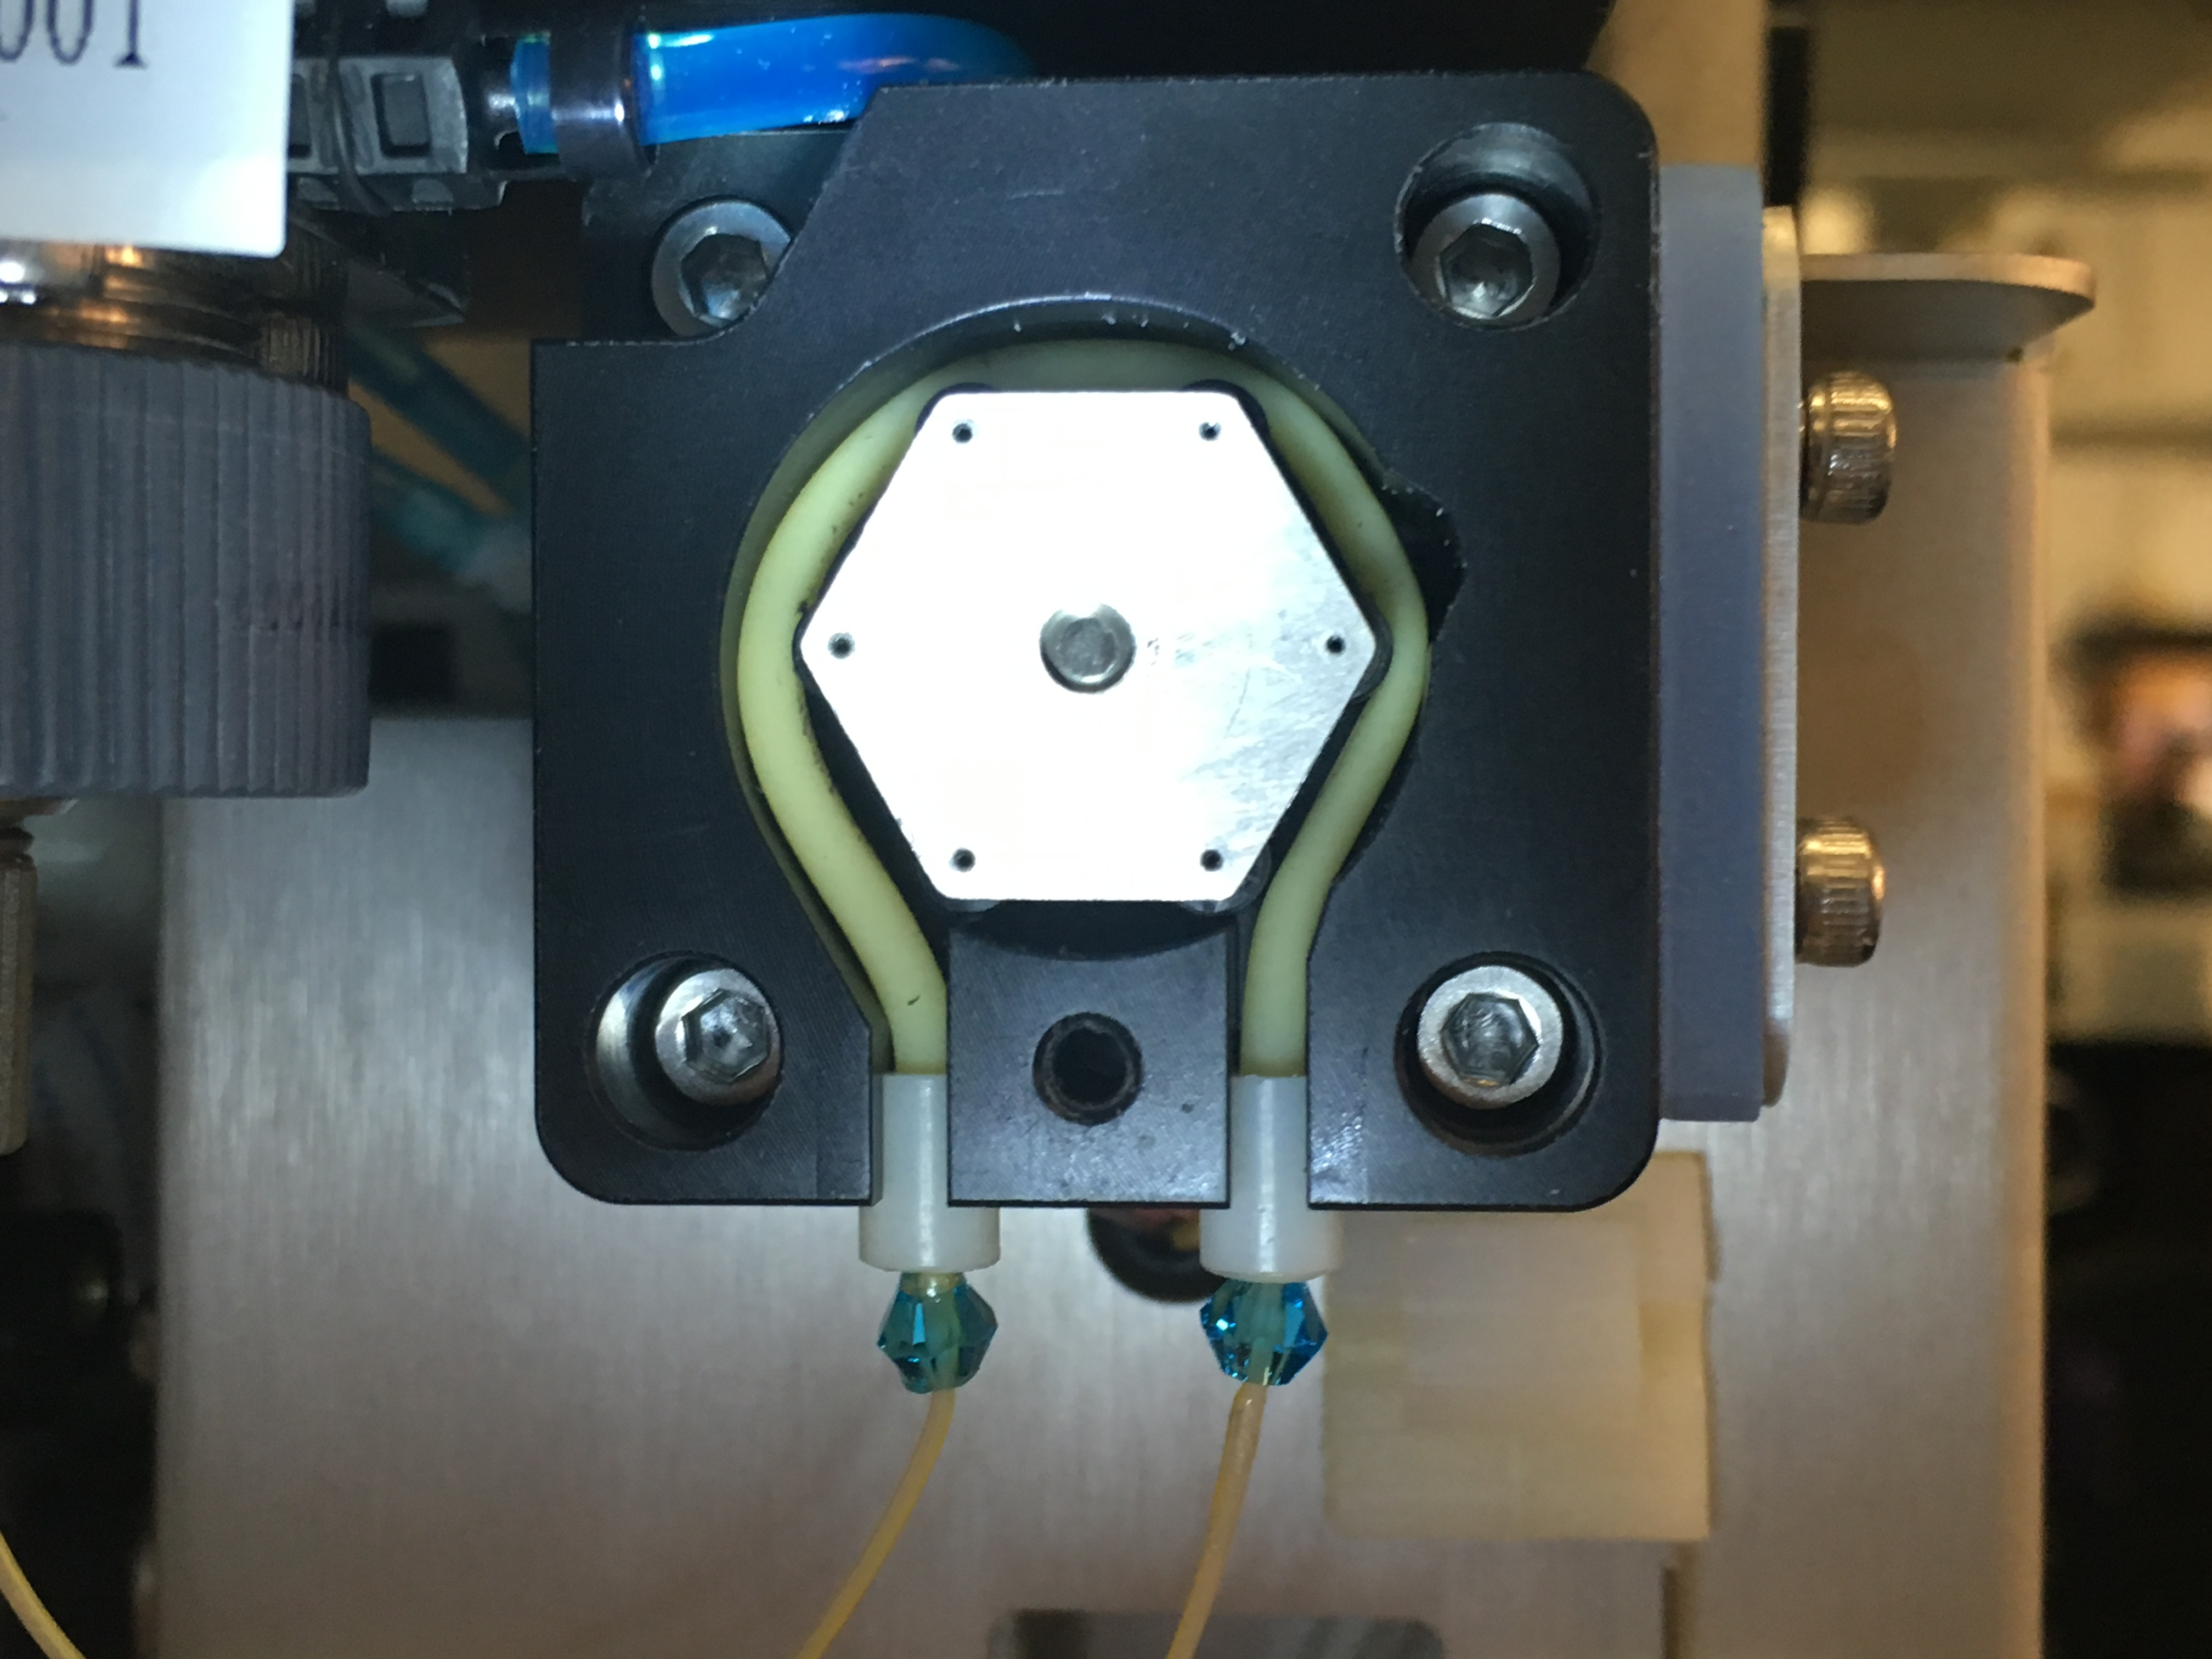
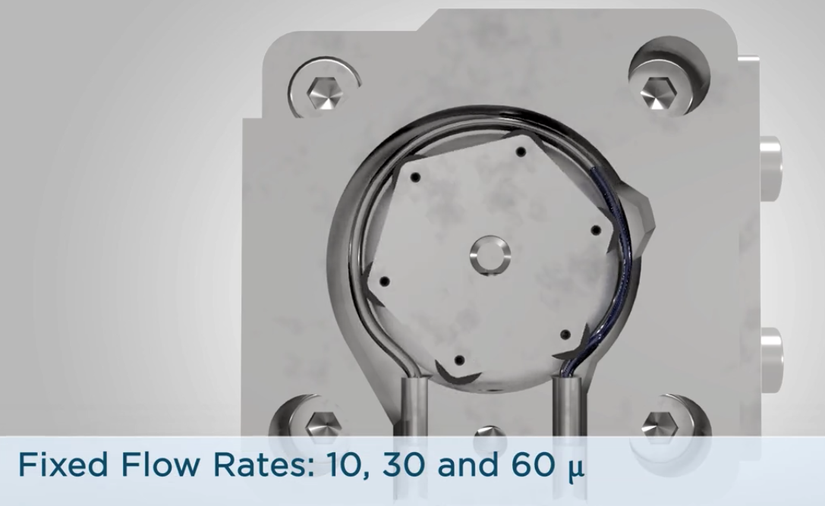
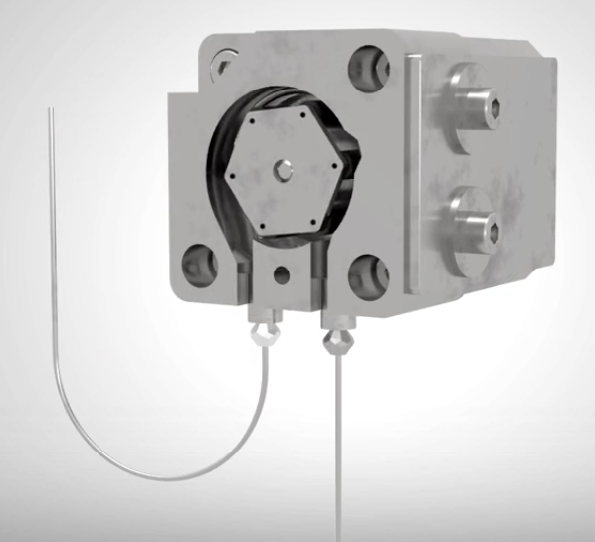
CytoFlex Fluidics System

Slide 26
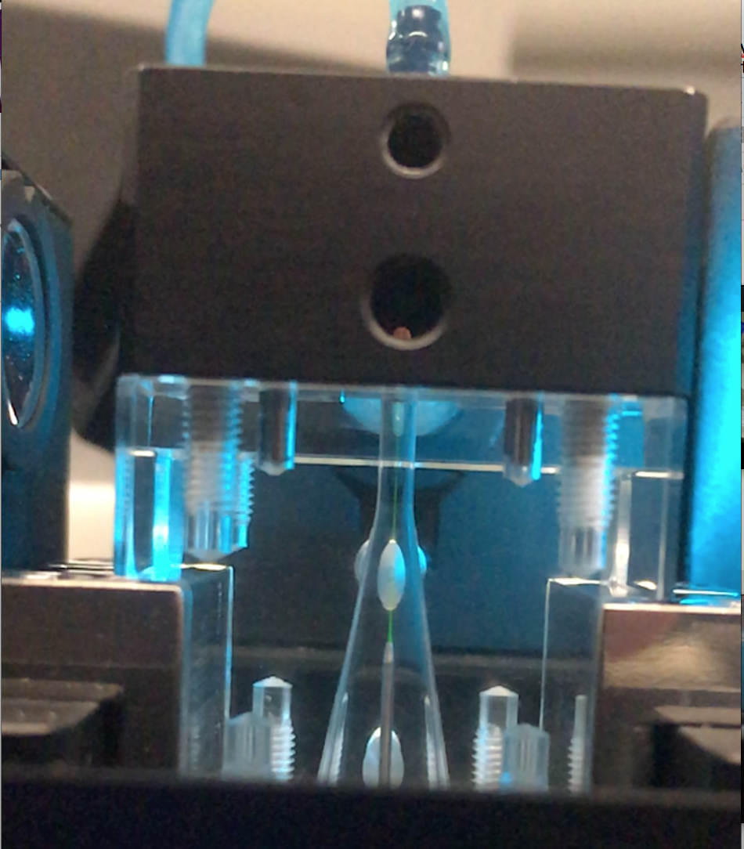
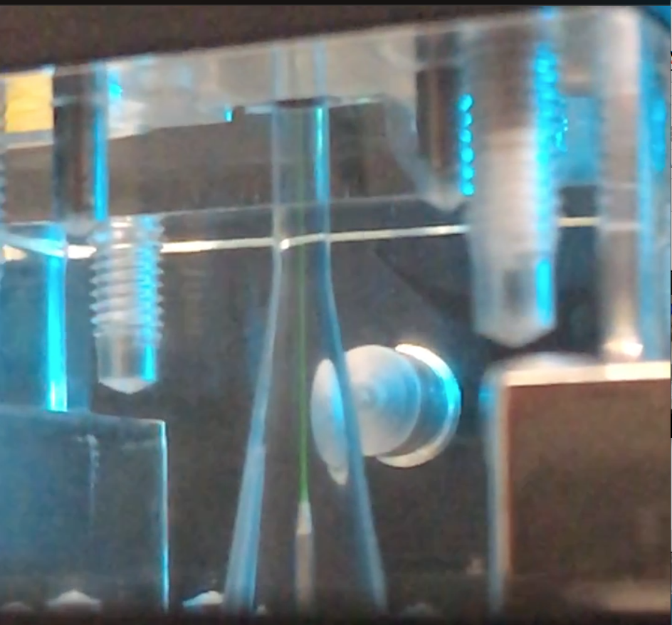
CytoFlex Flow Chamber

Slide 27
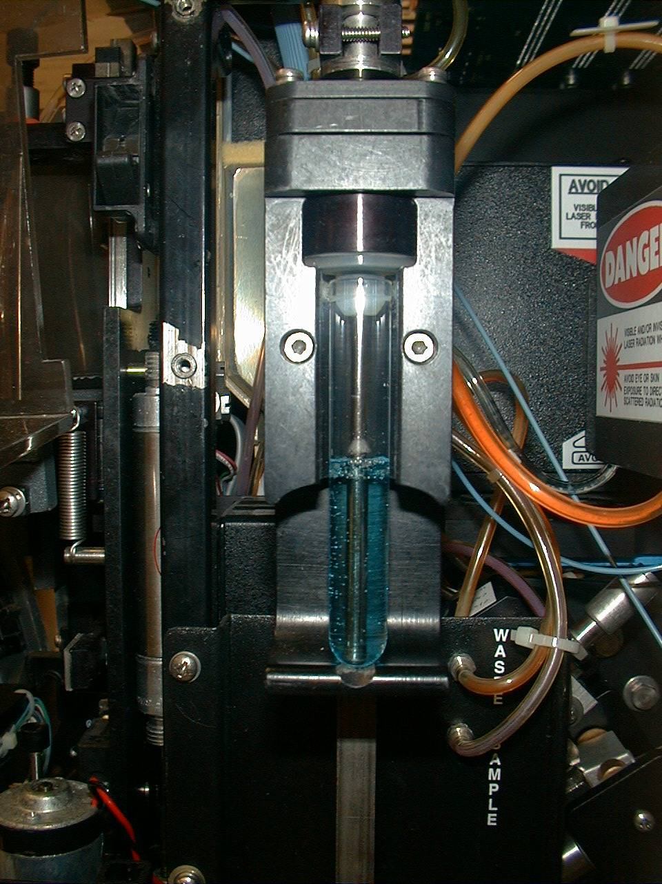
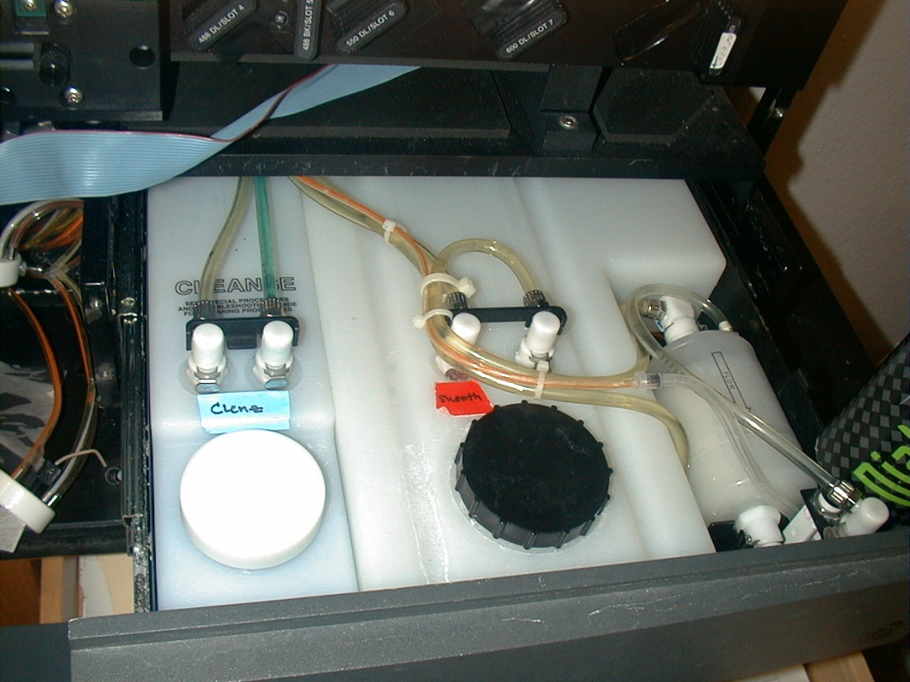
Coulter XL
Sheath and waste system
Sample tube
Photo: J. P Robinson

Slide 28
Fluidics - Particle Orientation and Deformation
As cells (or other particles) are hydrodynamically focused, they experience different shear stresses on different points on their surfaces (an in different locations in the stream)
These cause cells to orient with their long axis (if any) along the axis of flow
The shear stresses can also cause cells to deform (e.g., become more cigar-shaped)

Slide 29
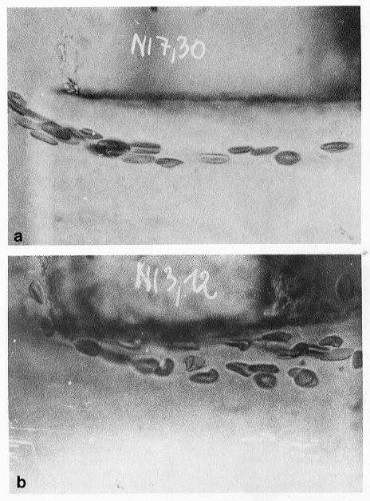
Fluidics - Particle Orientation and Deformation
“a: Native human erythrocytes near the margin of the core stream of a short tube (orifice). The cells are uniformly oriented and elongated by the hydrodynamic forces of the inlet flow.
b: In the turbulent flow near the tube wall, the cells are deformed and disoriented in a very individual way. v>3 m/s.”
Image fromV. Kachel, et al. – Melamed Chapt. 3

Slide 30
Fluidics - Flow Chambers
(Often referred to as “flow cell”)
The flow chamber
  defines the axis and dimensions of sheath and sample flow
  defines the point of optimal hydrodynamic focusing
  can also serve as the interrogation point (the illumination volume)

Slide 31
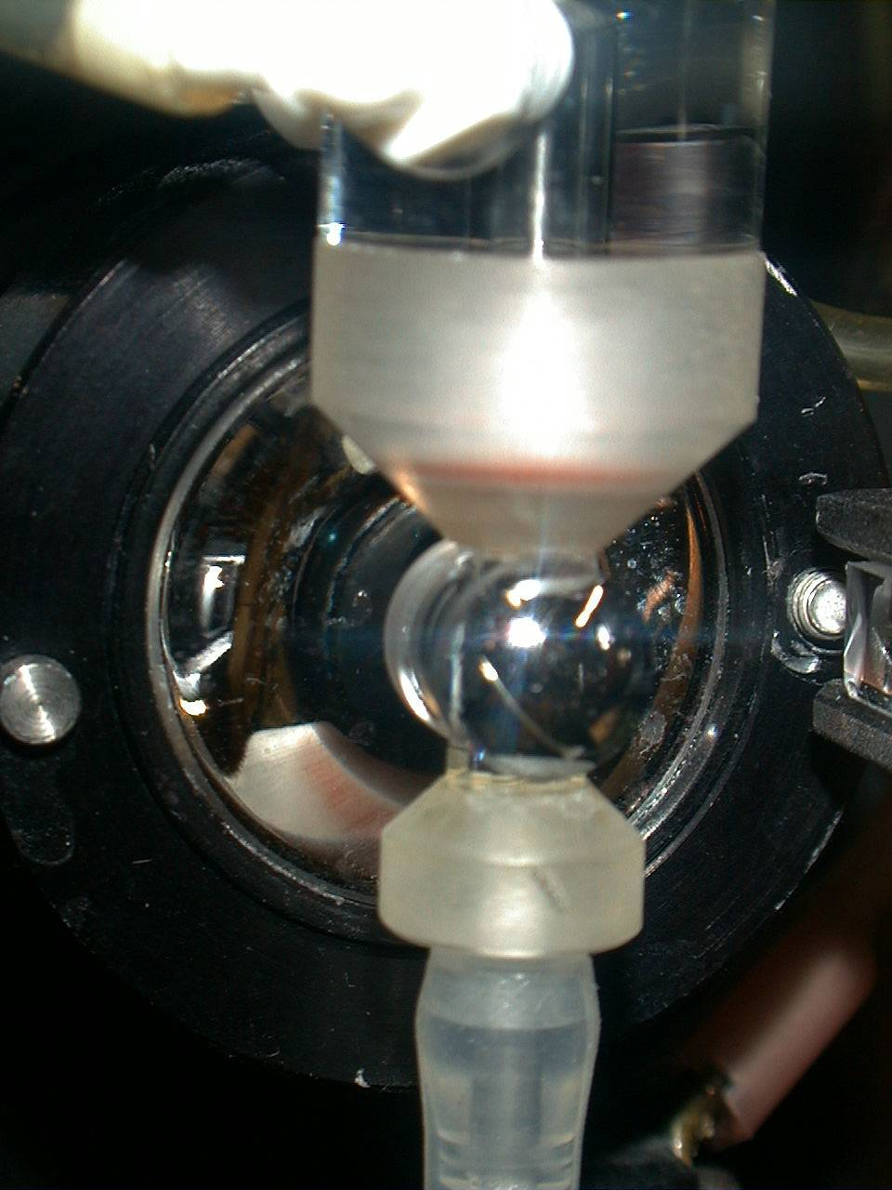
Closed flow chambers – e.g. Beckman Elite, Altra, XL
Forward Scatter detector
Laser direction
Fluorescence
signals
Photo: J. P Robinson

Slide 32
Fluidics - Flow Chambers
Four basic flow chamber types
  Jet-in-air
    best for sorting, inferior optical properties
  Flow-through cuvette
    excellent optical properties, can be used for sorting
  Closed cross flow
    best optical properties, can’t sort
  Open flow across surface
    best optical properties, can’t sort

Slide 33
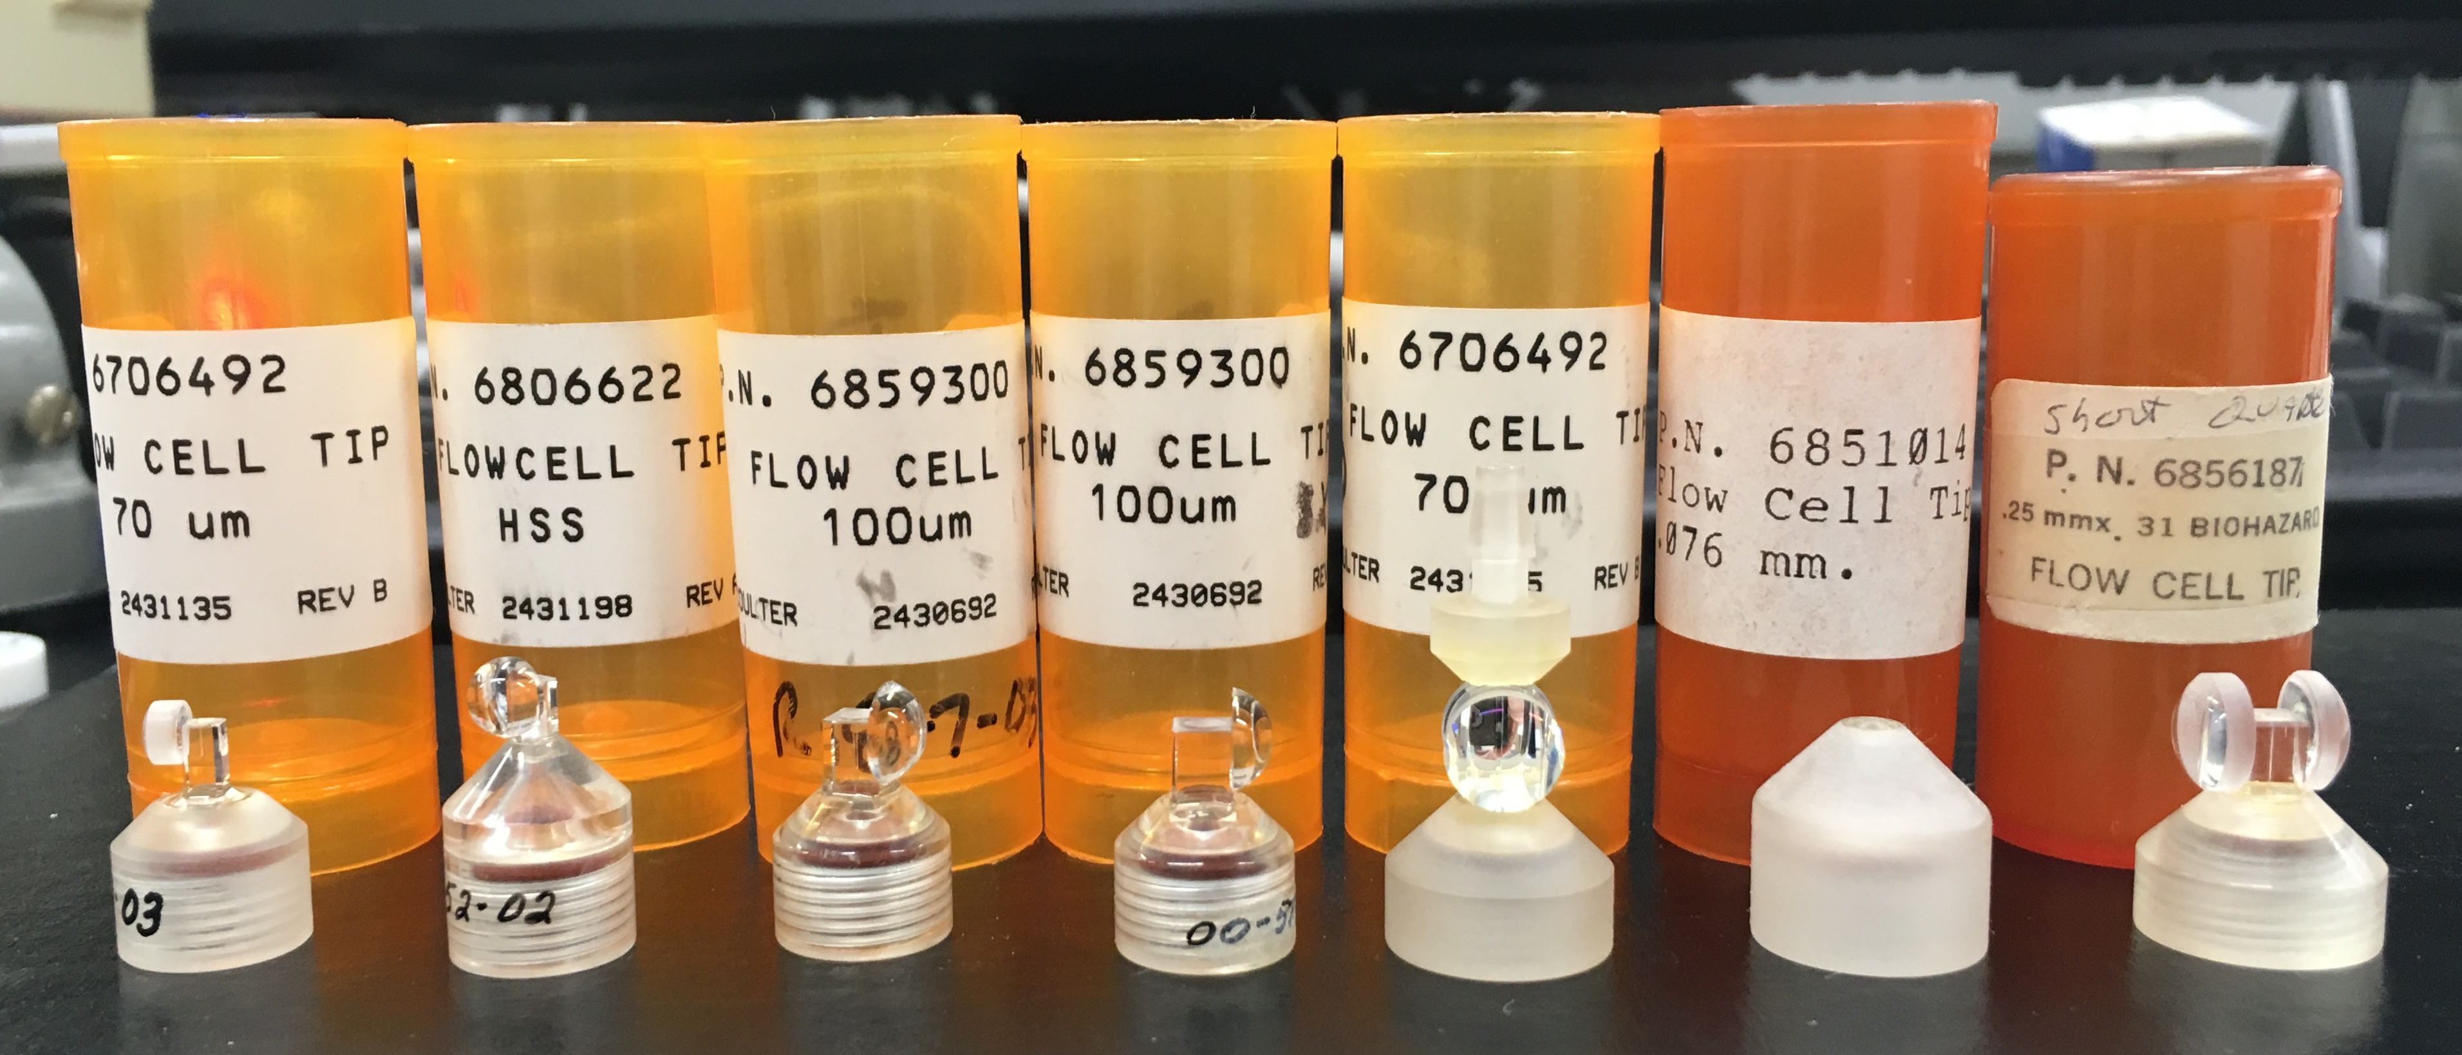
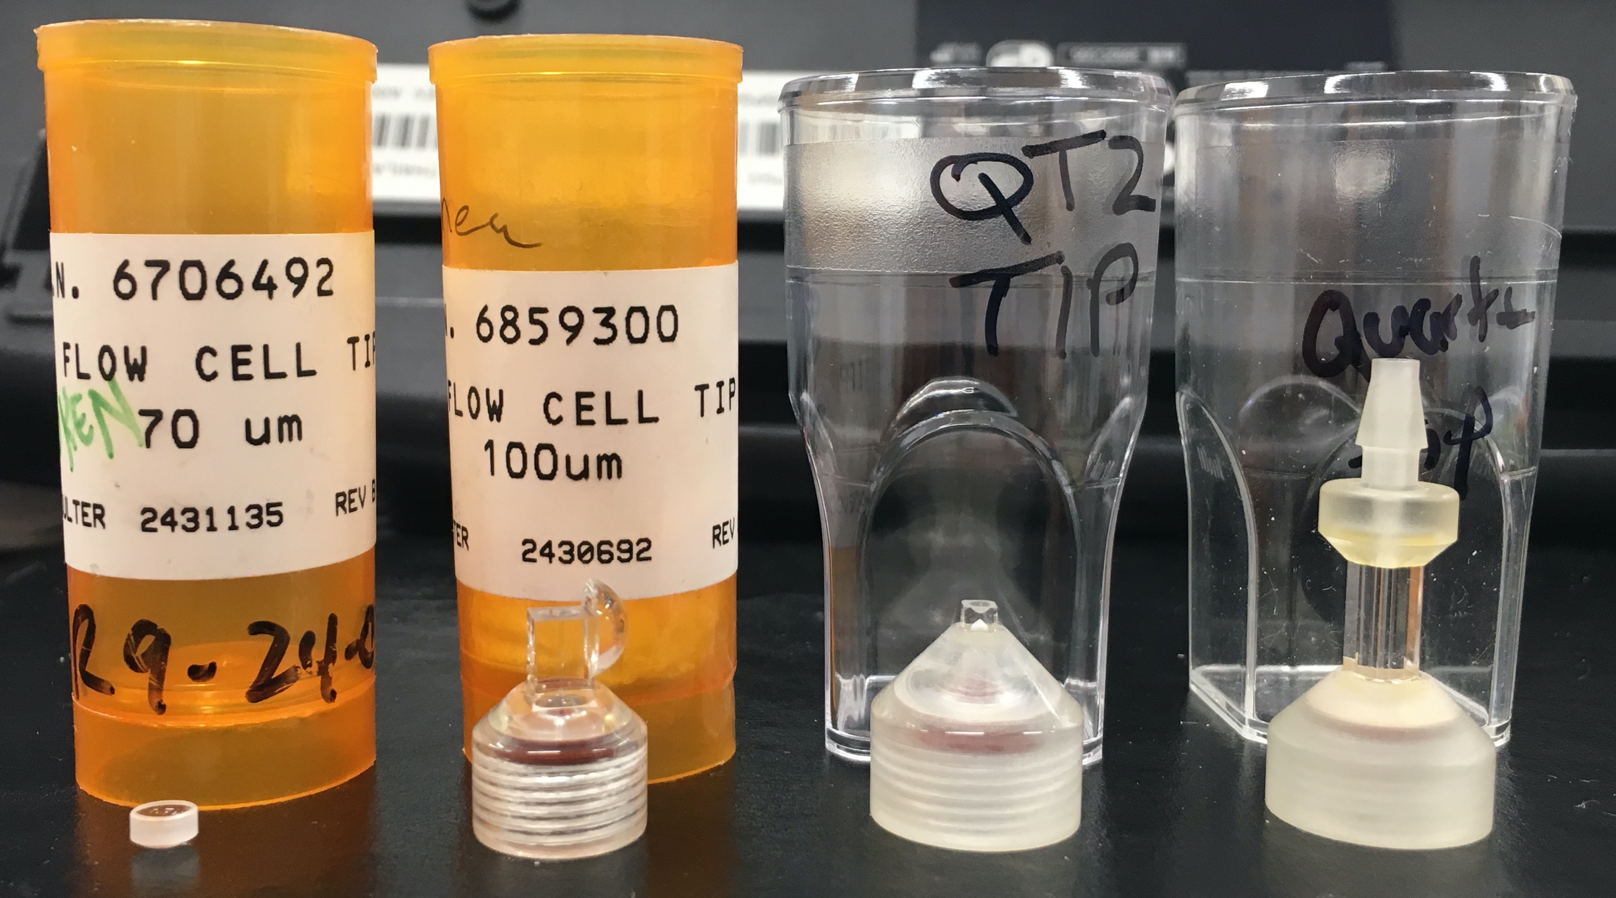
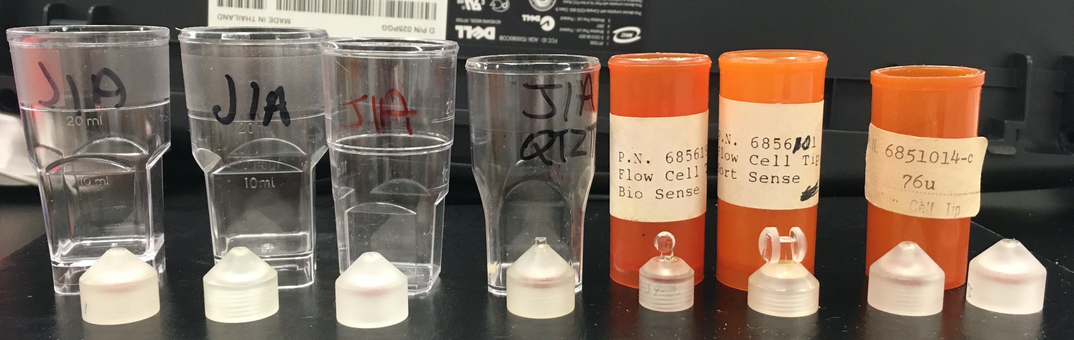
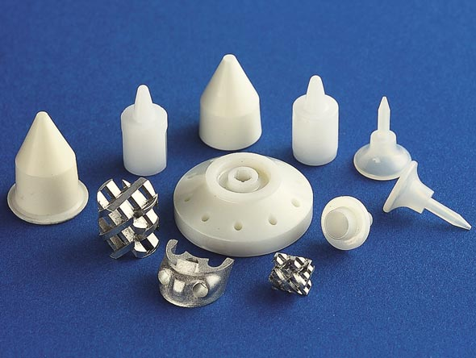
Example of manufacturer of chambers
Beckman Coulter Flow Chambers and nozzles
http://www.smallprecisiontools.com/products-and-solutions/fine-ceramics-solutions/introduction-in-ceramic-technologies/?oid=697&lang=en

Slide 34
Fluidics - Flow Chambers
Flow through cuvette (sense in quartz)
H.B. Steen - MLM Chapt. 2

Slide 35
Fluidics - Flow Chambers
Closed cross flow chamber
H.B. Steen - MLM Chapt. 2

Slide 36
Hydrodynamic Systems
Sample in
Sheath
Piezoelectric
crystal oscillator
Example Sorter
Flow Chamber
Sheath in
Fluorescence
Sensors
Laser beam
Scatter Sensor
Sheath
Core

Slide 37
Hydrodynamically focused fluidics

Slide 38
Hydrodynamically focused fluidics
Signal
Increase sample pressure:
Widen Core
Increase turbulence

Slide 39
Hydrodynamic Systems
Injector
Tip
Flow Chamber
Sheath
fluid
Fluorescence
signals
Focused laser
beam

Slide 40
Hydrodynamic Systems – Increase Sample Pressure
Injector
Tip
Flow Chamber
Sheath
fluid
Fluorescence
signals
Focused laser
beam
Increase sample pressure:
Widen Core
Increase turbulence

Slide 41
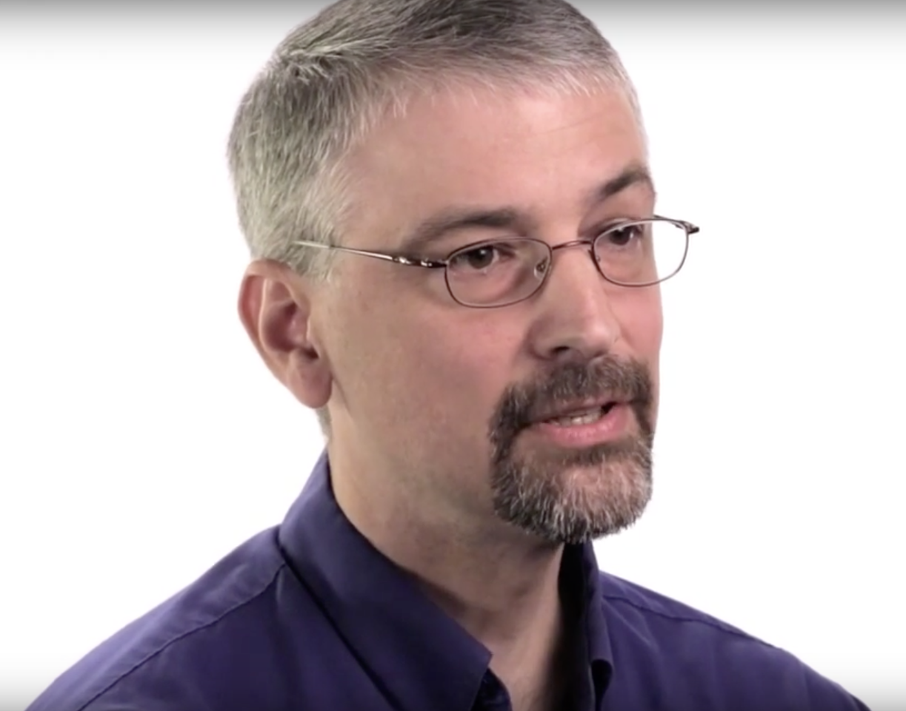
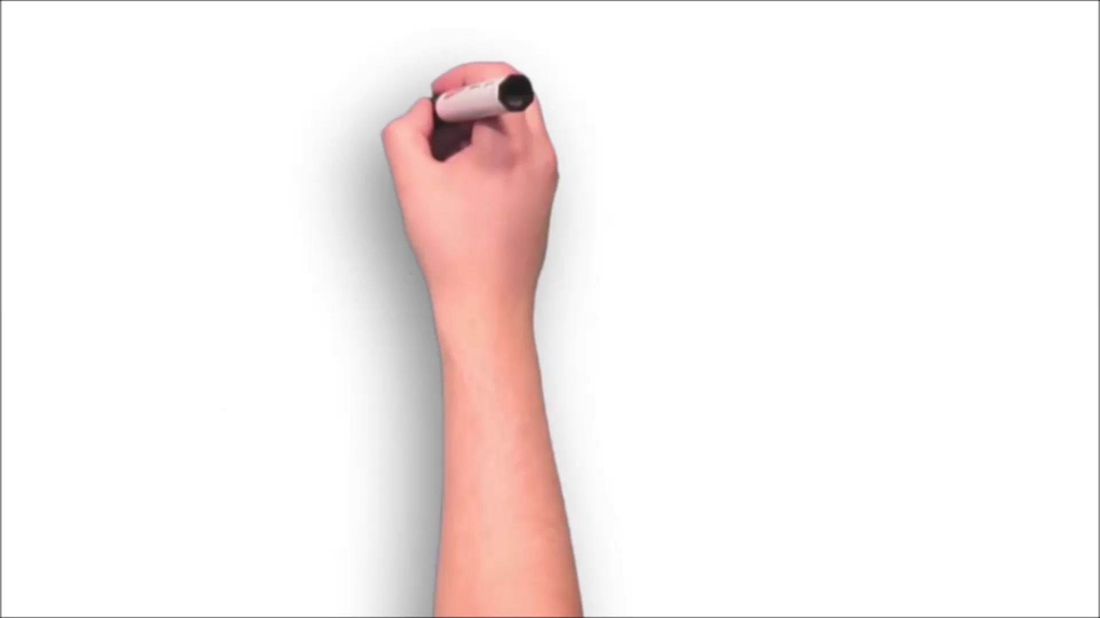
Acoustic Systems – e.g. Attune
Video provided by ThermoFisher
Notes:
Here is how his discovery can be explained -

Slide 42
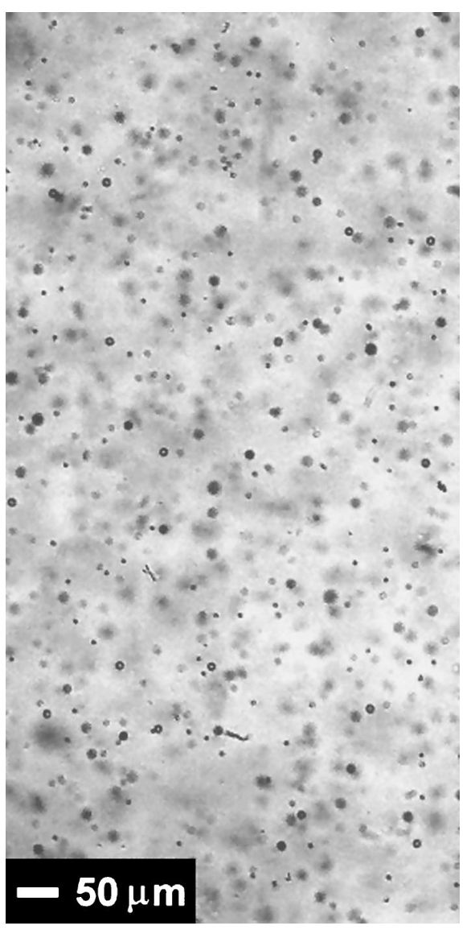
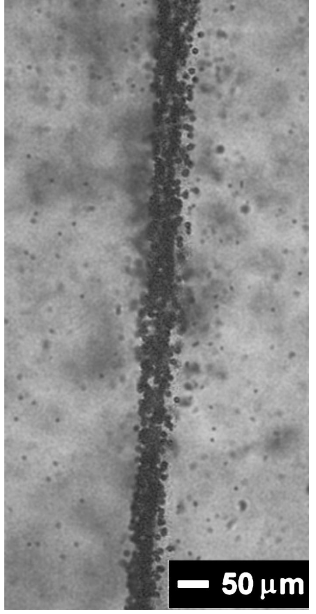
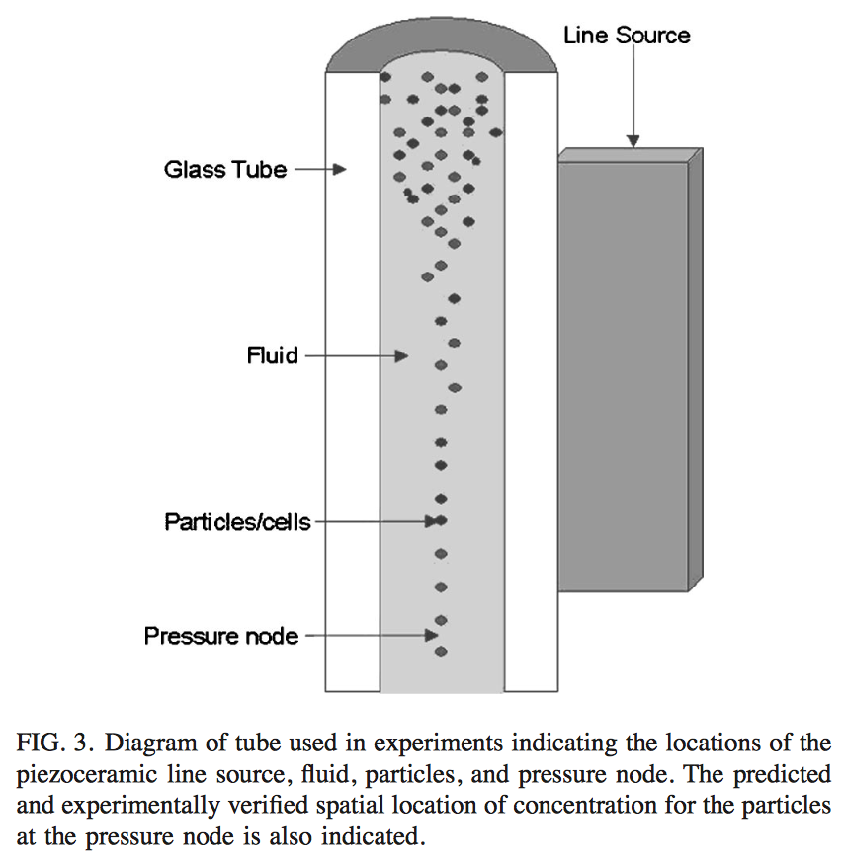
Notes:
And here is the evidence he saw down the micscope

Slide 43
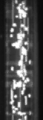
Acoustic Focusing with Hydrodynamic Assistance
Best of both worlds!!!
Hydrodynamic Sample Core
High sample flow rate > 100 µL/min
Focused laser
Acoustic Focusing Followed by Hydrodynamic Focusing
Acoustic Assisted Hydrodynamic Focusing
Narrow Data distribution
Sheath
Count
Intensity
Notes:
A new technology licensed from Los Alamos National Laboratory, called acoustic focusing, aids to extend the sample flow rate of traditional hydrodynamic focusing systems. Acoustic focusing uses ultrasonic radiation pressure to transport the particles to the center of the sample stream as shown in the video. The focused sample stream is then injected into the sheath stream for a further hydrodynamic focusing step.
Due to the combination of acoustic focusing and hydrodynamic focusing, this method of sample alignment is termed Acoustic Assisted Hydrodynamic Focusing.
With this new design, the system can run high sheath rates and low sample flow rates to produce the small core sizes similar to standard flow cytometers that customers have used for decades. But it can also run samples at very high sample flow rates and large cores sizes. This is possible since the acoustic focusing transports the particles to a tight stream within the sample injector before entering the sheath stream . . . And thus centers them in the central region of the core stream. This results in uniform illumination of the particles.
The user now has the ability to run high sample rates and retain narrow histogram distributions as well as standard hydrodynamic focusing modes.

Slide 44
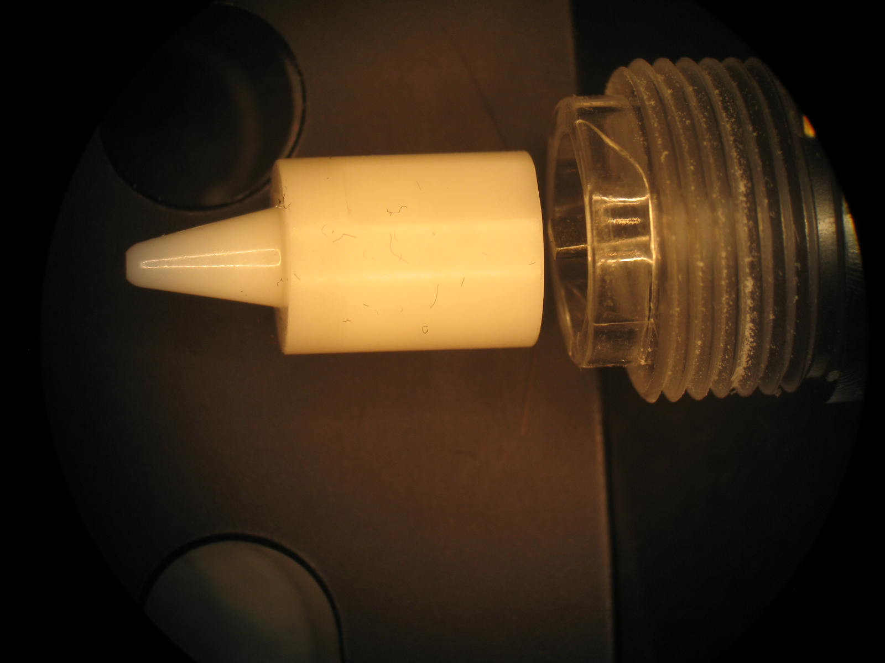
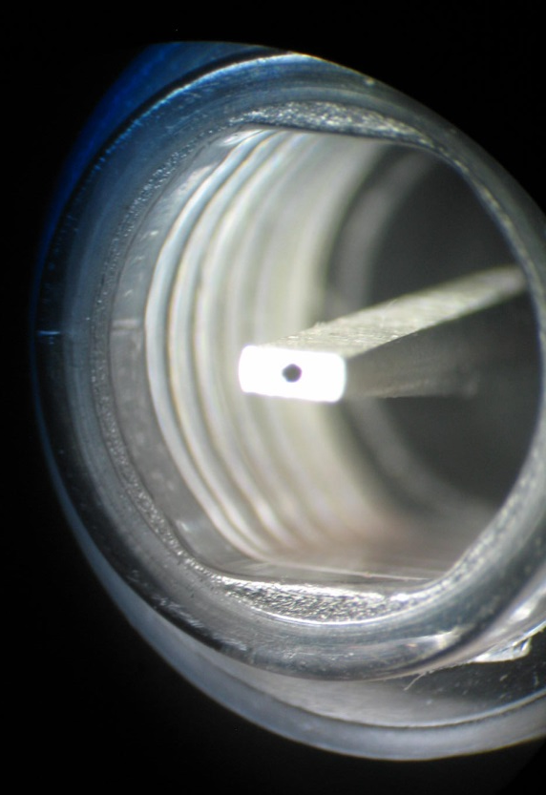
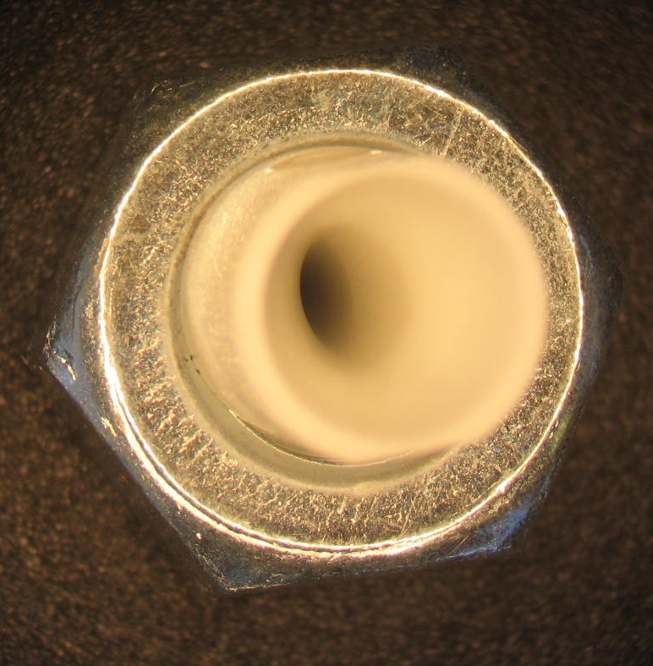
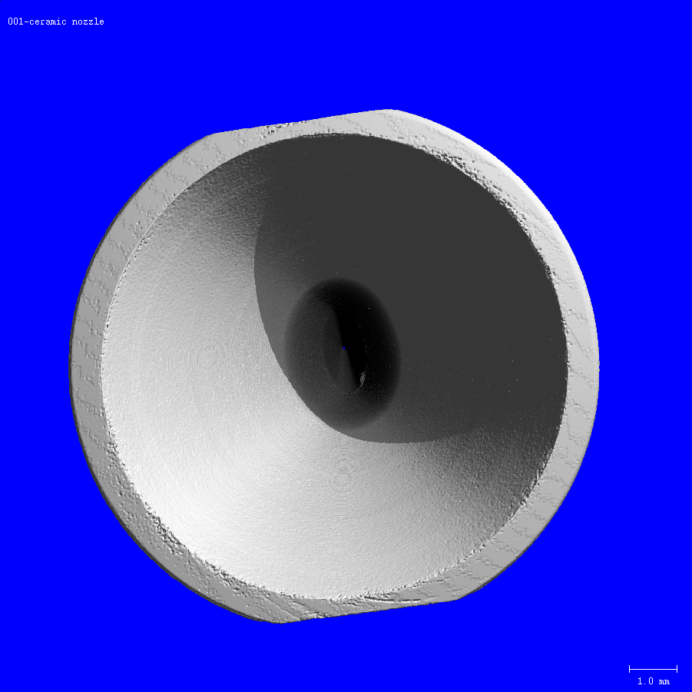
Inside a Flow Chamber and Nozzle
Disassembled System
Injection
tube
http://www.smallprecisiontools.com/products-and-solutions/fine-ceramics-solutions/introduction-in-ceramic-technologies/?oid=697&lang=en

Slide 45

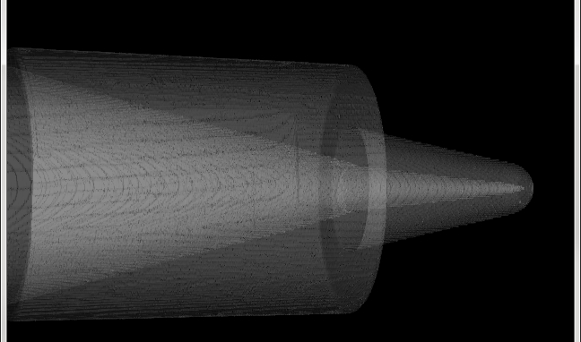
Inside a nozzle
Neck down
Region
Orifice is here
maybe 50-200 μm
Nozzle
Solid Nozzle

Slide 46
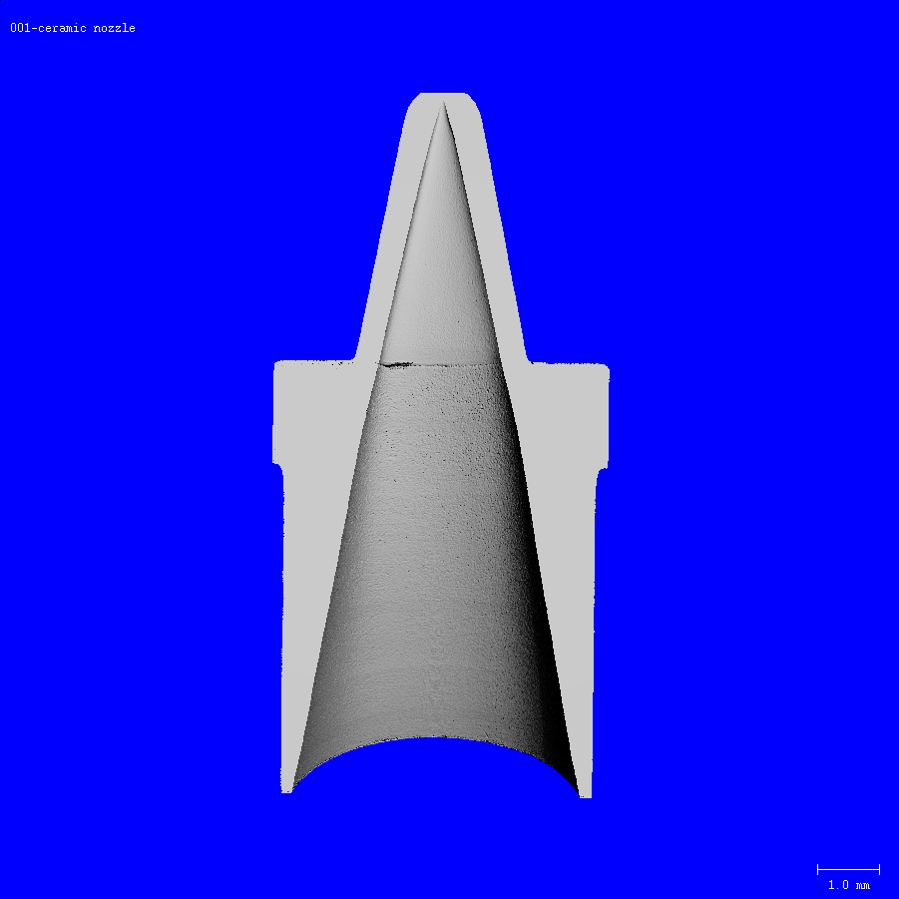

Slide 47
Inside a Sorting Nozzle
50 microns

Slide 48
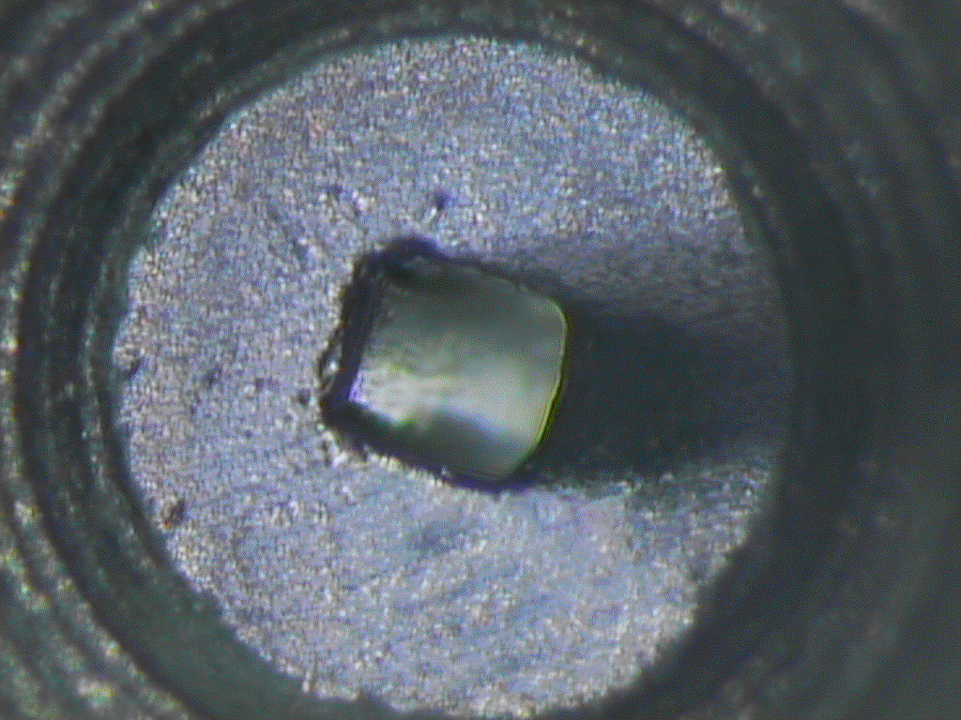
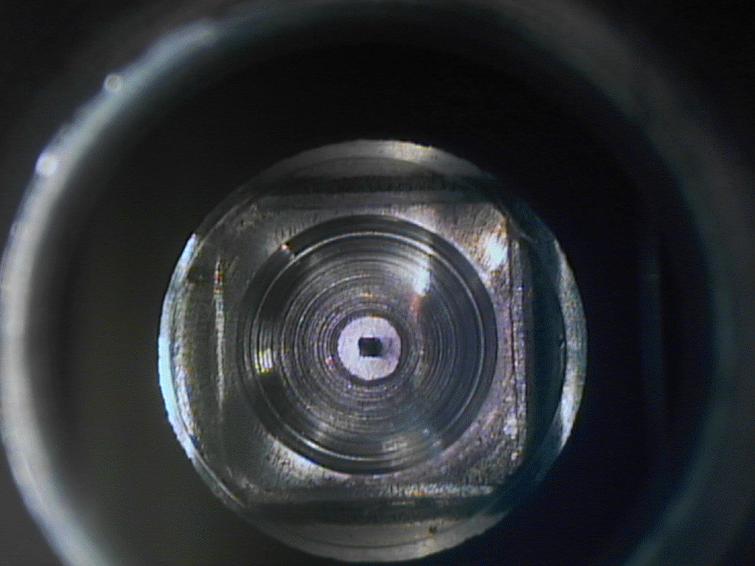
What happens when the channel is blocked?
Orifice is here maybe 250 μm for an analyzer
High mag image
Photo: J. P Robinson

Slide 49
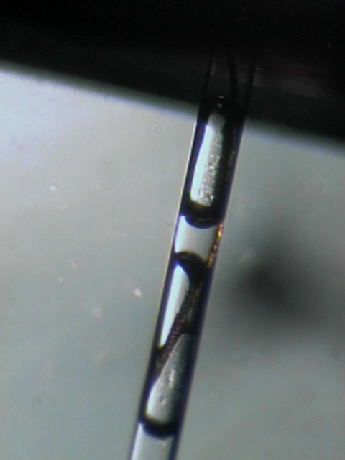
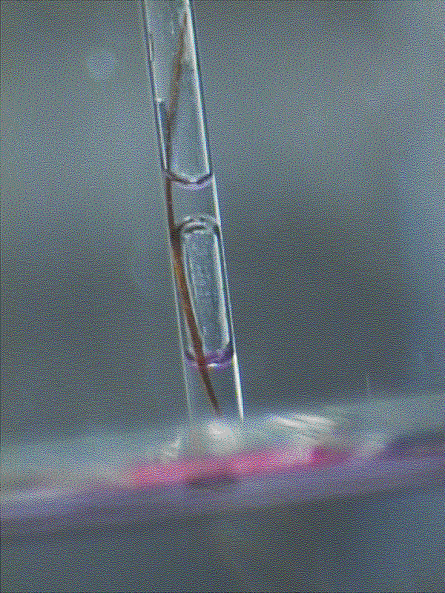
Flow chamber blockage
A human hair blocks the flow cell channel. Complete disruption of the flow results.
Photos: J. P Robinson

Slide 50
Note about Analyzers
Closed tube
Carrying waste
Analyzers typically run their flow chambers upside down!
This is to allow any bubbles to rise and not cause problems with the sample
Most are closed systems that are safer and have no open sample
Sample in
Sheath
Sheath in
Laser beam
Sheath
Core

Slide 51
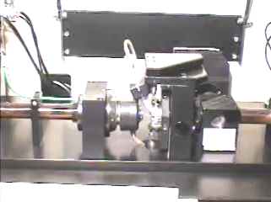
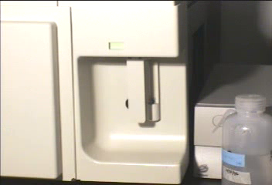
Bryte Fluidic Systems Detectors
Brytec.mp4
Brytec.mpg
Sample Collection and hydrodynamics
Photo: J. P Robinson

Slide 52
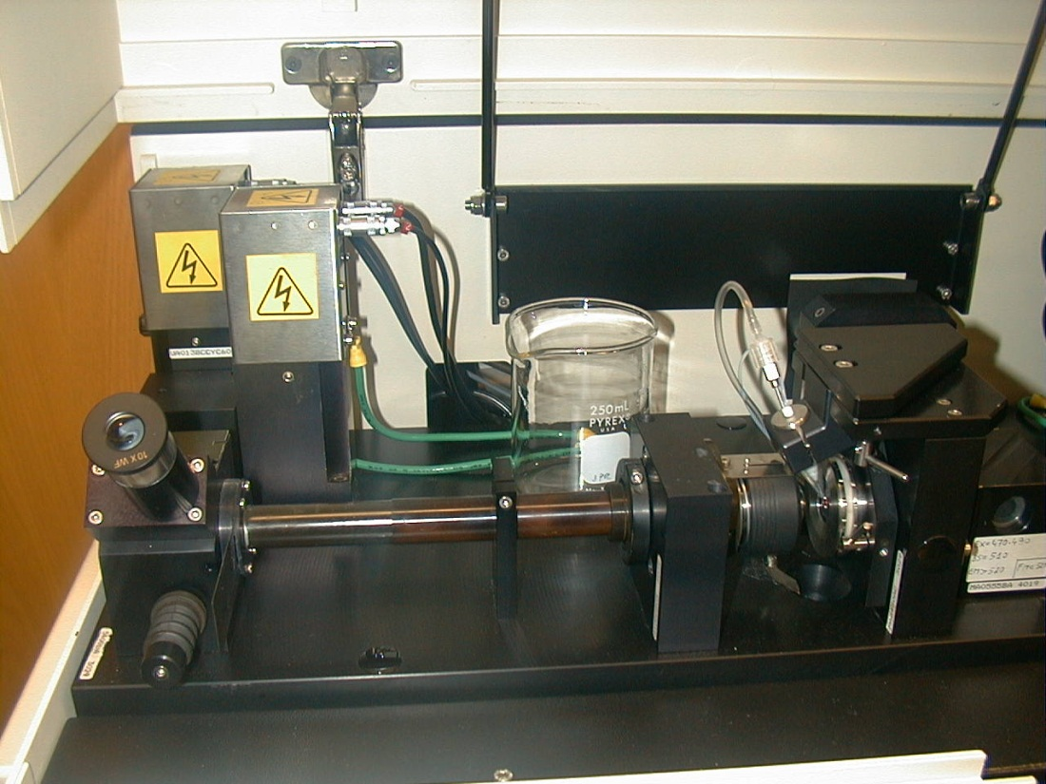
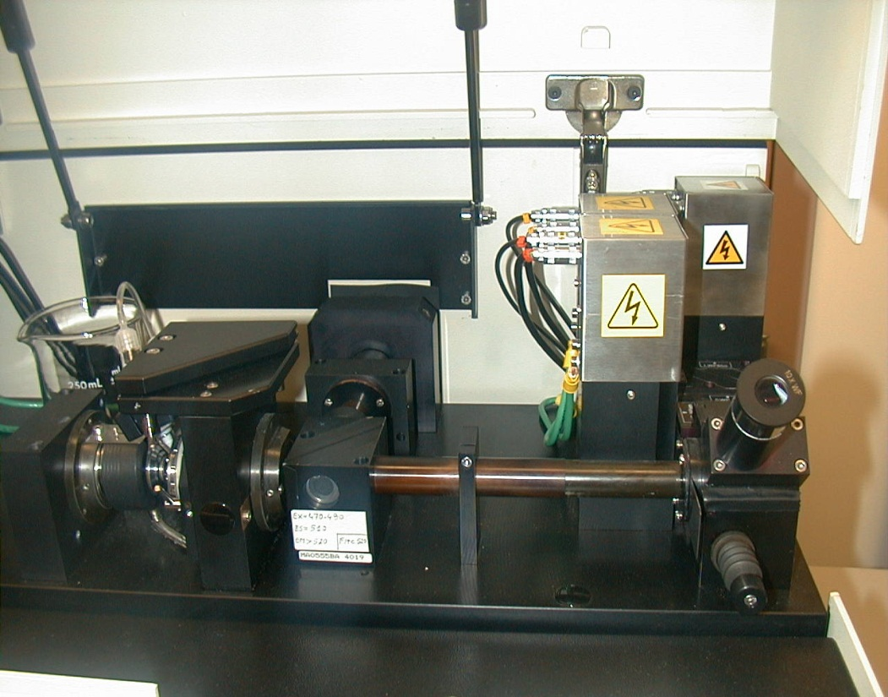
Detection Systems
Shown above is the Bryte HS optical train - demonstrating how the microscope-like optics using an arc lamp operates as a flow detection system. First are the scatter detectors (left side) followed by the central area where the excitation dichroic can be removed and replaced as necessary. Behind the dichroic block is the arc lamp. To the right will be the fluorescence detectors.
Photo: J. P Robinson
Fluorescence Detectors and Optical Train
Brytec.mpg

Slide 53
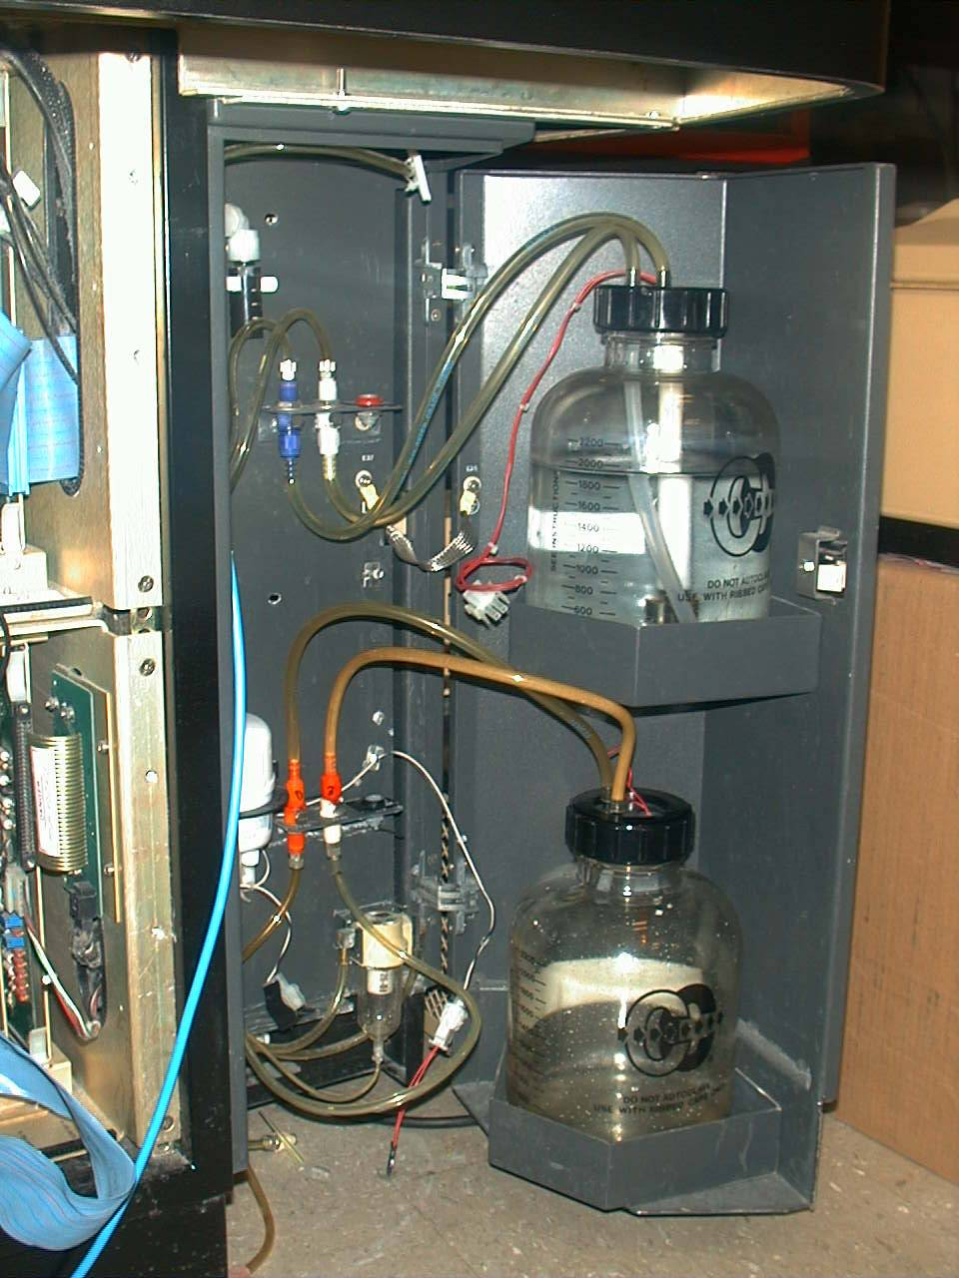
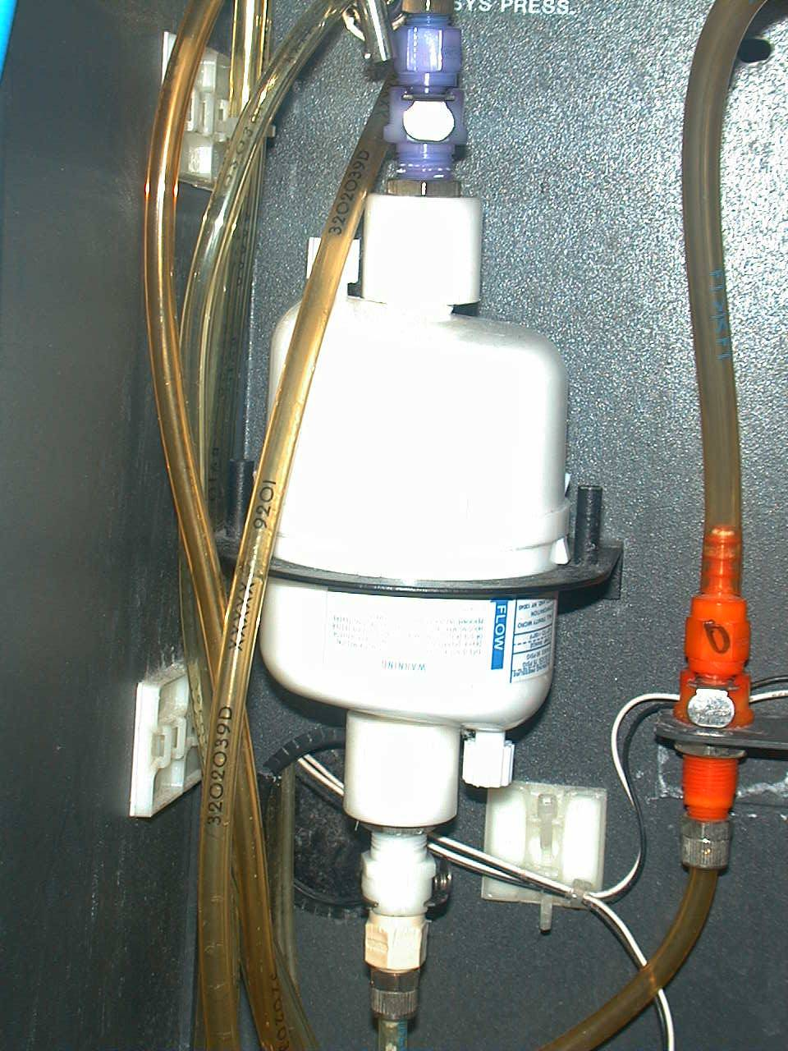
Sheath and waste systems
Epics Elite
Sheath
fluid
Sheath Filter Unit
Waste
container
Low Pressure
Sheath and
Waste bottles
Photo: J. P Robinson

Slide 54

Cytorial on Fluidics
Fluidic Systems CYTORIAL

Slide 55
Cytoflex fluidics
this YOUTUBE Fluidics Cytorial is here
https://youtu.be/nF10-wquVmQ

Slide 56
Lecture Summary
There are several types of fluidic control systems in flow cytometry – all work well and all have commercial products
Some systems however provide absolute counts, others perhaps less absolute!!
Flow must be laminar (appropriate Reynolds #)
  When R_{e} < 2300, flow is always laminar
Samples can be injected or flow via differential pressure
There are many types of flow chambers – many are changeable but all can be blocked by junk!!
Blockages must be properly cleared to obtain high precision
WEB http://www.cyto.purdue.edu

